Slide 1
Gateway Call Centers & Global Human Resource Management, Co.
Partnering to Improve
the Customer Experience
Notes:
Thank you for allowing Global HRM to present to you our plan to improve your customer experience. Feel free to ask questions during the presentation. We will also have a Q&A at the end of the presentation. Now, let’s begin.

Slide 2
Training & Development
Attrition Rates are highest within Call Centers Environments
High turnover rates impact quality and productivity due to lack of service continuity
Global HRM will develop continuous improvement programs and stay-interviews to minimize employee attrition
Global HRM will implement and manage employee focus groups, surveys an
other communication venues
Notes:
“The competitive forces that managers face today and will continue to confront in the future demand organizational excellence. To state it plainly: achieving organizational excellence must be the work of HR” (Ulrich, 1998). Human Resources in the 21st century must incorporate strategies to maintain their employee base in order to increase quality and productivity and overall profitability. Stay-interviews is one of our most significant components in meeting this objective. Stay-interviews allows the organization to proactively address employee issues prior to them reaching a point of employment separation.

Slide 3
Training & Employee Development Plan
Preliminary Interviews to Assess Performance and Employee Relations Deficiencies
Stay Interviews with High Risk Employees
Stage One Management Feedback & Recommendations
Training Program Realignment
Stage One Training
Continuous Improvement Plans
Notes:
There are six key steps to implementing a Training and Employee Development Plan. Global HRM will determine right away what the issues are and meet with the high-risk employees. Our goal is to immediately stop the exit of good employees. Next, we will provide this feedback during our Stage One meeting with the management team. We cannot assume that training is properly aligned to meet our critical objectives. As a result, the T&E Development Plan may require a realignment of trainers and training materials prior to Stage One Training. Finally, we will assess the results and plan continuous improvement strategies.

Slide 4
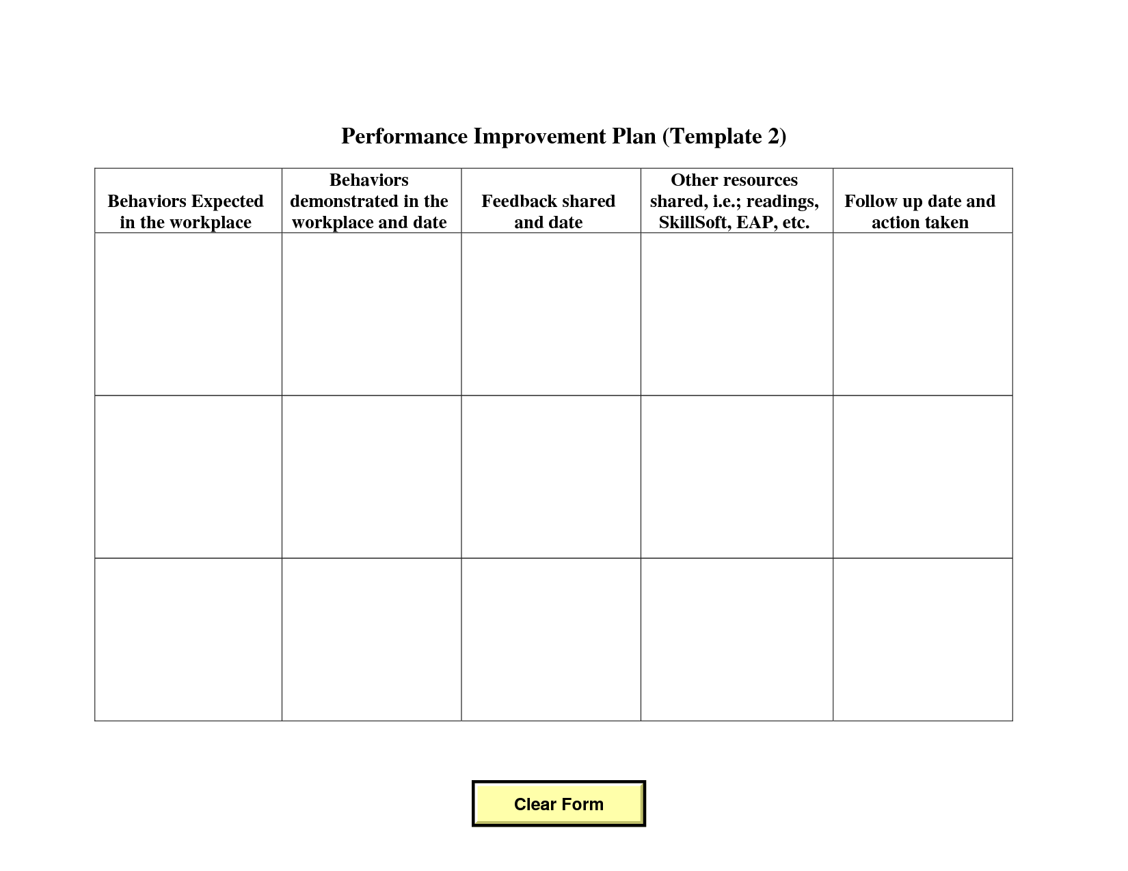
Process Improvement Plan Stage 1
Notes:
The last thing employees need is another worksheet. Worksheets must be replaced by one-on-one interactions. Our Stage One worksheet simply serves as a quick implementation to get the feedback process and improvement processes underway. The worksheet has five basic areas that we will cover and the worksheet becomes a working document for management versus the employee. The form should remain in the employee file and should always be used as part of the performance review process

Slide 5
Application of HRM Services
Hire the right people
Develop solid training and orientation programs
Communicate clear expectations the first time
Increase lines of communication
Ensure employees receive Appraisal Process Training
Continuous Development to include Reward and Recognition
Notes:
There are six key steps to applying the HRM Service. We will work with you to hire the right employees, develop solid programs, make sure employees understand what is occurring with the performance processes the first time around, open up lines of communication, ensure that employees are a part of the appraisal process and reward and recognize those employees who excel.

Slide 6
Benefits & Impact to Service
Decreased Attrition
Improved Customer Service Index Ratings
Increased Employee Satisfaction
Minimized Risks of Employee Grievances
Increased Diversity through Strategic Staffing
Transition from Annual Appraisal to Performance Management System
Organizational Profitability
Notes:
HRM will produce immediate benefits to your organization. Some of these benefits include:
Less turnovers
Increased customer satisfaction
Increased employee satisfaction
Less grievances and corporate escalations
A diverse operation with new and innovative ideas
An actual Performance Management System versus a basic performance evaluation
Most important for organizational longevity – profit.

Slide 7
Global HRM, Co.
Notes:
We will now take your questions.

Slide 8
References
Newstrom, John W. & Davis, Keith (1993). Organizational Behavior: Human Behavior at Work. New York: McGraw-Hill
Ulrich, D. (1998). A New Mandate for Human Resources. Retrieved July 25, 2011 from web:
http://www.vta.vic.edu.au/docs/strategic/New%20Mandate%20Ulrich%201998.pdf
Wilton, N. (2010). An Introduction to Human Resource Management. Thousand Oaks, CA: Sage Publications

