Slide 1
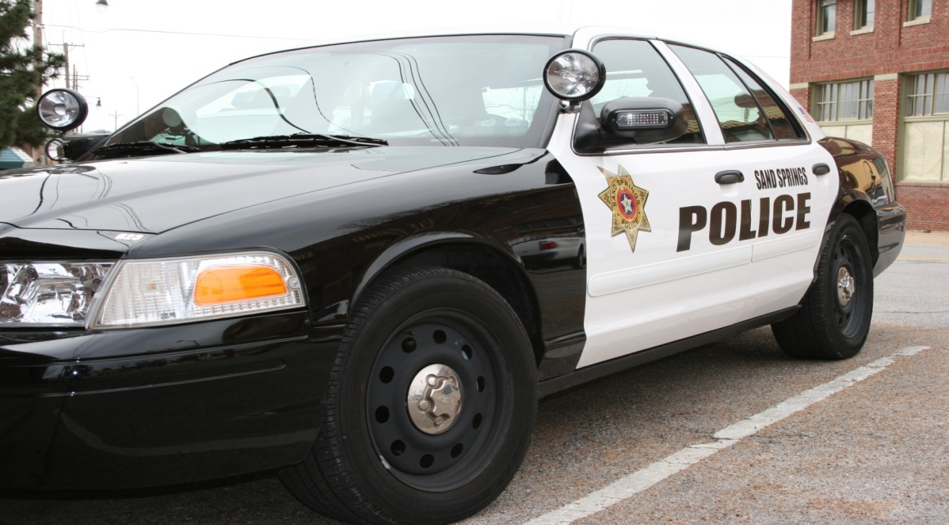
Police Communication
Protecting and Serving the Community through Enhanced Communication Services

Slide 2
Computerization and Wireless
Computerization
MDTs or Mobile Data Terminals
License plates and driver’s license verification
GPS or Global Positioning System
Police location and communication
Critical component to police pursuits
Emergency dispatch button
Wireless Communication
Wireless to wireless communication
Two way radios
Transmit radio waves for fast communication
Voice transaction in addition to sending and receiving alerts
Criminal activity and disastrous alerts
Notes:
The two primary sources for police communication includes computerization and wireless communication. Computerization includes MDTs or Mobile Data Terminals which is mounted in most police cars across the country. MDTs can be used for license plate and driver’s license verification. MDTs are also equipped with GPS or global positioning systems. These systems can provide immediate information regarding police location and is a critical sources of maintaining law enforcement location in the event of a police pursuit. The MDT comes equipped with an emergency button for law enforcement to initiate emergency dispatch to their location. Wireless communication can consist of two-way radios and wireless cell phones. Wireless technology is created through the transmission of radio waves for quick communication. In addition to voice to voice transactions, wireless communication can be used for sending and receiving alerts.

Slide 3
Reference
U. S. Department of Justice. (1998). State and Local Law Enforcement Wireless Communications and Interoperability: A Quantitative Analysis. Retrieved July 5, 2011 from web: http://www.ncjrs.gov/pdffiles1/168961.pdf

