Slide 1
Very Important Equilibrium reactions

Slide 2
Equilibrium: Introduction
Equilibrium is defined as follows: “A state in which opposing forces or actions are balanced so that one is not stronger or greater than the other” (Merriam-Webster)
Equilibrium in chemical reactions is an important tool in creating new compounds
There are many types of equilibrium reactions that have evolved over time
Two of the most important equilibrium processes involve the following:
  The manufacture of ammonia, known as the Haber Process
  The manufacture of sulfuric acid, known as the Contact Process
The properties of both types of processes will be explored in greater detail

Slide 3
Equilibrium: Haber process
The Haber Process involves the manufacture of ammonia from two gases: Nitrogen (N) and Hydrogen (H)
The process flow for this reaction is as follows (Clark, 2002):
This flow supports the conversion of N and C under specific conditions to create liquid ammonia (Clark, 2002)

Slide 4
Equilibrium: Haber process
The Haber Process involves several key components:
  The catalyst: a combination that includes iron and potassium hydroxide (Clark, 2002)
  The pressure: pressure is extremely high to generate the gaseous reaction (Clark, 2002)
  Recycling: Approximately 15 percent of these gases are actually converted to ammonia and the remainder is recycled for future use (Clark, 2002)
    The gaseous conversion rate for this reaction is approximately 98 percent (Clark, 2002)

Slide 5
Equilibrium: Haber Process
The ratio of Nitrogen to Hydrogen is 1:3, using Avogadro’s Law (Clark, 2002)
The temperature is lowered to achieve the desired exothermic reaction (Clark, 2002):
A lower temperature results in a slower reaction, so 400-450˚C is the optimal temperature that manufacturers use to generate the proper reaction (Clark, 2002)
The desired level of pressure for this reaction as at least 200 atmospheres to achieve the desired equilibrium (Clark, 2002)
  This rate reduces manufacturing costs because higher pressures are more expensive to produce (Clark, 2002)
Once the reaction is complete, the ammonia converts to liquid and the hydrogen and nitrogen may be reused (Clark, 2002)

Slide 6
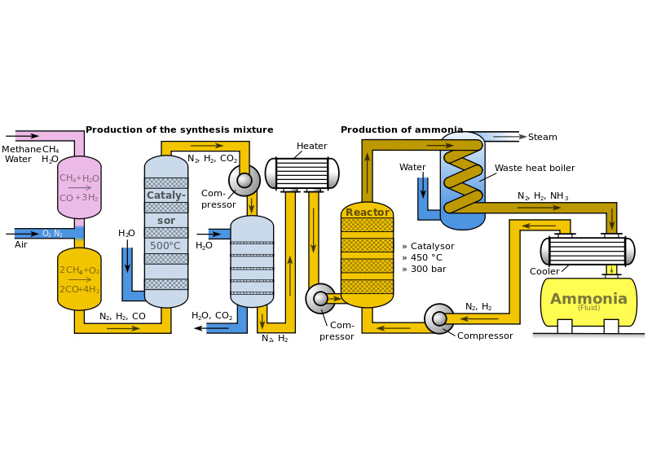
Equilibrium: haber Process
The Haber manufacturing process is described as follows (Rae-Dupree, 2011):
This process summarizes the actions taking place to achieve equilibrium and to produce ammonia under ideal conditions

Slide 7
Equilibrium: Contact Process
The Contact Process involves the manufacture of sulfuric acid from Sulfur (S) and Oxygen (O) (Clark, 2002)
The proposed flow for this reaction is as follows:
        This reaction flow is designed to transform sulfur dioxide to sulfur trioxide using the following exothermic formula:
        Once the sulfur trioxide is created, it is dissolved in sulfuric acid, a process known as oleum (Clark, 2002)
        This product then reacts with H2O to create sulfuric acid in a concentrated form:

Slide 8
Equilibrium: Contact Process
Sulfur dioxide and Oxygen must be equally proportioned in order for the proper reaction to occur, according to Avogadro’s Law (Clark, 2002)
Le Chatelier’s Principle supports the belief that increasing oxygen by shifting the equilibrium to the right is a less expensive means of creating sulfuric acid (Clark, 2002)
  A 1:1 proportion is ideal to reduce sulfur dioxide concentrations (Clark, 2002)
The appropriate temperature to achieve the desired reaction quickly is 400-450˚C (Clark, 2002)

Slide 9
Equilibrium: Contact Process
Higher pressure to produce sulfur dioxide is not worth the risk or the expense (Clark, 2002)
Lower pressure has a 99.5% success rate of conversion to produce sulfur dioxide (Clark, 2002)
A catalyst has little impact on the reaction other than to increase its speed (Clark, 2002)
  If a catalyst is not present, the reaction time is very slow, so it is essential to increase the speed of the reaction and to allow the gases to achieve equilibrium (Clark, 2002)

Slide 10
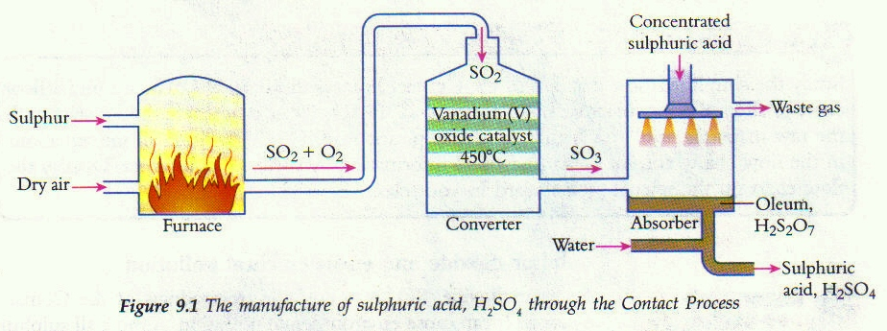
Equilibrium: Contact Process
The Contact manufacturing process is described as follows (Wong, 2012):
This process summarizes the actions taking place to achieve equilibrium and to produce sulfuric acid under ideal conditions

Slide 11
Equilibrium: conclusion
Achieving equilibrium requires specific reactions to produce the desired chemical compounds
The production of ammonia and sulfuric acid are achieved through very specific reactions that involve a number of factors:
  Temperature
  Pressure
  Recycling, in the case of ammonia production
These reactions are produced in manufacturing plants under controlled conditions to produce high amounts of product in a cost effective manner

Slide 12
Equilibrium: references
Clark, J. (2002). The Contact Process. Retrieved from
  http://www.chemguide.co.uk/physical/equilibria/contact.html
Clark, J. (2002). The Haber Process. Retrieved from
  http://www.chemguide.co.uk/physical/equilibria/haber.html
Merriam-Webster (2013). Equilibrium. Retrieved from
  http://www.merriam-webster.com/dictionary/equilibrium
Rae-Dupree, J. (2011). Phrase of the week: Haber-Bosch Process. Retrieved from
  https://news.slac.stanford.edu/features/phrase-week-haber-bosch-process
Wong, S. (2012). Properties of sulfur. Retrieved from
  http://igcsetuition.blogspot.com/2012/12/sulfur_9.html

