Slide 1
21st Century Skills
Name Class Date

Slide 2
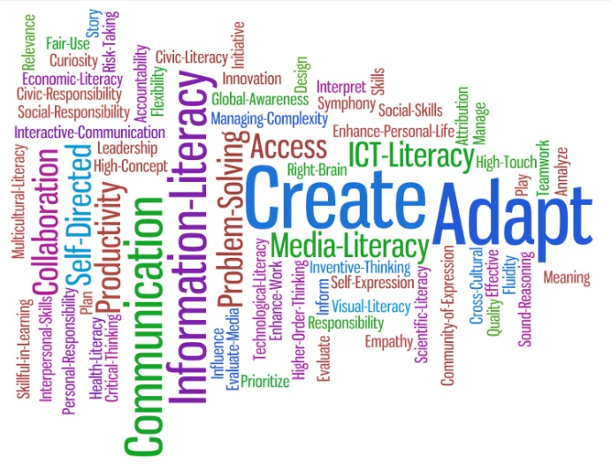
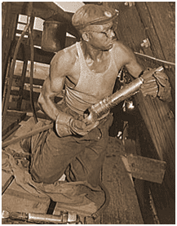
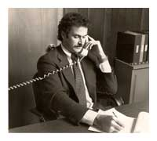
21st Century Skills
What are 21st Century Skills
Are they different?
Parents?
Grand Parents?
Notes:
What are the skills for the 21st century? Are they any different than those skills that made leaders of the past successful? Do they focus on technological advancements?
As a country’s economic business model changes the skillsets of those that inhabit the country must also change or evolve over time. When our parents were working in the 60’s, 70’s and 80’s many of them focused on labor intensive jobs but within those jobs technological advancements were taking place. These includes robots to weld assemblies, new tools to make the workers more productive and improvements to policies, procedures and practices to make things safer. Prior to that our grandparents were working in significantly different times in which they would subject themselves to riskier and more arduous tasks that was necessary for living in their time.
The key point is that as the demand for specific labor must be supplied by those that are willing and capable to perform those efforts.

Slide 3
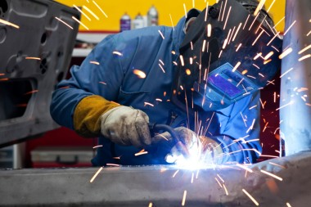
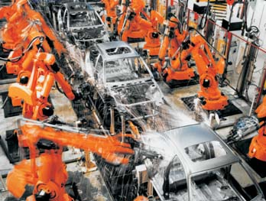
21st Century Skills
Transition
Manufacturing
Technology
Notes:
The United States become an economic powerhouse after the second World War. Prior to that the Great Depression had taken a toll on the quality of life that Americans enjoyed and led to desperate times for the US citizens. After WWII, the American economy boomed through a growth in the industrial revolution in which manufacturing held fast as the demand in the US as well as the world grew. Returning Americans needed work but they also wanted cars, housing and other goods. The increased demand gave way to an exponential growth in manufacturing.
As the growth increased there was also a demand to do things better, quicker and maintain quality through the process. Technological advancements crept into the manufacturing and assembly processes. As technology increased there was a new demand for savvy and capable employees to run and maintain the machinery and other technology. The skillsets changed from manufacturing through strictly human effort to a technologically aided process.

Slide 4
21st Century Skills
Transition
Service Oriented
Knowledge Oriented
Notes:
Once the United States began to outsource production to obtain cheaper prices for production there was a shift to a service oriented process where the United States provided services both domestically and internationally. The core capabilities of those in the United States shifted to producing goods to providing services. As time progressed the skillsets shifted from technical skills to a predominately knowledge based skillset. This included managing teams, aligned best practices, leading financial transactions and creating advancements in the arts and sciences. . The hard and soft skills must provide quicker reactions, more complex problem solving and include a globalized economy. The shift from manufacturing and production based economic frameworks to a more knowledge and service based economic structure is driving changes to the skillsets and learning environments that students need to develop and teachers need to create.

Slide 5
21st Century Skills
Hard and Soft Skillsets
Move from Technical Skills
Focus on Soft skillset development
Notes:
Skillsets are broken down into two subsets including hard and soft skills. Hard skillsets include those that focus on skills and abilities that can be taught and learned in a specific, measurable and quantifiable manner. These types of skills include carpentry, blacksmith, programming and other skills that have an output that can be measured distinctively. Soft skills, conversely, are harder to measure because they are focused on personality, interactions and other actions that lead to seemingly intangible outputs. These examples include leadership, negotiations, communication or other personality and interaction capabilities.
With the shift from primarily hard skillsets to the incorporation of soft skillsets into the overall matrix of capabilities of the individual there is a need for the teacher and the learner to make adjustments. These adjustments would focus on the ability to not only provide the foundation for the learner but also ensure the teacher has the opportunity to teach the learner these skillsets.

Slide 6
21st Century Skills
Bridging the Gap between Skillsets
Teaching
Learning
Making the learning relevant
Teach through disciplines
Develop thinking skills
Encourage learning transfer
Teach students how to learn
Address misunderstandings directly
Treat teamwork like an outcome
Exploit technology to support learning
Foster creativity
Notes:
The skills for the 21st century incorporate the deep knowledge of the hard skillsets incorporated with the finesse and capability to utilize soft skills. There is a demand by the global economic environment to have the gap bridged between hard and soft to establish a conducive environment for those in the 21st century to succeed.
Within the teaching realm there are nine areas that require focus for the 21st century learner. These include: making the learning relevant, teach through disciplines, develop thinking skills, encourage learning transfer, teach students how to learn, address misunderstandings directly, treat teamwork like an outcome, exploit technology to support learning and foster creativity (Kappan, 2012).
The teacher has the responsibility to create the learning environment and provide the vessel for learning. The learner must understand that honing the soft skillsets will take a different approach than the hard skillsets and potentially will require more effort and a different mindset to allow for success. These skillsets take experience, immersion and understanding to fully take advantage of learning a soft skill (Banta, 2009)

Slide 7
21st Century Skills
Success in the 21st Century
Hard Skills
Project Management/Collaboration
Technology
Soft Skills
Leadership
Communication
Notes:
There are some examples of the increased need by those in an economy that is based on knowledge. This includes the ability to provide a technical best practice framework for projects for their companies. This skill is the epitome of matching hard skill tactics and operations while marrying those aspects with soft skill implementation. Project management provides the ability to utilize tools and techniques to provide a specific objective. The ability to lead projects is more of a soft skill but the ability to utilize the tools and techniques is a hard skill, both of which are mandatory for success in the 21st century. This a perfect example of bridging the gap between hard skillsets and soft skillset techniques. Project management focuses on the technical best practices of leading a project to success but it also emphasizes the ability to collaborate among multiple people, places and departments. The collaboration cross-functionally among multiple entities lends itself to honing the teamwork mentality and ultimate objective of launching a successful project.
In previous times in the United States tools of the trades could have been presses, hammers, shovels, rivet guns or other labor intensive tools. As the shift occurs in the 21st century, technology focuses on applications, systems, programs, computers, tablets and cell phones. While this is ever evolving, the need to understand how to utilize the technology will not only make the user effective it will make them more efficient as well. In order to maintain a certain level of productivity it is imperative to become a master of technology.
With the strictly soft skills, there are leadership and communication focal points. Critical thinking is paramount for the basis of 21st century skillsets. Critical thinking is defined as the ability to analyze, interpret, evaluate, summarize, and synthesize information. In order to take the output from the critical thinking activities and ensure they are implemented there needs to be a leader that has the capability to communicate. Management is seen as doing things right and leadership is doing the right things. A leader would utilize the intelligence, charisma and knowledge to assess the situation and provide guidance and a plan to do the right things (Hyslop, 2011). The ability to take an idea and turn it into action is the keystone in the current economic US environment.
Communication is the ability to send and receive messages. The communication and collaboration skill sets refer to the ability of individuals to communicate clearly, using oral, written, and non-verbal languages, and collaborate effectively and responsibly with diverse populations (Pacific Policy Research Center, 2010). With the increased capability to communicate through video conferencing, cell phones, texts, instant messages, Skype, Facebook and last but not least a written letter there is the increased opportunity to send a message and not have it received as intended. The honing of the communication skillset includes the ability to choose the best method for communication, the composition of the message and the ability to provide feedback. The teaching and learning of this activity takes practice as well as the understanding that there will be continual improvement to remain relevant as the shift in the types of communications increase.

Slide 8
21st Century Skills
Conclusion
21st Century Skillset Gaps
Reasons for Shift
Skillset Interconnectedness
Notes:
The need to bridge the gap between the hard skillsets and the soft skillsets through the increased focus of the teachers and the honing of the skills by the learners is a primary focal point for preparing for the 21st century and beyond. The key interdependencies between the hard and soft skills are a key driver for success in the changing global economy. The future business person needs to be savvy in their capabilities both technically and in regard to their personality traits. The skills between hard and soft become blurry in the academic setting and will remain a challenge for the teacher to properly prepare the learner for the challenges they may face. The only way that the people entering business in the 21st century must be prepared and the only way to be prepared is to take on learning and trying to immerse oneself in business interactions (Aldridge, 2010).

Slide 9
References
Aldridge, J. (2010). 21st century skills: The challenges ahead. Childhood Education, 86(3), 195. Retrieved from http://bluehawk.monmouth.edu:2048/?url=/docview/721863312?accountid=12532
Banta, M. (2009). The Value of Teaching 21st-century Skills. Businesswest, 25(21), 12.
Duran, E., Yaussy, D., & Yaussy, L. (2011). Race to the Future: Integrating 21st Century Skills into Science Instruction. ScienceActivities, 48(3), 98-106. Print.
Hyslop, A. (2011). CTE and 21st century skills in college and career readiness. Techniques, 86(3), 10-11. Retrieved from http://bluehawk.monmouth.edu:2048/?url=/docview/852983051?accountid=12532
Joyce, P. (2008). Learning the real-world skills of the 21st century. Techniques, 83(4), 25-27. Retrieved from http://bluehawk.monmouth.edu:2048/?url=/docview/216124311?accountid=12532
Kappan. (2012). Learning 21st-century skills requires 21st- century teaching. Kappan Magazine, 94(N2). Retrieved from: www.kappanmagazine.org
Kotter, J. (2012). Leading change. Boston, MA: Harvard Business Review Press.
Kouzes, J. M., & Posner, B. Z. (2008). The leadership challenge. (4th ed.). San Francisco: Jossey-Bass Inc Pub.
Milone,M. (1996). Preparing teachers for the 21st century. Technology & Learning, 17(2), 42. Retrieved from http://bluehawk.monmouth.edu:2048/?url=/docview/212079177?accountid=12532
Pacific Policy Research Center. (2010). 21st century skills for students and teachers. Research and Evaluation. Kamehameha Schools Research and Evaluation Division.
Project Management Institute, P. M. (2008). A guide to the project management body of knowledge. (4th ed.). Newtown Square: Project Management Inst.
Salpeter, J. (2003). 21st century skills: Will our students be prepared? Technology & Learning, 24(3), 17-18,20,22,24,26. Retrieved from http://bluehawk.monmouth.edu:2048/?url=/docview/212099794?accountid=12532
Trilling & Fadel (2009). 21st Century Learning Skills. San Francisco, CA: John Wiley & Sons.
Notes:
Aldridge, J. (2010). 21st century skills: The challenges ahead. Childhood Education, 86(3), 195. Retrieved from http://bluehawk.monmouth.edu:2048/?url=/docview/721863312?accountid=12532
Banta, M. (2009). The Value of Teaching 21st-century Skills. Businesswest, 25(21), 12.
Duran, E., Yaussy, D., & Yaussy, L. (2011). Race to the Future: Integrating 21st Century Skills into Science Instruction. ScienceActivities, 48(3), 98-106. Print.
Hyslop, A. (2011). CTE and 21st century skills in college and career readiness. Techniques, 86(3), 10-11. Retrieved from http://bluehawk.monmouth.edu:2048/?url=/docview/852983051?accountid=12532
Joyce, P. (2008). Learning the real-world skills of the 21st century. Techniques, 83(4), 25-27. Retrieved from http://bluehawk.monmouth.edu:2048/?url=/docview/216124311?accountid=12532
Kappan. (2012). Learning 21st-century skills requires 21st- century teaching. Kappan Magazine, 94(N2). Retrieved from: www.kappanmagazine.org
Kotter, J. (2012). Leading change. Boston, MA: Harvard Business Review Press.
Kouzes, J. M., & Posner, B. Z. (2008). The leadership challenge. (4th ed.). San Francisco: Jossey-Bass Inc Pub.
Milone,M. (1996). Preparing teachers for the 21st century. Technology & Learning, 17(2), 42. Retrieved from http://bluehawk.monmouth.edu:2048/?url=/docview/212079177?accountid=12532
Pacific Policy Research Center. (2010). 21st century skills for students and teachers. Research and Evaluation. Kamehameha Schools Research and Evaluation Division.
Project Management Institute, P. M. (2008). A guide to the project management body of knowledge. (4th ed.). Newtown Square: Project Management Inst.
Salpeter, J. (2003). 21st century skills: Will our students be prepared? Technology & Learning, 24(3), 17-18,20,22,24,26. Retrieved from http://bluehawk.monmouth.edu:2048/?url=/docview/212099794?accountid=12532
Trilling & Fadel (2009). 21st Century Learning Skills. San Francisco, CA: John Wiley & Sons.

