Slide 1
Advertising Method: Micro-film
Google’s “Reunion”
By: Name

Slide 2
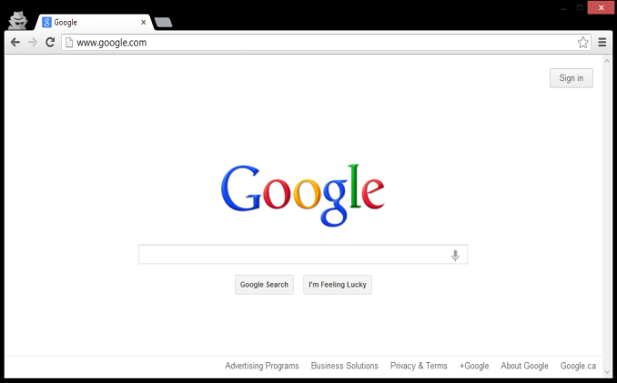
Google Advertisement“Reunion”
Increase in advertising capabilities.
Micro-film
Short duration: 3:33 minutes
Purpose
For Google to advertise their Internet Search Page
Heartfelt Story: Girl helps her grandfather find his long lost childhood best friend in India using Google Search.
Various ways to use Google Search:
Locate people, locate businesses, travel, buy items, Visa requirements, weather etc.
Use of Cell phone and Laptop
Notes:
With the increase in the variation of methods for advertising, Google came up with a micro-film advertisment to attract an audience to their product…Internet website, “Google”. A microfilm is a short duration film that usually last for about 30 seconds to 5 minutes in length. This particular advertisement was 3.33 minutes. The puprose of the microfilm was to advertise the intefnet search page through a heart-felt Story about a girl who visits her grandfather in India. The grandfather tells her about his childhood best friend who he never seen since he was a young child due to the partition. With some details provided from her grandfather, the girl uses “Google” to locate the long lost friend of the grandfather. The long lost friend and his grandson also use google throughout the ad to travel to visit his friend. Various scenes show the different ways one can use Google Search Engine, as well as different devices such as cell phones or laptops.

Slide 3
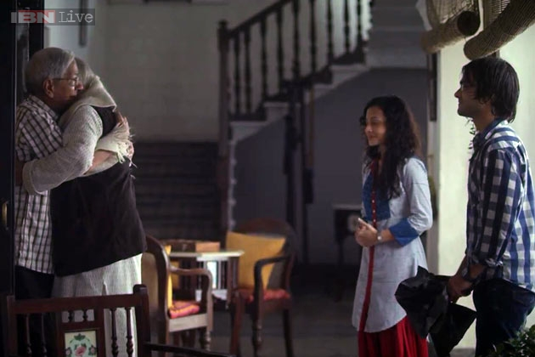
Target Audience
Geared towards Anyone capable of conducting Internet Searches
Use of young adults and senior citizens.
Both sexes
Different races
Different cultures:
Universal!
Notes:
The target audience for this advertisement is anyone capable of conducting Internet searches. In the microfilm they use young adults and senior citizens to illustrate the age span and effective use of Google Search. In addition, the ad shows both male and female, as well as uses a foreign ad to show how people around the world can use Google Search.

Slide 4
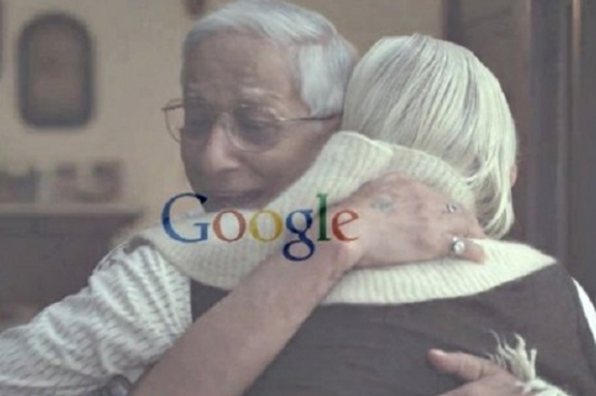
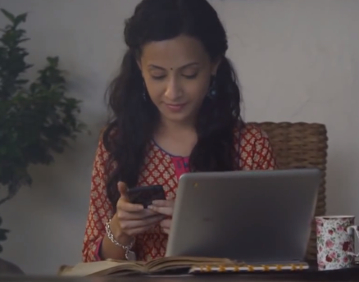
Key Visual Techniques
Visual Guide of “How to Search” using Close-Up Shots of the Computer Screen.
Ad continues to show how the girls uses Google to obtain her results.
Also shows the grandfather friend and grandson using Google to prepare for trip to visit
Music and Visual Background
Notes:
In the ad, there are several Key Visual Techniques that are used. The ad does a close-up screen shot of “Google” Home page and shows what the girl is typing into the search box. The ad then continues to show how the girls uses the Google Search to obtain her results of the candy shop where her grandfather’s friends family owned their business. The ad continues showing google search page for various searches. In between searches it returns to the story of the ad, grabbing the audience’s attention with story, music and intriguing cultural background.

Slide 5
Questions?

