Slide 1
DREAMING OF A DESTINATION?
WE CAN GET YOU THERE
Big Sales Meeting
Student Name
MGMT 104
Date

Slide 2
Best Travel Inc.
#1 IN CUSTOMER SATISFACTION

Slide 3
Best Travel Inc.
Best Travel Inc.
3%.
TravelClick
6%
Denihan Hospitality Group
7%
Benchmark Hospitality International
13%
CheapCaribbean.com
10 %
Market Share
Best Travel
Travel Click
Denihan Hospitality Group
CheapCaribbean.com
Benchmark Hospitality International
Best Travel Inc. is a small percentage compared to the U.S market of small businesses emerging across the country. However, with each month and with each new client the company is steadily growing.

Slide 4
Best Travel Inc.
Regional Sales Performance

Slide 5
Best Travel Inc.
CEO
Name
VP Sales
Steven Lee
Marketing Manager
Maria Minor
Sales Office Support(Centrall)
Barry Hues
Sales Office Support(West)
JohnSmith
Barry
Salesperson
Mary
Salesperson
Thomas
Salesperson
Sales Office Support (East)
Jimmy Dean
Kevin
Salesperson
Marolyn
Salesperson
Micheal
Salesperson
Organizational Culture

Slide 6
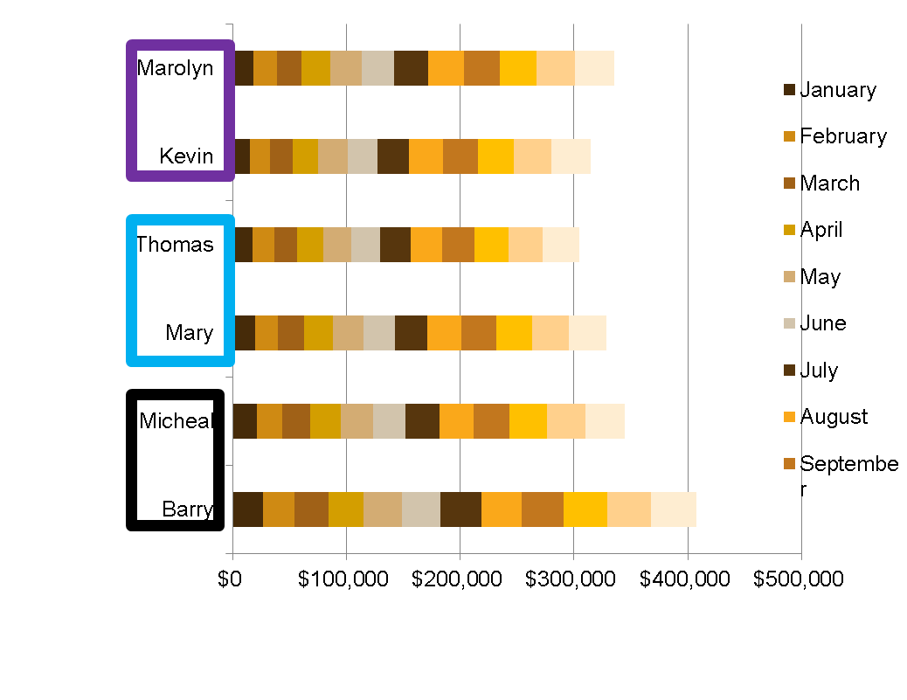
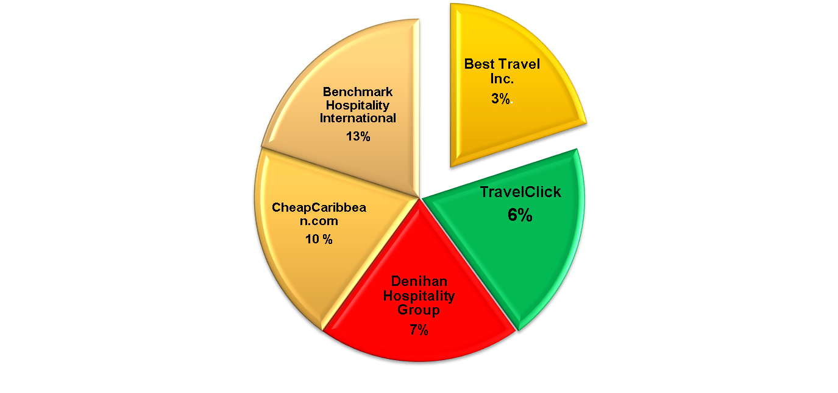
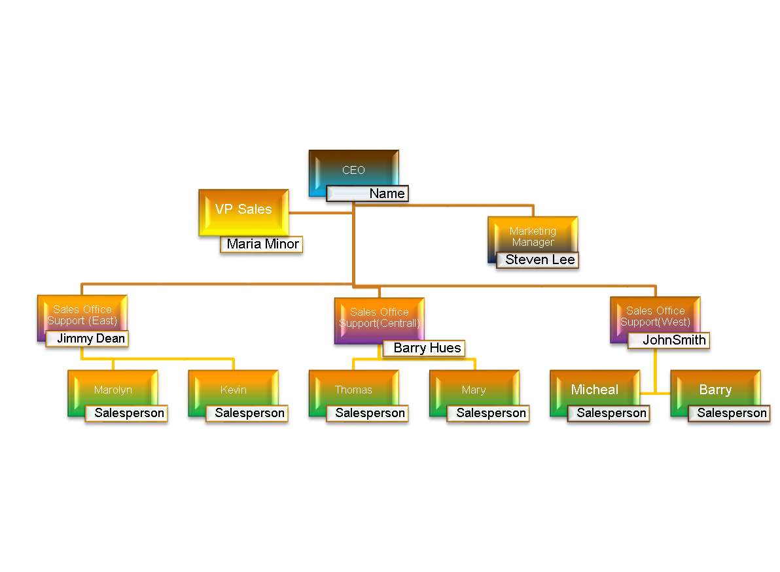
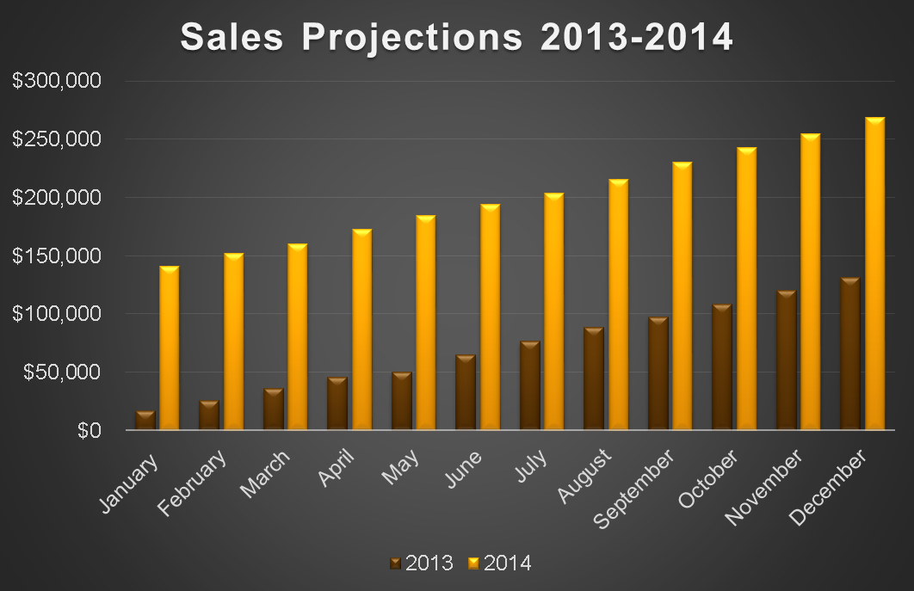
PLAN YOUR TRAVEL WITH THE INSIGHT OF EXPERTS
Market Share
Regional Sales Performance
Sales Projection 2014-2013
Organizational Culture

