Slide 1
Capstone Presentation
Botanic Gardens, Aquaponics, Seed Banks, and Molecular Mapping

Slide 2
Botanic Gardens
Botanic gardens are well-kept parks which displays the botanical names of various plant species
The primary purpose of a botanical garden is the attainment and dispersal of botanical knowledge
Most botanical gardens are under the care of scientific research centers
The research centers document the collection of living plants; conserve these plants; educate others on their unique characteristics; and conducts scientific research on the plants

Slide 3
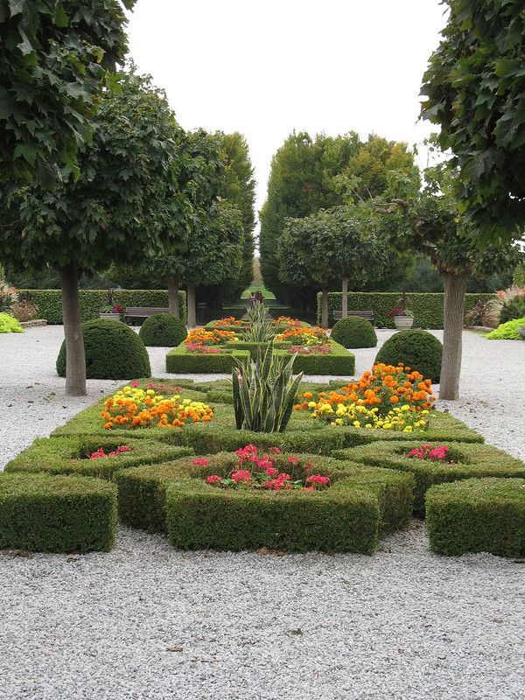
Botanic Gardens
Notes:
People visit botanical gardens for a variety of reasons. Their visits range from recreational purposes to relaxation. In addition, people visit botanic gardens to educate themselves on the characteristics of botany and horticulture. All plants in a botanic garden are living and each plant is accompanied by a scientifically-based interpretive comment. The primary purpose of botanic gardens is to preserve plant species and educate the public about the varying plant species alive today.

Slide 4
Botanic Gardens
Current Known Botanic Gardens:
The Raffles Botanical Garden, Creekside Park, Mushrif Park, and Al Barari Property Development in Dubai,
Sharjah Natural History and Botanical Museum in Sharjah,
Al Ain Wildlife and Resort in Al Ain City
Notes:
Although several botanic gardens are currently in operation in various locations worldwide, several more are in the works. Proposed botanical gardens for the UAE include Quranic Botanical Garden, and Desert Botanic Garden in Sharjah, Mushrif Central Park in Abu Dhabi, Seed Bank in Sharjah , and Gene Bank in Al Ain. The purpose of these proposed parks are to explore, record, preserve, and develop the botanic heritage of countries.

Slide 5
Botanic Gardens
Botanic gardens exist to conserve plant life through educating society, and researching plant species
In addition to preserving plants, botanic gardens also preserves cultural heritage by including historical buildings in many of its locations
This combination is referred to as ethno-botanical heritage (the relationship between culture and the culture's use of plants)
The availability of plant diversity makes a significant contribution to the field of medicine
Notes:
This is a sign that society values the importance of botany and horticulture. Plants are essential to life and botanic gardens provide a nurturing environment where thousands of plant species can thrive.

Slide 6
Aquaponics
Aquaponics is a food production system which combines aquaculture and hydroponics
Aquaculture is the process of raising fish in water
Hydroponics is the process of raising plants in water
Notes:
The word Aquaponics is a combination of aquaculture and hydroponics. Aquaculture is the cultivation of fish or other water-based animals, and hydroponics is the cultivation of plants in a sterile medium, or water. Aquaponics therefore refers to the process of growing freshwater fish, or other fresh water-based animals, and plants together in one integrated, soilless system.

Slide 7
Aquaphonics
In this system fish waste serves as a food source for the plants and the plants provide a natural filter for the water the fish live in
Notes:
Aquaponic systems vary in size from small indoor or outdoor units to large commercial units, using the same technology. Although these systems typically use fresh water, salt water systems have been used depending on the type of fish and vegetation that is grown. Aquaponic science is considered to still be at an early stage.

Slide 8
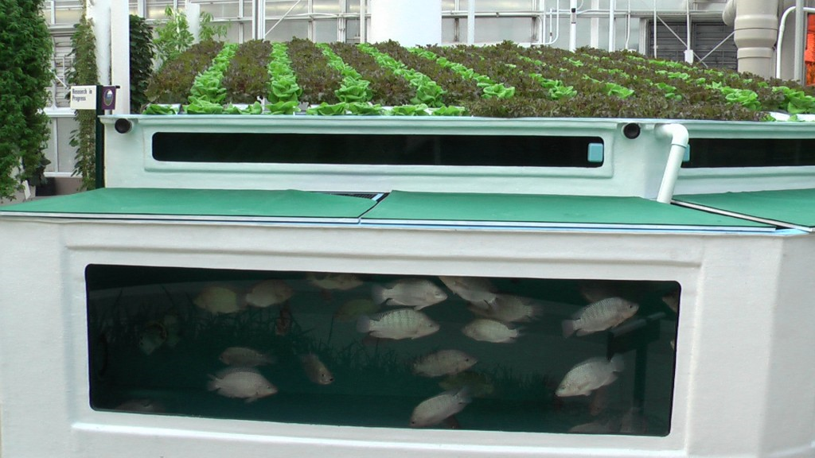
Aquaponics
Notes:
Aquaponics preserves energy and creates an environment in which fresh, clean, and organic food is grown. Because of the greenhouse environment of an Aquaponics setup, premium quality crops can be grown, year-round, anywhere in the world. The success of an Aquaponics system is contingent on climate. These systems can be used to raise freshwater fish, or organic vegetables. It can generate enough food to feed a city. The costs are less than traditional means of agriculture, as the system preserves water and fertilizers.

Slide 9
Aquaponics
Common fish species grown through Aquaponics include Koi, Goldfish, Tilapia, Water Prawn, and Channel Catfish
Common vegetables grown through Aquaponics include peas, lettuce, cucumber, parsley, tomatoes, and celery
Notes:
Through Aquaponics, vegetables such as cucumbers have been harvested within 25 days of first being planted. These vegetables are free of dyes and other chemicals.

Slide 10
Aquaponics
Benefits of Aquaponics:
Agricultural process is free of fertilizer and chemicals,
Reduced water usage,
The system is not location specific; in other words it can be used anywhere
Notes:
Because fish waste acts as a natural fertilizer to the growing crops, the need for traditional fertilizers is eliminated. Also, because water is recycled within the system’s tanks, Aquaponics uses nearly 80 percent less water than traditional means of agriculture. Both these facts will be beneficial to the agriculture industry of the UAE because fresh water supplies are limited and fertilizer is expensive. Farmers could save a lot of money while growing healthier, chemical-free crops and food.

Slide 11
Restoration Seed Banks
More than half of the world’s ecosystem has been degraded
Ecological restoration is a method to achieve global preservation goals
Notes:
The restoration of nature, natural assets, and biodiversity is a global business worth at least $1.6 trillion annually and likely to continue substantial growth. Seed banks have emerged as a tool to protect wild plant species.

Slide 12
Restoration Seed Banks
More than half of the world’s ecosystem has been degraded
Ecological restoration is a method to achieve global preservation goals

Slide 13
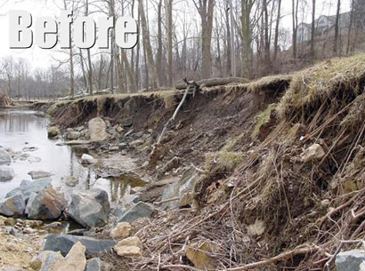
Restoration Seed Banks
Delaware Stream Bank Restoration Project
Notes:
Restoration of seed banks require adequate amounts of seeds, but since there is a current shortage of seeds, many restoration projects cannot go forward. Kuwait is a prime example of such a seed shortage. Restoration processes are delayed due to insufficient technological resources and the inability to deliver landscape-scale restoration. Additionally, there is a severe lack of research data on the phenology of seed development and maturation. It is therefore crucial for restoration specialists to document and understand the quality viability of seeds.

Slide 14
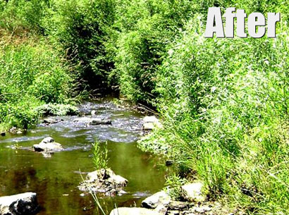
Restoration Seed Banks
Delaware Stream Bank Restoration Project
Notes:
Successful restoration begins with the implementation of a collection of plant species that can deliver restoration-ready seeds at the scale of a metric ton and larger. There also needs to be a definitive connection between science-based restoration functions and community-based restoration initiatives. Methods to reduce seed usage should be implemented in order to save future costs on seeds. More substantial funding for botanic gardens are needed to expedite the restoration process. Effective restoration will result in improved lifestyles and healthier natural environments.

Slide 15
Seed Banks & Molecular Maps
Global population is growing faster than any other time in history
By 2030 the global population is expected to reach nearly 9 billion people
Increased population growth requires increased food supply
The only way to meet these demands is to genetically enhance food products
Notes:
Current research indicates that genetic crop improvements are possible with current seed banks. Scientists argue that genetic improvement is possible by placing increased emphasis on superior genetic structures by utilizing molecular linkage maps.

Slide 16
Seed Banks & Molecular Maps
Germaplasm banks have been established to improve agriculture crops
Genetic linkage maps make the study of chromosomal gene locations possible
Notes:
Germaplasm banks refer to living seed collections which serve as repositories of genetic variation. Genome research has the power to unleash the genetic potential of wild and cultivated germaplasm resources which will improve society.

Slide 17
Seed Banks & Molecular Maps
Only a few productive types of crop species exist
Genetic diversity in crops have been reduced though human intervention
As a result these plant species are at a heightened risk of disease and reduced flexibility
Notes:
Strong, flexible, and healthy crops are naturally possible. modern plant-breeding techniques have diminished this natural process; for example soy beans (they have a narrow genetic base as a result of human intervention). Human interventions have a diverse impact on the process of genetic diversity.

Slide 18
Seed Banks & Molecular Maps
Through molecular mapping bio-genetic diversity will be possible
Success with this method have already been noted in the growth of Golden rice and tomatoes
Molecular mapping facilitates seed banks which create genetic diversity from the genomes of wild species to introduce new strains

