Slide 1
Budapest - Hungary
Name
Course
Instructor
Date

Slide 2
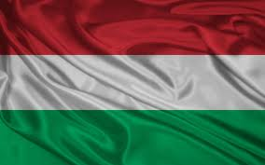
Introduction
Budapest
Capital of Hungary
Originally comprised of two cities
Buda
1/3rd of total area
Mostly hilly
Pest
2/3rd of total area
Mostly plain
Description | Value
Area | 525 sq. km
Population | 1.69m
Religions | Roman Catholic (45%), Other Christian (18%), Unaffiliated (19%)
Ethnic Groups | Hungarian, Roma, German
Time Zone | GMT +1

Slide 3
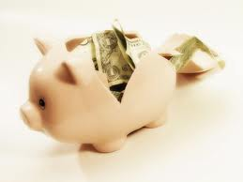
Budget
Budapest: Good Candidate for Budget Travel
Eastern Europe relatively cheaper than Western Europe
This budget is a liberal estimation
Assumes a weeklong vacation for a single individual
Includes return flight cost from New York to Budapest
Actual average cost may be lower for a party of two or more
Savings in accommodation and food
Discounts on multi-ticket purchases at museums, parks, and other tourist spots

Slide 4
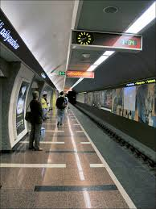
Getting to and Getting around Budapest
Several U.S. and International Airlines carry American tourists to Budapest
American Airlines
United Airlines
Lufthansa
Swissair
Budapest has an inexpensive, extensive, and efficient public transportation system
Public transportation fares should be pre-purchased
Metro ticket windows
Newspapers kiosks
Automated machines
Learning the map is the key to efficient travel around the city
Night travel could be challenging
Certain areas such as Buda Hills only accessible through taxis around midnight
Public transportation to some areas like Castle Hill is crowded at night
Travelers should be careful of pickpockets at crowded public transportation systems

Slide 5
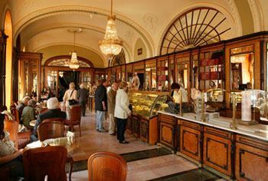
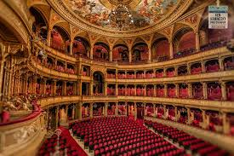
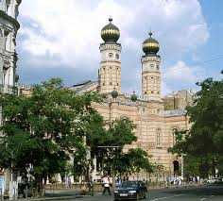
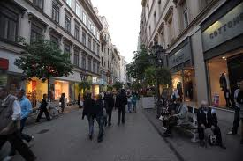
Places to Visit
Cafe Gerbeaud
Most popular coffeehouse, founded in 1858
Famous for pastries, especially plum pies
Hungarian State Opera House
Designed by famous Hungarian architect Miklos Ybl
Budapest’s most celebrated performance hall
Guided tours available
Dohany Synagogue
Europe’s largest synagogue
Architecture has Byzantine and Moorish elements
Hosts the National Jewish Museum
Vaci Utca
Budapest’s main shopping destination
First McDonald’s in Hungary opened here
That, too during Communist rule

Slide 6
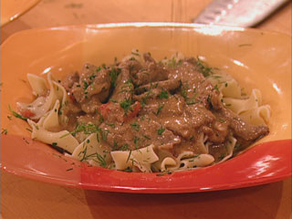
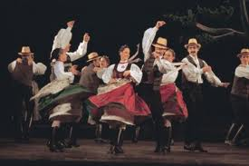
Food & Culture
Food
Paprika is an important component of Hungarian food culture
Ghoulash is a popular Hungarian soup
Made with potato, meat, pork, and beef and seasoned with paprika
Music
Gypsy and Hungarian Folk music is authentic Hungarian music
Involves rhythmic floor tapping and slap dancing
Lifestyle
Hungarians not fond of long working hours
Like many Europeans, place huge emphasis on social life
Restaurants and cafes are popular hangout spots
Public mineral water baths can be found throughout Budapest
Popular place to relax

Slide 7
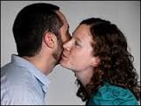
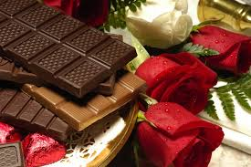
Etiquette and Conclusion
Greetings
Both men and women shake hands
Older generation usually bows to women
Close friends kiss on the cheek, starting from left
Visiting a house
Hungarians expect punctuality
Shoes are removed before entering the house
Hungarians share private details and expect others to do the same
A gift such as good chocolates or flowers may be recommended
Conclusion
Budapest, Hungary is an affordable tourist destination
Getting around the city is easy though may be challenging after midnights
Budapest offers both modern and traditional culture
Hungarians place huge emphasis on social life and relations

Slide 8
References
Budapest. (n.d.). General Information. Retrieved January 17, 2014, from http://www.budapest.com/city_guide/general_information/information_about_budapest.en.html
Kwintessential. (n.d.). Hungary - Language, Culture, Customs and Etiquette. Retrieved January 17, 2014, from www.kwintessential.co.uk/resources/global-etiquette/hungary-country-profile.html
Princz, A., Banfalvy, C., Kutor, A., & Lakos, N. (n.d.). Budapest & the Best of Hungary. Frommer's.

