Slide 1
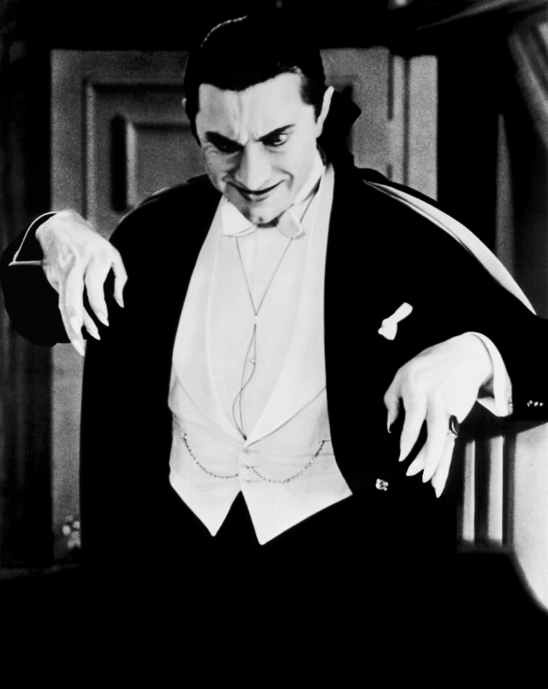
Bram Stoker’s Dracula

Slide 2
Introduction
What would you do if you woke one night to find a Count of deathly proportions salivating at your bedside?
This presentation will discuss the significance of a timeless literary monster, Count Dracula, and his eerie role during the Late Victorian period.
Bram Stoker wrote Dracula in 1897 but the character’s immortality makes him relevant even today.

Slide 3
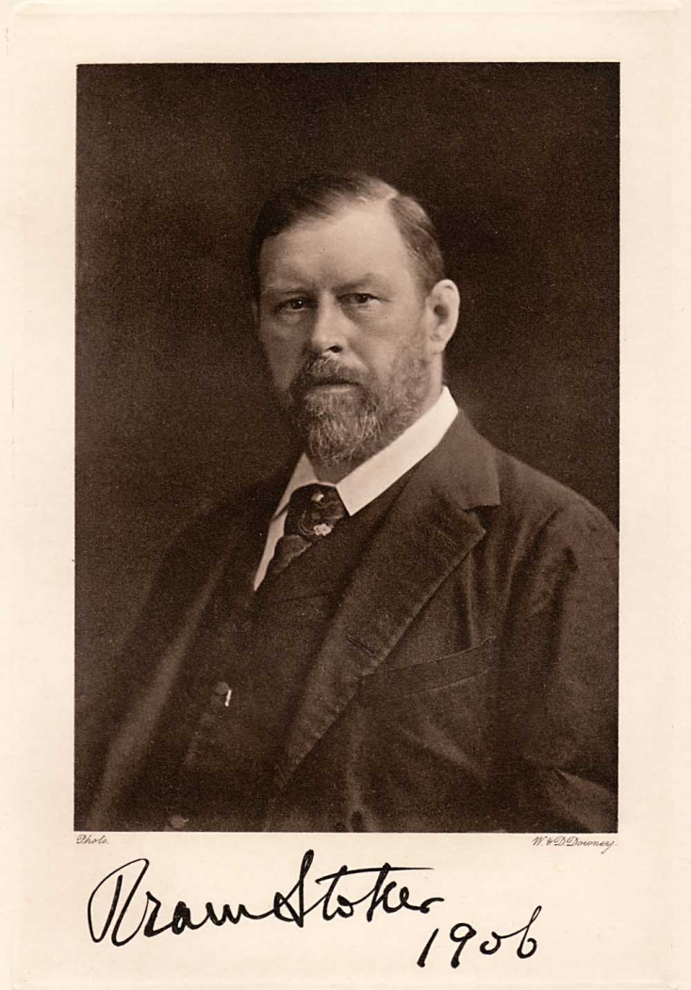
Bram Stoker
Born 1847 in Clontarf, Ireland
Died in 1912
Famous author of gothic horror tales; most notably Dracula
Heavily influenced by tales told by his mother about the cholera epidemic of 1832

Slide 4
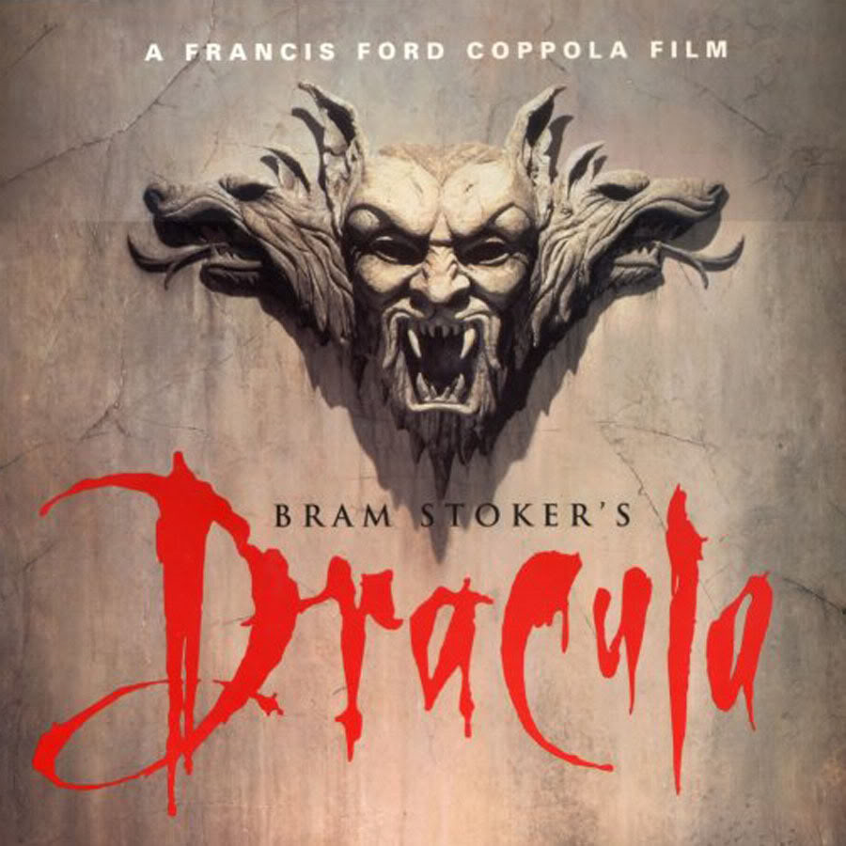
Characters
Count Dracula – Transylvanian nobleman and centuries old vampire
Van Helsing – Dutch professor and Dracula’s primary protagonist
Jonathan Harker – Lawyer and naïve captive of Dracula

Slide 5
Characters
Mina Murray – Considered to be the novel’s heroine; Harker’s fiancé; best friend of Dracula’s first victim
Lucy Westenra – Dracula’s first victim; she becomes a vampire herself
John Seward – Dedicated to fighting the Count; doctor at an insane asylum close to Dracula’s home

Slide 6
Plot Summary
Gothic horror novel set in the late Victorian period
Harker sets out to Transylvania to conduct a real estate transaction with Count Dracula
Harker becomes a prisoner at Castle Dracula
He discovers that the Count has supernatural powers and intends to use them on unsuspecting victims

Slide 7
Plot Summary
Throughout the novel, the Count becomes increasingly more threatening
Dracula begins to terrorize innocent victims such as Lucy Westenra
When Mina Murray falls victim to Dracula, Van Helsing, Harker, and Seward set out to destroy him
They eventually catch up with the count in his attempt to flee to Transylvania
He is killed by knives

Slide 8
Thesis
In addition to being a terrifying classic of gothic proportions, Dracula douses the reader with disturbing sexuality. Stoker addresses the Victorian need to define sexuality through the elements of violence and darkness.

Slide 9
Proof of Thesis
Being a purely seductive figure, Count Dracula did not limit his hypnotic control to female victims: “The vampire is not lesbian, homosexual, or heterosexual; the vampire represents the productions of sexuality itself”
Victorians expressed a natural disgust toward sexually active women
Stoker defied this frame of mind by blatantly presenting women as figures of lust and sexual intensity
For instance, in describing the trio of Dracula's “wives” Jonathan Harker meets in the Count's castle, he writes of one: “There was a deliberate voluptuousness which was both thrilling and repulsive, and as she arched her neck she actually licked her lips like an animal...” (Stoker 43).

Slide 10
Proof of Thesis
"We are in Transylvania, and Transylvania is not England. Our ways are not your ways, and there shall be to you many strange things.“
"I was afraid to raise my eyelids, but looked out and saw perfectly under the lashes. The girl went on her knees, and bent over me, simply gloating. There was a deliberate voluptuousness which was both thrilling and repulsive, and as she arched her neck, she actually licked her lips like an animal... Lower and lower went her head as the lips went below the range of my mouth and chin and seemed about to fasten on my throat...I closed my eyes in a languorous ecstasy and waited - waited with beating heart."

Slide 11
Proof of Thesis
"She still advanced, however, and with a languorous voluptuous grace, said: - 'Come to me, Arthur. Leave these others and come to me. My arms are hungry for you. Come, and we can rest together. Come, my husband, come!' There was something diabolically sweet in her tones - something of the tingling of glass when struck - which rang through the brains even of us who heard the words addressed to another. As for Arthur, he seemed under a spell; moving his hands from his face, he opened wide his arms."

Slide 12
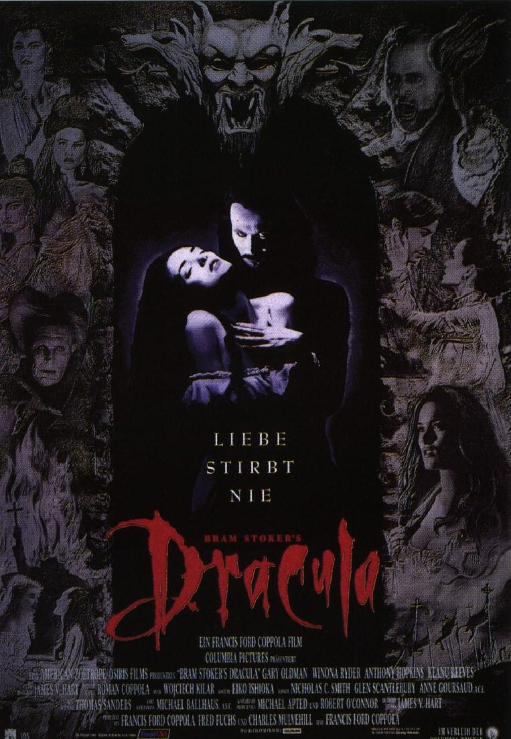
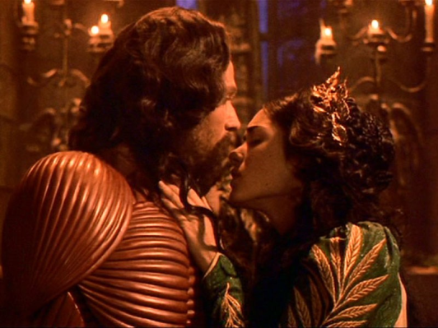
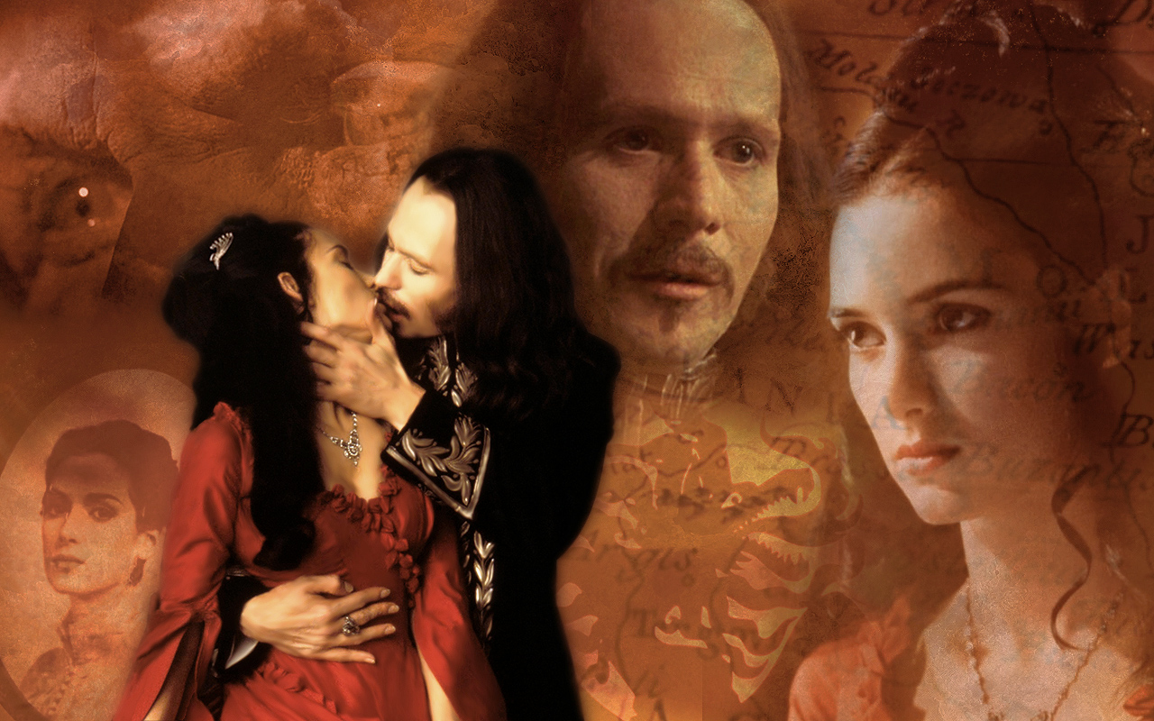
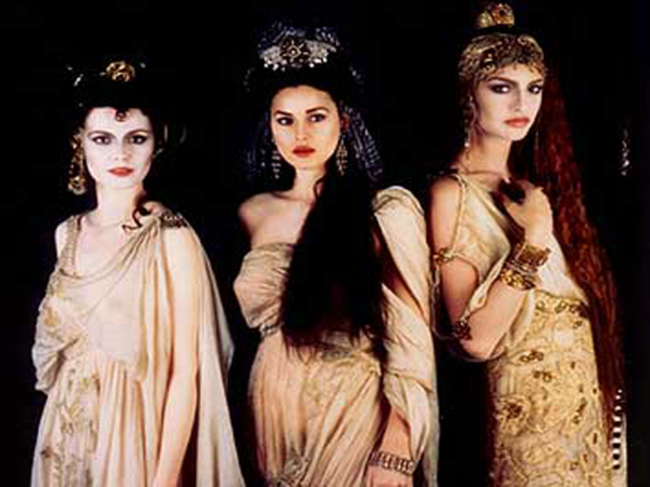
Proof of Thesis

Slide 13
Bram Stoker’s Dracula
This clip will show the scene from the film based on Stoker’s novel
Harker arrives at Castle Dracula
The accompanying soundtrack creates an eerie, yet seductive overtone
http://youtu.be/eFAu3vT5wUg
(right click on hyperlink and choose ‘open’ hyperlink)

Slide 14
Bram Stoker’s Dracula
Various artists have been inspired by Dracula and vampires
Rob Zombie released a song Dragula which exemplifies the darkness associated with vampires
http://youtu.be/EqQuihD0hoI
Music video by Rob Zombie performing Dragula. (C) 1998 Geffen Records

Slide 15
Bram Stoker’s Dracula
Victims bitten by Dracula would become vampires themselves
Dracula would bite his victims in the neck where his sharp teeth could pierce their soft skin and he could access their blood
The following clip shows a typical encounter between Dracula and a victim
http://youtu.be/hYHVb0DQ6Ag

Slide 16
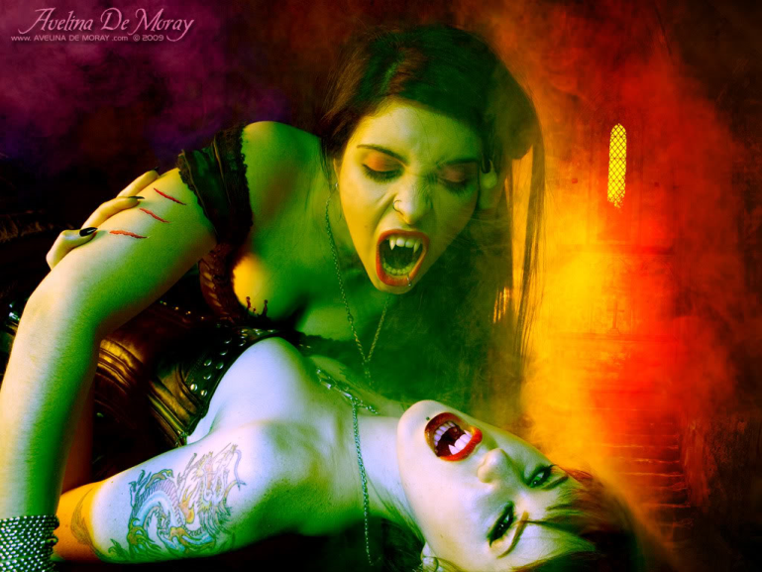
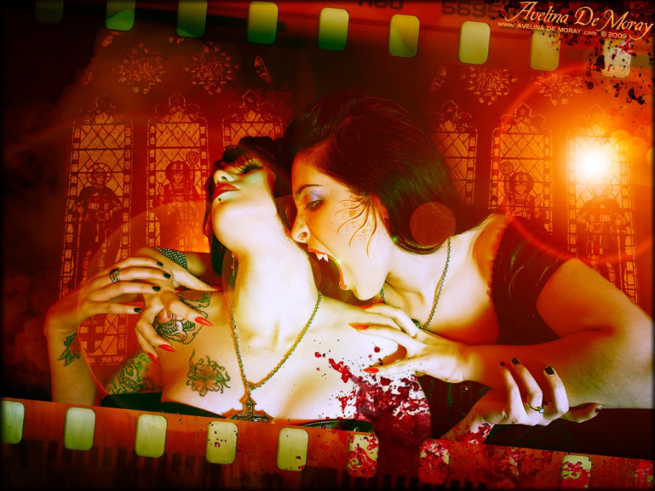
Bram Stoker’s Dracula
Art inspired by the vampire theme is often dark and sinister
It is important to note that vampire art typically has a sexual theme, regardless of the associated darkness

Slide 17
Conclusion
This book is a timeless classic which will resonate with readers everywhere. The theme is universal and eternal; horror and disturbing sexuality.
This novel will be enjoyed by mature audiences with a healthy imagination and an insatiable desire to probe deeper into the world of Count Dracula

