Slide 1
Ancient Date Seeds
Germination, Genetics, and Growth

Slide 2
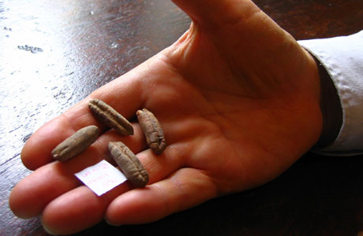
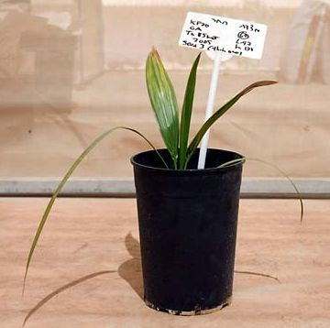
Ancient Dates
Germination of lotus seeds as old as 1300-years have been documented
These seeds are estimated to have existed between 206 BCE and 24 CE
Ancient seeds were identified as Date seeds
Seeds dating as far back as 113 BCE were planted in 2005
Ancient Date seeds from Masada
Germinated Seedling; Aged 23 Months
Notes:
Claims about the permanency of Date seeds have been controversial. A two-year excavation of Masada, which ended in 1965, revealed the existence of ancient Date seeds. The seeds were collected and stored at room temperature for four decades.

Slide 3
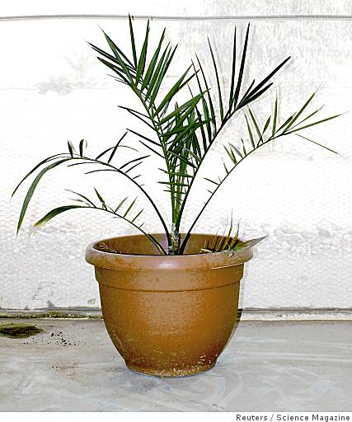
Ancient Dates
Plant was transferred to a larger pot after 15 months
The longevity of the ancient seeds are attributed to high summer temperatures and low precipitation of ancient Masada
Date Palm was domesticated more than 5,000 years ago
Ancient seedling at 26 months
Notes:
Seeds from this collection were obtained in 2005 and identified as Date seeds. Three seeds were found to be intact and were planted in a prepared and quarantined site. Within eight weeks of being planted, one seed germinated. The seedling showed growth patterns consistent with that of modern Date seeds. The only visible disparity between the ancient seedling and modern seedlings were whitish spots on very early leaves of the ancient seedling. Experts agree this was due insufficient nutrients during its initial stages of germination. Genetic analysis of the germinated seedling indicate that the plant is made up of Moroccan, Egyptian, and Iraqi cultivars. The information gathered through the germination of ancient seedlings provide significant information about the background of historic crops, as well as the cultivation of modern date palms.

Slide 4
DNA Barcoding in Plants
Taxonomy in a new perspective

Slide 5
DNA Barcoding
DNA barcoding refers to the process of identifying species based on the diversity of nucleotides of short DNA segments
It is well-established in animals, but not in plants because plants do not have a universally accepted barcode
Notes:
Recent efficacy testing has identified a possible candidate for a universally accepted plant barcode. The barcode is a two-locus barcode which will be able to serve various plant species. DNA barcoding is helpful in accurate and prompt species identification. Additionally, DNA barcoding is helpful in identifying species which are often overlooked. With the use of DNA barcoding, online libraries of barcode sequences are developed and all known and unknown species can be matched to these barcodes.

Slide 6
DNA Barcoding
Because no sufficient DNA barcode has been developed for plants, a temporary two-locus standard barcode will be used
This is a step in the direction of establishing a centralized plant barcode database
Notes:
A centralized plant barcode database will assist with taxonomy, biodiversity assessment and conservation, control of plant import and export procedures, and identification of endangered plant species. The temporary suggested barcode requires significant refinement because it currently does not have the capacity to accommodate all land and water plant species. In the meantime, the two-locus barcode (rbcL + matK) will be used to initiate barcoding of all plants.

Slide 7
Barcoding of Plants & Fungi
Ecology

Slide 8
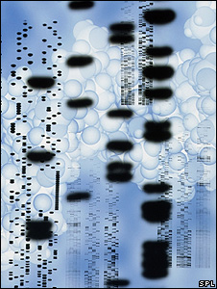
Barcoding
Barcoding identification of plants and fungi are faced with several challenges
Animals and algae have universal barcodes, but this is not possible with plants
Notes:
Plant and fungi barcoding is more complex than animal and algae barcoding because it requires intraspecific identification. This means that it requires identification within a species. Animal and algae barcoding provides interspecific identification. This means it provides identification between various species. Barcoding for plants and fungi requires a more complex formula in order to identify slow-developing genes, as well as to identify various intraspecific qualities.

Slide 9
Barcoding
Nuclear DNA is more effective than organellar DNA
Barcoding used in plants and animals are of an organellar nature
Notes:
Nuclear DNA means that DNA is derived from both parents of the species. Organellar DNA means DNA is derived from only one parent. Nuclear DNA is far more accurate. Although plant and fungi barcoding is in its infancy, it is crucial that a more complex and effective system be developed. Doing so will assure the rapid and accurate identification of various plant and fungi species.

Slide 10
Land Plants and DNA Barcoding
Short-term and long-term goals

Slide 11
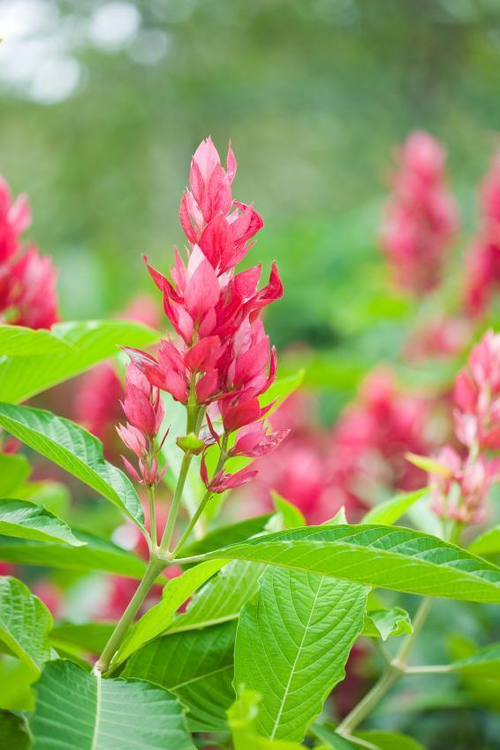
Land Plants
DNA barcoding for land plants have proved to be problematic
Most prominent barcode users are scientists (other than those in the field of taxonomy), and taxonomists
Notes:
Barcoding for land plants are problematic because they have exceedingly high levels of variability and typical land plant plastid phylogenetic markers have limited variation. For these reasons the development of barcoding for land plants is at a temporary standstill.

Slide 12
Land Plants
DNA samples can be extracted from plant species that have a higher quality of intact materials
DNA banks are already in progress, for example the Royal Botanic Gardens
Notes:
In an effort to commence with the barcoding system of land plants, herbarium and museum specimens have been utilized. Experts have concluded that it will be an impossible task to effectively gather samples of each land plant species on earth today. As a result, specimens that have already been collected are used. However, many of these specimens have highly degraded DNA. It is therefore pertinent that the process of collecting and identifying specimens and their genetic makeup resume in a speedy fashion.

