Slide 1
Global Health Care Issues

Slide 2
Introduction
Global health is defined as a science inclusive of research and practice prioritizing health to mean the achievement of equitable distribution of its resources for all people worldwide. Precisely, its goal is to improve health internationally through eradicating elements that create disparities. Ultimately, it is providing national border security and protection against global threats. These principles are applied of health care delivery internationally (Holtz, 2008).

Slide 3
Global Health Care Issues
Global health Care issues encompass diseases and conditions affecting health care internationally. Some of them include HIV/AIDS; malnutrition and maternal/child health. This discussion will embrace reflections on these three issues.

Slide 4
HIV/AIDS
HIV/AIDS is a global problem since this disease affects the entire world and so far has reduced major portions of the world’s population. While researchers are busy developing cures, vaccines, palliative and preventative measures people are dying since there is not cure for HIV/AIDS (Centers for Disease Control and Prevention, (CDC), 2011)

Slide 5
Epidemiology
World health Organization (WHO) reports from data received during disclosed that an estimated 35.3 million people are infected with HIV globally. New infections are expected to be in the vicinity of 2.3 million. With preventative interventions the figure was reduced from 3.1 million new infections in 2001. Women infection estimation rate is 16.8 million are women with 3.4 million below age 15 years old. So far up to 2012 there was a total estimated death worldwide of 1.6 million; significant reduction from 2.2 million in 2005 (Centers for Disease Control and Prevention, (CDC), 2011)

Slide 6
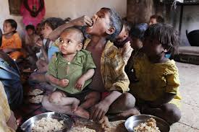
Malnutrition
Malnutrition is most often referred to as either bad nutrition or under nutrition. It manifests as hunger and inadequate quantities of food consumption as well as, overweight and obesity. Statistics (2010) reveal that an estimated 104 million children internationally are underweight, and undernourished. This is responsible for one third of all children deaths globally. Further malnutrition alters immune system function and worsens incidences of infection (Koplan, 2009).

Slide 7
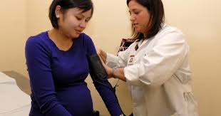
Maternal and child health
Complications of pregnancy and child birth are epidemic in certain societies. According to World Health organization every minute a woman dies from complications of pregnancy and child birth. This is the leading cause of death among child bearing age women. Further reports are that unsafe maternal intervention is the fourth leading cause of death internationally (Koplan, 2009). .

Slide 8
Conclusion Challenges
Limited health care – global shortage of health care workers
Appropriate funding from donors – Holding donors accountable
Sustainable developmental goals - Launching a process to develop goals

Slide 9
Conclusion Interventions
Targeting priories –HIV/AIDS; maternal and child health; treatment of acute and severe malnutrition
Promoting breast feeding and vaccination programs.
Provision of low cost evidence based health care

Slide 10
References
Centers for Disease Control and Prevention, (CDC) (2011-06-03). "HIV
surveillance—United States, 1981–2008". MMWR. Morbidity and
mortality weekly report 60 (21): 689–93.
Holtz, C. (2008). Global Healthcare: Issues and Policies. New York. Bartlett
and Jones.
Koplan, J. (2009). Towards a common definition of
global health. The Lancet 373 (9679); 1993–1995.

