Slide 1
Kaiser Permanente: Health Care Delivery System
By: Name

Slide 2
Unique Delivery System
Since 1945: Kaiser utilized integrated model
High-Quality
Affordable
Non-Profit
Pre-Paid
Integrated Health Care Model through partnership:
Three Entities:
Kaiser Foundation Health Plans
Kaiser Foundation Hospital
Permanente Medical Groups.
(Kaiser Permanente)
Notes:
Since 1945, Kaiser Permanente has used an integrated model and has delivered a high quality, affordable, non-profit and prepaid health care system. There health care integrated model of health care financing and delivery has been conducted through a partnership with three entities. Kaiser Foundation Health Plans, Kaiser Foundation Hospital and Permanente Medical Groups.

Slide 3
Integrated Health Care Model
Kaiser Foundation Health Plans –
Non-profit regional health plan
Individual or group
Prepaid comprehensive service
Kaiser Foundation Hospitals –
Nonprofit corporations
Provide services for plan members
Permanente Medical Groups –
Self-governed, specialty groups
Contract with Kaiser to provide services
(Kaiser Permanente)
Notes:
Kaiser Foundation Health Plans are nonprofit regional health plans that contract with its members, which are individuals or groups for a prepaid comprehensive health care service. Kaiser Foundation Hospitals are nonprofit corporations that own or operate or contract for hospital facilities and services of care for the Kaiser Health plan members. Permanente Medical Groups are self-governed medical groups in a Kaiser Permanente region that contract with Kaiser Foundation Health Plans and Hospitals to provide medical services to its members.

Slide 4
Non-Integrated Healthcare Delivery System
HealthCare Partners Medical Group
Deliver high-quality medical care through two models:
1) Staff Model: primary care physicians and specialists
For HMO and fee-for-service patients
Contracts with major HMOs and PPOs in Greater Los Angeles area.
2) IPA model: contract independent primary care physicians
Wide selection of physicians.
Patients referred by either IPA or Staff Model physicians.
(HealthCare Partners, 2014)
Notes:
Some healthcare systems are not run in an integrated model. For instance, Health Care Partners Medical Group. HealthCare Partners Medical Group is located in Southern California and delivers medical care through two delivery models. The first one is through the staff model which employs several hundred primary care physicians and specialists. The second with the independent physician association (IPA) model, which contracts with hundreds of independent primary care physicians. The Staff Model provides health care services to both HMO members and fee-for-service patients and has contracts with most major HMO’s and PPOs in the Greater LA areas. The IPA model, doctors who are affiliated with HealthCare partners and communities serve to wider selection of physicians. The IPAs consist of greater than 1400 primary care physicians and work with over 3000 specialists who are referred by IPA and staff model doctors.

Slide 5
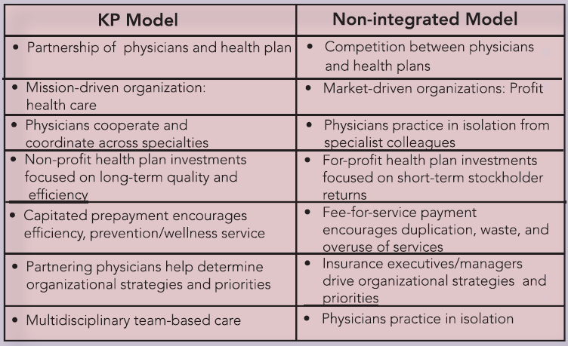
Comparison with non-Integrated Health Care Delivery System
Kaiser differs from HealthCare Partners Medical Group
Kaiser has distinguishing characteristics
Pre-payment
Integration
Group Practice
Non-profit
Non-integrated: fee-for service
Fee-for service
No collaboration
No group practice
For profit
Table 1. KP Model vs. Non-Integrated Model (Kaiser Permanente)
(Kaiser Permanente)
Notes:
Kaiser Permanente Groups have a combination of characteristics that distinguish it from most other types of healthcare organizations. Kaiser offers a prepayment or capitation of the annual member premium means that with this coverage, plan members will not face no economic strains to medical necessity care as determined by their primary physician. Pre-paying provides incentives between the health plan and the member so that they both would benefit from the care provided. This differs from IPAs, such as Healthcare Partners, where there is a fee-for service. In addition, Kaiser has an integration with the insurance, administrative and clinical functions of the health care through working with the health plan, hospitals, and physicians. The care is aligned and all groups work together for quality of care and efficiency. In an non-Integrated system, patients are referred to physicians that work with that healthcare group; however, it is not integrated and fees for service apply at each. Kaiser also has a Group Practice in which the medical care is coordinated among everyone working with the patient. In addition, the nonprofit portion of the health plan means that the revenue margins are invested in improved patient care and programs. As seen in Table 1., The Differences are illustrated between a Kaiser Permanente Model and Non-integrated Model.

Slide 6
Compliance, Regulatory, Licensing
Enforced at Federal, State, and local government level.
Medical Keeping Practices
Patient Confidentiality
Notification of termination of Participating Providers
Provider appeal and grievances policies
Different types of appeals: denials, emergencies, written
Medicare Policies and Rights
(Kaiser Permanente, 2012)
Notes:
Compliance and regulatory requirements for health care are enforced at the Federal, State and local government. These policies and licenses ensure that the healthcare system has Medical Keeping Practices, Patient Confidentiality, Notification of termination of participating providers in the network, Provider appeals, denials, emergencies, written, etc., Medicare policies and rights

Slide 7
Effects of Compliance, Regulatory and Licensing
Safeguarding reputation and economic status
Decrease protection to health
State Regulators become more influential in smaller jurisdictions
Leads to change in regulations between States
(Field, 2008)
Notes:
It is suggested that due to regulations in the healthcare system, there are effects that occur, such as the healthcare system becomes more interested in safeguarding the reputation and economic status of their company. In addition, state regulators can become more influential, especially states in smaller jurisdictions. Therefore, regulations may be governed differently according to State.

Slide 8
Changes in Healthcare Licensing and Regulations
In US, to practice a license from state is required.
Began early 20th century
Licensing restricts nurse practitioners and mid-level clinicians
Stricter education
Results: limited entry into medical professions
Increases prices
Reduction of care
Decrease in Health Outcomes
(Svorny, 2008)
Notes:
In the United States, the regulation of medical professionals lies within the states and to practice within a state, physicians must obtain a license from the state government. These regulations were put forth in the early 20th century. The problem with licensing is that it is restricting nurse practitioners and other mid-level clinicians who exceed the scope of practice. The licensing also has stricter education requirements with will lead to a limited number of entries into the medical professions. This results in in increased prices for the healthcare system, which further results in worse health outcomes.

Slide 9
National Trends Affecting Competition and Healthcare Costs
Overuse of Healthcare Services
Lifestyle Behaviors
Tobaccos Use
Obesity
Technology
Aging population
Decreased use in Managed Care
(Leitz)
Notes:
The overuse of healthcare services has driven up costs, Lifestyle Behaviors such as tobacco use and obesity related medical care. Technological advances are also thought to increase healthcare costs. In addition, the aging population is also considered a factor for increases in healthcare costs, due to the increase in healthcare costs that go along with aging, such as medical tests, medication, doctor visits, etc. Furthermore, a decrease in the use of managed care. There was an increase in enrollees in HMO plans which restrict networks and try to reduce costs for services.

Slide 10
Quality Indicators (QIs) and Effects to Local Health agencies
Measures of health care quality
Indicate potential concerns and need for further research
(U.S. Department of Health and Human Services)
Effects to Local Health agencies
State and Federal Underpayment for services
Low reimbursements result in decrease in medical care
Medicare and Medicaid patients
( Sioux Center Community Hospital and Community Center )
Notes:
The Quality Indicators (QIs) are measures that are used in health care quality that use hospital inpatient administrative data. The Qis are used to indicate any potential quality concerns, identify areas that need further research and track trends over time. The use of quality indicators can result in effects to local healthcare agencies due to State and Federal Underpayment for services. This results in low reimbursement rates and therefore a decrease in the quality of medical care. This is especially since in Medicare and Medicaid Patients.

Slide 11
Questions?

Slide 12
Overview
Kaiser Permanente Integrated Health System
Integrated System Provides Benefits:
Member
Provider
Health Care Organization
Results in Benefits for Licensing and Regulations, as well as QIs.
Notes:
The Kaiser Permanente Integrated Health System can provide benefits to the member, healthcare organization and provider. In addition, the system can also provide more benefits in regard to the licensing and regulations, as well as the effects from Quality Indicators. Providing a an integrated system with a fixed amount can result in less effects to quality of healthcare through the collaboration of the three entities.

Slide 13
References
HealthCare Partners. (2014). About us. Retrieved from: https://www.healthcarepartners.com/aboutus/our-organization.aspx?mid=49
Leitz, S. Healthcare Costs Growths, Drivers, and Implications for State. Retrieved from: http://www.familyimpactseminars.org/s_wifis21c01.pdf
Kaiser Permanente. KP Model An Inegrated Healthcare. Retrieved from: http://xnet.kp.org/kpinternational/docs/The%20KP%20Model.pdf
Kaiser Permanente. (2012). Compliance and Regulatory. Retrieved from: http://providers.kaiserpermanente.org/info_assets/cpp_mas/mas_provmanch7_Feb2012.pdf
Svorny, S. (2008). Medical Licensing An Obstacle to Affordable, Quality Care. Policy Analysis. 621:1-20.
Field, R.I. PhD. (2008). Why Is Health Care Regulation So Complex? P&T. 33(10): 607–608.
U.S. Department of Health and Human Services. Home Page. Retrieved from: http://www.qualityindicators.ahrq.gov/
Sioux Center Community Hospital and Community Center. SCCH&HC POLICY POSITION 2007 Hospital Pricing Transparency. Retrieved from:
http://www1.avera.org/amck/regionalfacilities/siouxcenter/about/quality.aspx

