Slide 1
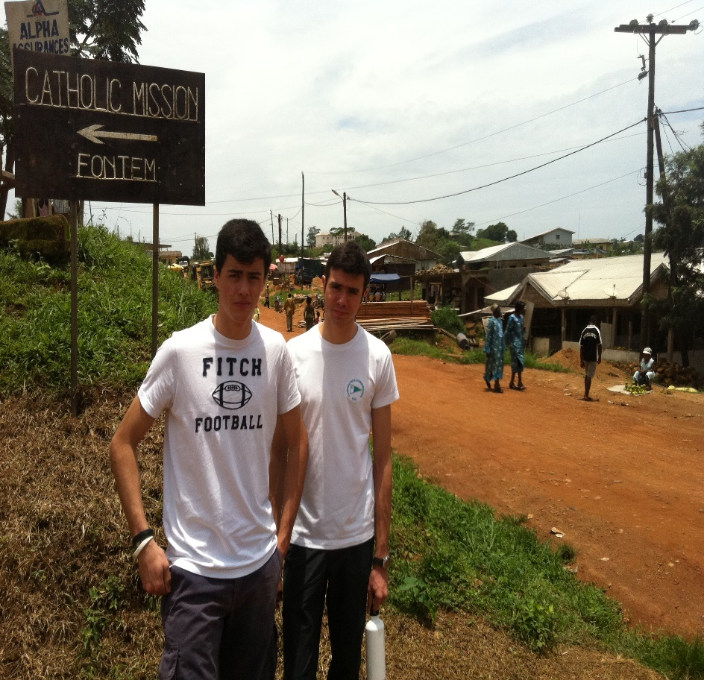
Our Service Learning Project
unique
PLACES
REGIONAL TOURISM
Bellua, Cameroon
The Making of Dispensary at Bellua, Cameroon
Matteo Catelli and Carlo Maria Allegrini
Elizabeth Johnson Mottola
St. Stephen’s School Service Learning Program
3/27/2013 to 4/7/2013

Slide 2
Where It All Started
unique
PLACES
REGIONAL TOURISM
The Catholic Mission in Douala
We left Rome on a midnight plane to Addis Abeba, and from there to Douala which is the second largest city of Cameroon.
Our trip on the plane was filled with interesting stories that included, a group of Chinese businessmen that were buying up vast amounts of properties.
We met our guide, Paul that was able to send us to the Mission for the night.
We stayed the night in Doula because it is not safe to travel at night and the trip to Fontem is long.
We must only travel during the day when its safe.
Notes:
Our service task began when we switched planes in Italy to board our flight to Cameroon. The trip involved me, my mother, my best friend Carlo Maria, and his family. We made an old promise to go to the Catholic Mission of Fontem. Our pledge was to help the local doctors build their pharmacy inside the Dispensary in conjunction with the Hospital . We postponed the trip because Carlo’s mother was ill during Christmas, but now we were all ready to take the trip. From the plane ride to reach our destination, we were surrounded by interesting interactions. On board the flight to Douala, there were several Chinese passengers, mostly young men. I was curious, but I didn’t asked at the time, but when we met our guide he informed us that Chinese businessmen were buying up the properties and land in order to grow different kinds of crops, that included sugar, fruit, and coffee to sell throughout the world. We learned that the local people were very angry that many were stealing jobs from the Cameroon people. As we left the plane we were met by our guide at the Doula airport, considered the second largest city in Cameroon, after Yaoundé, the countries capital. Our guide Paul spoke Italian after spending a year in Italy, he helped us gather our suitcases. As we were coming out of Customs, we were greeted by a crowd of locals that wanted to pack our suitcases to the car. As much as the guide Paul was talking to them to say, no, we eventually obliged and paid them.

Slide 3
Road to Fontem
unique
PLACES
REGIONAL TOURISM
We woke up early and embarked on our ride to Fontem
Nevertheless we were able to experience the beauty of Africa.
We were able to taste the fruit that was superior to any throughout Europe.
The smell, nature, and the people are why I love coming back to Africa
Throughout my childhood I was able to come to Africa many times, and I have always loved it.
Notes:
We spent the night in Doula because the trip to Fontem was long, and at night the streets are not safe. We could only travel during the day because it was much safer. Doula is a modern city, unlike a few cities within Africa. Unlike in Kenya where I have been several times, the streets are broken and dirty. We went to the Mission to check in for the night, and then we went to an African restaurant for something “typical.” The restaurant was anything but typical, the atmosphere was filed with people watching TV preachers as people continued to eat. The tableware was plastic , however the food was what was served in eastern restaurants (rice, potatoes, and chicken). Thinking back to restaurants in Italy, people would be eating and watching a football match, however we weren’t’ in Italy anymore. The road to Fontem was long but we were entertained by the beautiful views of nature.

Slide 4
The Dispensary
unique
PLACES
REGIONAL TOURISM
The car ride to Fontem took 6 hours in a 4 passenger car.
However, we were able to take in the beauty of nature that was outside our window
“Sickness of Africa” claimed me as I have enjoyed coming to Africa since I was a child.
The views of nature, the wilderness, and the people were astounding.
We finally arrived at the dispensary ready to work.
The floors were dirty , covered with thick dust and dirt, where the color of the floors were unrecognizable.
Notes:
Today’s journey to Fontem was long. The trip lasted for six hours, and we were in six deep into a car whose maximum capacity was for four people. Nevertheless, through the long and uncomfortable car ride, the outside views were beautiful. We were able to experience the beauty of Africa, looking at the wilderness, nature, and the indigenous people that continued to offer up several items from dead skunks to mushrooms. The outside view of nature was breathtaking. We ate fruit that was unlike any we ever tasted throughout Europe. Throughout my childhood I was able to come to Africa many times, and I have always loved it. Going to the Dispensary we saw the lack of cleanliness that the place was kept. We were taken in the views and shuffling through the boxes and dirt.

Slide 5
The Dispensary
Arriving at the dispensary, we were able to see all the work that was needed to be done to help the pharmacy.
They had fresh water because of the implementation of water tanks that provide water to patients
However, the floors and the rooms were still covered in dirt.
Thanks in part to the surroundings everyone that walked in would carry dirt and grass in the Dispensary.
Notes:
In my opinion, the best part of Africa is Kenya. The saying “sickness of Africa” has claimed me, especially as this past Christmas we weren’t able to go. Although I wasn’t in Kenya I was in my beloved Africa. As we made our way to the village we were met with a warm greeting by the locals. They made us feel at ease, as we made our way through the village. It was calm and relaxing as we were looking forward to tomorrow. We woke up early, eager to finally help. We were met with dirt and dust that penetrated the air. Chaos ensued throughout the place, as mice ran through boxes and across the floors. We worked from 11 am to 7 pm, with only a 2 hour break in between, which meant we were working for six hours to make it better than before we came.

Slide 6
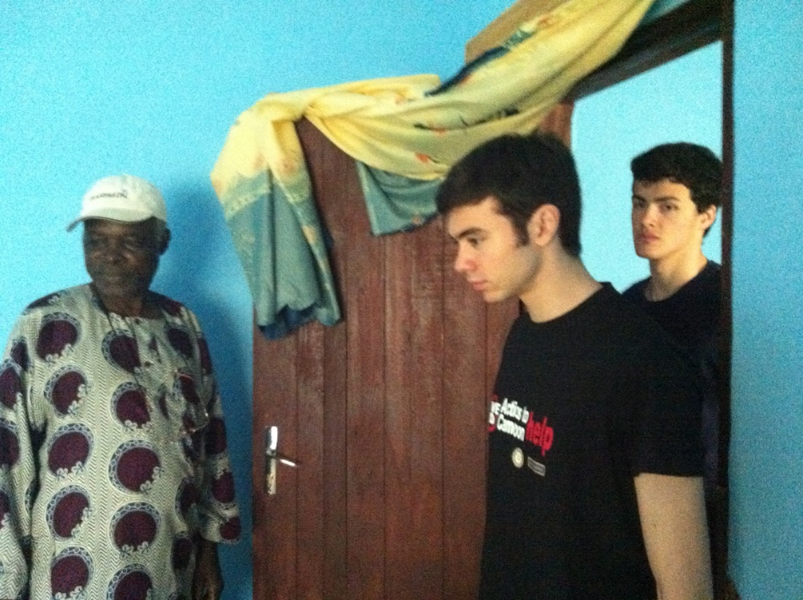
Dr. Joseph Leke Asonganyi, the Supervisor
We met with Dr. Joseph Leke Asonganyi, who informed us further on the significance of our presence.
Our help in making the pharmacy more suitable so he and his staff were able to work.
More importantly our help was needed so patients could be treated and cured.
Notes:
We met with Dr. Joseph Leke Asonganyi, who was the supervisor over the hospital and pharmacy. He showed us all the rooms that were overrun with dirt and dust that needed to be cleaned in order to properly shelf the medicines. No matter the condition, Dr. Joseph informs us further on the importance on making the rooms clean in order for people to work and patients to be cured. Before we really began work, we took a tour of the dispensary and the pharmacy, looking at all the many rooms and places where staff was working. Although it was building was built nicely, we could see that there was a lot of work that needed to be done in order to make the place efficient for the incoming patients.

Slide 7
The Boxes Full of Medical Supplies
It was imperative that we handled the boxes with care as they were full of medical supplies.
Dr. Joseph showed us how disorganized the boxes were, how it was important that a storage room be created.
Each box was filled with valuable materials that were needed in helping to cure and treat patients. However, the room was filled to capacity.
Dr. Joseph informed us that they needed help in creating an adequate storage room, where the medical supplies needed to be categorized and organized in an efficient manner
Notes:
As Dr. Joseph took us to a room full of boxes that held medical material, we knew that we had to have extra precaution with handling the valuable supplies strongly needed in the hospital. The working conditions were really precarious. The boxes were stuffed into the corner, piled up on top each other. Each box was filled with valuable materials that were needed in helping to cure and treat patients. However, he room was filled to capacity, we knew we had to put in a lot of work to make it more efficient. Dr. Joseph informed us that they needed help in creating an adequate storage room, where the medical supplies were able to be categorized and organized in an efficient manner.

Slide 8
The Empty Pharmacy Shelf
The initial task was in making the pharmacy more durable and efficient.
We made the first step in first clearing the shelves.
We properly set up the shelves and cleaned out the room.
Notes:
Once we knew what he had to do, we set out to complete the initial task of clearing out the shelves. In taking down all the boxes and supplies we were left with neatly made shelving that needed to be filled with the supplies. Clearing out the boxes made the mice and dirt more apparent, even when my mom screamed in the other room from the sight of mice, I knew I had to remain on task to complete the job in the hours available to us. Working to organize the shelves would take much patience and diligence.

Slide 9
We start the Job
With the instruction and the direction of Dr. Joseph and the pharmacy staff, we got to work.
Our fast task was moving all the boxes, and cleaning the room to make way for organization.
The job was not as easy as we first thought. There was a lot of dirt and debris that covered the rooms, thanks in part to people coming in and out with dirt on their shoes.
We had to put a plan in motion in order to complete the task before the end of the day.
Notes:
Working with no air conditioning or venting made it particularly hard, especially because the heat and the dust mixed with the confusion of sorting all of the medical equipment. Fortunately we managed to work in a very efficient manner and put nearly everything in order. We were motivated and ready to get to work. Our mission was to help the pharmacy and the hospital. By helping to make the storage and supply room more manageable we provided organization for the staff to get the supplies they needed in treating patients.

Slide 10
Sorting Out the Medicines
We had to sort through all the boxes to get out the medical supplies.
Going through the boxes we discovered several large amounts of medicine and medical equipment.
We even supplied the hospital with medical equipment packed in the boxes.
In addition, we brought along several medicine and medical equipment for the pharmacy.
Notes:
We were creating a storage room and a supply room by putting all the medicinal supplies into the shelves. We divided each by class, and w also took out expired supplies that would be harmful. We took out the equipment that was needed for surgery and sent it to the hospital. In addition to coming to help clean up, we also had brought some medical equipment and medicines to give to the pharmacy. Going through the boxes that were piled up, we discovered several large amounts of supplies that were available to the pharmacy.

Slide 11
Making up the Shelf
After clearing out the boxes and the shelves we were able to categorically and neatly make up the shelves
We worked together in sorting out medical supplies in neat spaces that were easily accessible to staff.
Working with no air conditioning or venting made it especially hard because the heat and the dust mixed made everything very hard.
We were motivated and ready to get to work.
Our mission was to help the pharmacy and the hospital. By helping to make the storage and supply room more manageable.
We provided organization for the staff to get the supplies they needed in treating patients.
Notes:
We worked diligently throughout the day to clean the rooms and clear out the shelves. We were able to sort out all the medical supplies and medicines out the boxes, and placed them neatly in an organized manner. This provided easy access, and ability for more patients to be treated in an efficient manner. Everyone helped to complete the task, as it took much energy and focus in the heat to remain on focus.

Slide 12
With Joseph, Brigitte the nurse Richard, Carlo, and Matteo
Dr. Joseph and Nurse Brigitte were pleased with the work we done.
The shelves were now neatly organized and the materials were placed so that the staff can have easy access.
We were able to complete the mission in which we set out to do and the staff couldn’t be more than satisfied with the effort we put into making the pharmacy a functioning place for the community.
Notes:
Dr. Joseph and Nurse Brigitte were pleased with the work we had done. The shelves were now complete, and the materials were neatly sorted for the pharmacy staff. We were able to complete the mission in which we set out to do and the staff couldn’t be more than satisfied with the effort we put into making the pharmacy a functioning place for the community. The hard work had paid off and the community and staff were pleased that we were able to provide structure and organization for the pharmacy.

Slide 13
Job Well done!
We completed our tasked of helping the pharmacy by creating a storage room and help to organize the medical supplies in order to be more efficient.
Doing this job and completing the job has really affected me. It has made me a better person after doing these actions where we helped people in need.
It is with great satisfaction that knowing that more people will be treated and cured because of the work we done in helping to make the pharmacy function better.
Notes:
We were done with our task. The job we set out to do, had been completed. We had created an efficient workspace and storage room that allowed for quality service in treating those that come through the hospital. Completing the job has really affected me. It has made be a better person after setting out to complete these actions where we helped people in need. It is with great satisfaction that knowing that more people will be treated and cured, because of the work we done in helping to make the pharmacy function better.

Slide 14
With the kids of the Catholic Mission
It was Easter Sunday, and we were greeted by a throng of children outside of the Mission
The crowd was packed with church attendees ready to hear the Easter sermon.
After the Mass we spoke to children of the Mission and we gave them the little presents we had brought from Italy.
How happy they were and how simple it was to make them happy!
They were all screaming of excitement and I can say that we had made their day.
Notes:
It was Easter Sunday, and the village was lively with thousands of kids and people ready to hear the Easter Sermon. We had completed our job in the pharmacy and we ready to take in the culture again as Easter Sunday afforded us with the ability to see thousands of people and hear the sermon that was quite different from what we were used to. After the Mass we spoke to children of the Mission and we gave them the little presents we had brought from Italy. How happy they were and how simple is to make them happy! They were all screaming of excitement and. I can say that we have made their day!

Slide 15
In front of the Church
It was Easter Sunday and we were one of the thousands of people that came out to church.
2000 people came and 2000 people were seated to hear the sermon.
People everywhere were dancing, singing, and praying.
The people all looked very happy and enjoying the sermon.
Notes:
Easter Mass at Fontem, Cameroon had over 2000 people seated, and over 2,000 people had taken part in the communion. The people were all singing during the Celebration, the Mass lasted 3 hours. Throughout the service, we saw people praying, singing, and dancing the entire time. The people all looked very happy. The big difference between us and them was that they don't own anything. They survive every day of their lives dealing with through hunger and illnesses. Throughout their struggles they are happy. They look at their future and they are optimistic.

Slide 16
With father Andrew, the head of the Mission
After the 3 hour sermon we were able to meet the Priest of the Mission after Church.
Father Andrew, the head of the Mission, invited us to the Mayor’s house.
We happily obliged.
The Mayor’s house was surprisingly adorned with beautiful and precious items that showed signs of modernity, but also showed the problems with the retro mentality of hygiene and dirt.
Notes:
Throughout the sermon and afterwards, we encountered several members of the community that were happy about their lives. One of the people we met told me, that everyone even the little he has are similar to everybody else. My house is your house, my food is your food and it is true. We live our lives searching for power, for money, for any kind of goals, and we are alone, pessimistic, never happy. I wish I can be someday as happy as these people I met here. Father Andrew, the head of the Mission, invited us to the Mayor's house, and we happily obliged. The Mayor’s house was surprisingly adorned with beautiful and precious items that showed signs of modernity, but also the problems with the retro mentality of hygiene and dirt.

Slide 17
The Focolarini' s Hospital at Fontem.
We visited the hospital which turned out to be better than we expected.
The exterior was beautifully groomed, and the interior looked neat and tidy.
Although not up to European standards, they didn’t have long to go to making it a suitable place for treatment.
Notes:
We went to the hospital on April Fool’s Day. I must admit I expected worse out of it. It was fairly clean and there were people that kept after it. Although in respect to what we are used to in Europe, the standards are pretty low.. We met a Dutch Focolari nurse and she showed us around. The hospital looked as if it was in a good situation, however it was understaffed and some places within the hospital still needed to be organized. Although we did not visit it completely since there was not enough personnel, the places we were able to see was adequate. With a few implementations of hygiene and maintenance the hospital will be able to function in an clean and sterile environment suitable for treating patients.

Slide 18
The Italian School, with teachers and students
After we left the hospital we visited some more places before we left for home.
We took a visit to a school that taught Italian.
We also visited the Ministry of Health.
Although the place was sort of clean, there were still instances such as dust and dirt covering his walls and dust on his desk, that implied the mentality that ran rampant throughout the village
The common characteristics of developing countries was, "Low standards of living, characterized by low incomes, inequality, poor health, and inadequate education.
In developing countries , low standards of living tend to be experienced by the majority of the population.
Notes:
Visiting the Minister of Health and the schools, later made me reflect a lot especially when I was studying Economics. In chapter 29 of the Oxford Economics book. The writer stated as one of the common characteristics of developing countries was, "Low standards of living, characterized by low incomes, inequality, poor health, and inadequate education. In developing countries, low standards of living tend to be experienced by the majority of the population. The main indicators of these low living standards are high poverty levels, very low incomes, high levels of inequality, very poor housing, low standards of health, high infant mortality rates, high levels of malnutrition and lack of education." Reading this I laughed thinking of the coincidences of life and told to myself in amazement. Wow this is exactly what Cameroon is going through.

Slide 19
The King's Palace and the 50 barracks for his wives
Before we took our leave home we visited the Royal Palace.
The place and the nature surrounding it was breathtaking
However the lack of hygiene was a central theme where animal excrements were all over the floors
The harsh conditions of the King's 50 wives living in cramped apartments with their kids, was astounding.
It made me question , how can we expect that these new African generations grow up healthy if the live in dirt and mud?
Notes:
One of the last places we visited was the Royal Palace. The nature around us was breath taking, and the palace was very beautiful. However, the hygienic conditions were atrocious. Goat excrements covered the floor and dirt covered the walls. The king had his 50 wives live in barracks, much like horse stables outside his home. These poor women lived in small dark and dirty houses that surrounded the palace. Unlike houses, these apartments looked more like pig sties, and in these conditions also lived small children and infants. It made me question , how can we expect that these new African generations grow up healthy if the live in dirt and mud?

Slide 20
We Are Friends Conclusion
unique
PLACES
REGIONAL TOURISM
Throughout our mission to Africa we were able to help the pharmacy and the hospital.
We created a storage room, and organized their shelves by categorizing and cleaning up the mess left from dirt and debris, and the unopened boxes of essential medical supplies.
We were also able to help clean up the dispensary that was important in dispensing needed supplies and water.
The village and the people were warm and inviting. The nature that surrounded Africa spoke for itself as it astounded us in every view.
There are a few problems that we saw, which include the lack of hygiene and problems with cleanliness.
However we are sure that throughout time and with intervention these problems will hopefully be eradicated.
Notes:
I am really happy of all that I have achieved, even if I am not sure what they have learned and understood. The importance of sterilizing the pharmacy for the patient is a necessity when a patient enters into a place of care. We were excited coming to Fontem and helping the community. As a final consideration, I would like to draw your attention on the necessity of building the dispensaries. They are necessary even if there is a hospital is in the area. Due to the bad conditions of the roads people can reach easily access the Dispensary that can also serve as a health center. A Dispensary is where you can get a first intervention that can save your life. While there are a few other problems that we seen that includes more attention paid to prevent all the dirt on the floors, and keeping the shelves tidy, we are sure that with more intervention and interaction with those that are willing to help they will eradicate the problems. The trip will be a lasting experience from the people, to the beauty that is the nature of Africa. This experience will stay with me, as I know I have helped in some capacity the people of Fontem.

Slide 21
unique
PLACES
REGIONAL TOURISM
Thank You

