Slide 1
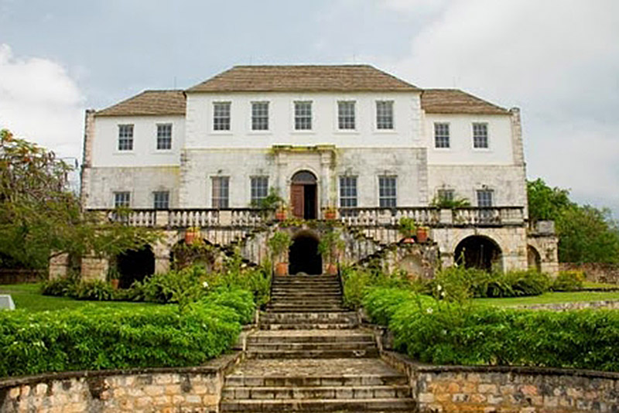
The White Witch of Rose Hall • Rose Hall was built from 1178-1790 by John Palmer, a wealthy British planter • Originally, this was a 6,521-acre plantation with over 2,000 slaves • The Palmers also owned Palmyra, a large plantation nearby (Frommer 114)

Slide 2
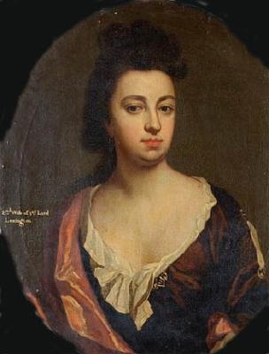
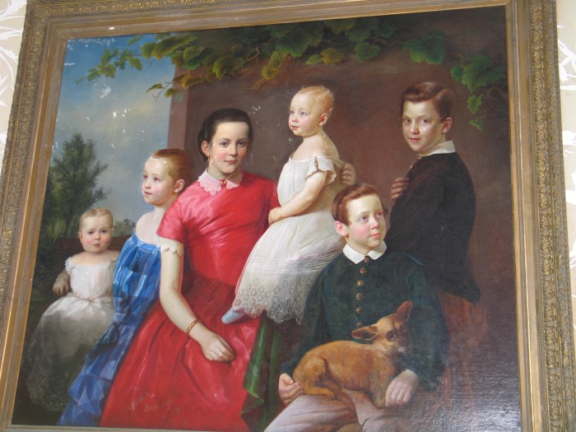
[Is either of these paintings a portrait of Annie?] Annie Mae Paterson Palmer. . . • Her Irish/English parents brought her to Haiti (from England) when she was 10 • When they died of yellow fever, she was adopted by her Haitian nanny, rumored to be a voodoo priestess • Annie arrived at Rose Hall, Montego Bay, on 28 March 1820 • She was 18 years old, 4’11” tall and (allegedly) beautiful • She married the Honorable John Rose Palmer, owner of Rose Hall (114)

Slide 3
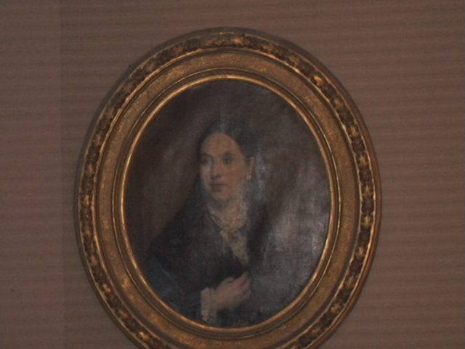
[Is this a portrait of Annie?] Here’s where fact meets fiction: which is witch? • Her husband beat her after discovering her affair with a young slave • John Palmer died that same night: allegedly because Annie poisoned his coffee (114) • Her second husband went mad and was reportedly stabbed to death; the third married her for money and died by strangulation (Radford)

Slide 4
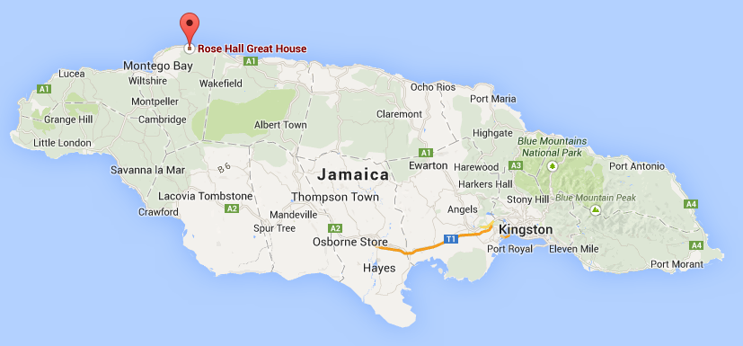
Here’s where fact meets fiction: which is witch? • She (allegedly) had her lover flogged to death in front of her, fearing he would blackmail her • She allegedly had many other slave lovers, but had them killed when she tired of them (114)

Slide 5
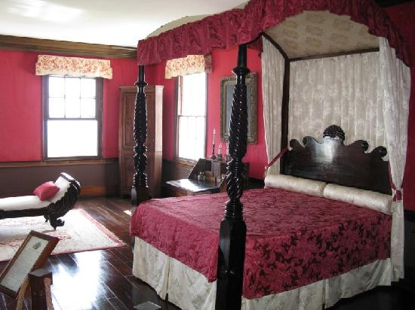
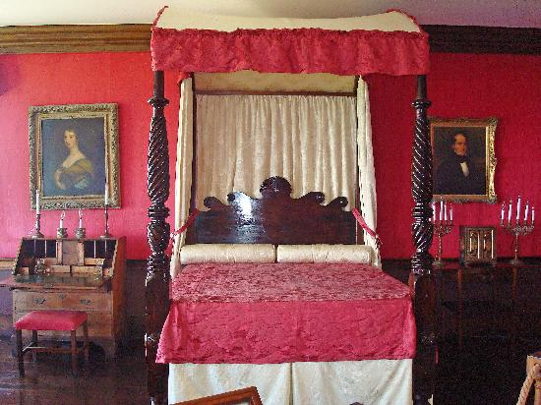
Here’s where fact meets fiction: which is witch? • Annie was found strangled in her bed in 1831, murdered by Takoo, a freed slave • Annie had put a curse on Takoo’s granddaughter (in a fit of jealous rage), causing the girl to “wither and die” (114)

Slide 6
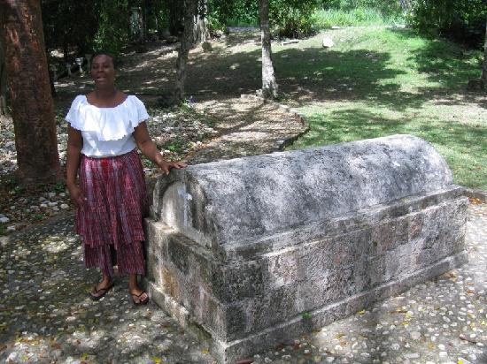
Here’s where fact meets fiction: which is witch? • Annie’s household servants, fearing her return from the dead, burned her possessions and buried her as deeply in the ground as possible • Rose Hall is considered a haunted house, as subsequent owners allegedly faced tragedies blamed on its curse (114)

Slide 7
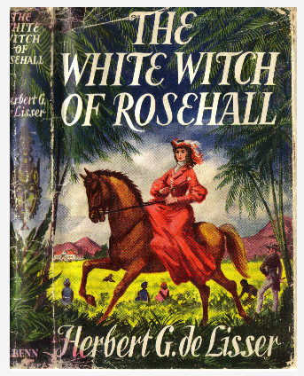
Here’s where fact meets fiction: which is witch? • Lots of fiction has been written about Rose Hall’s “White Witch” • The most famous book was written in 1929 by Herbert G. de Lisser (114)

Slide 8
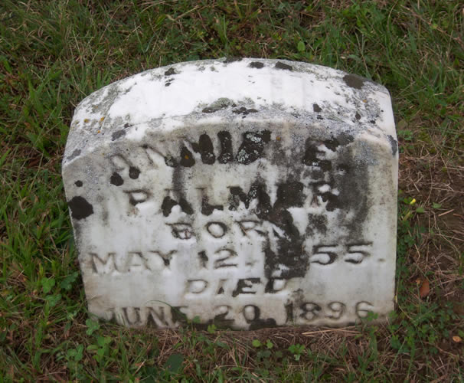
Here’s where fact meets fiction: which is witch? • If Annie Palmer was born in 1802 and killed in 1831, whose headstone is this? (114)

Slide 9
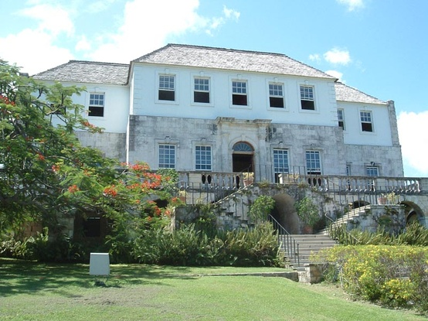
Here’s where fact meets fiction: which is witch? • Over the centuries, it has become difficult to separate fact from fiction regarding the White Witch of Rose Hall • The great house was in ruins until its restoration in the 1960s by an American millionaire (114)

Slide 10
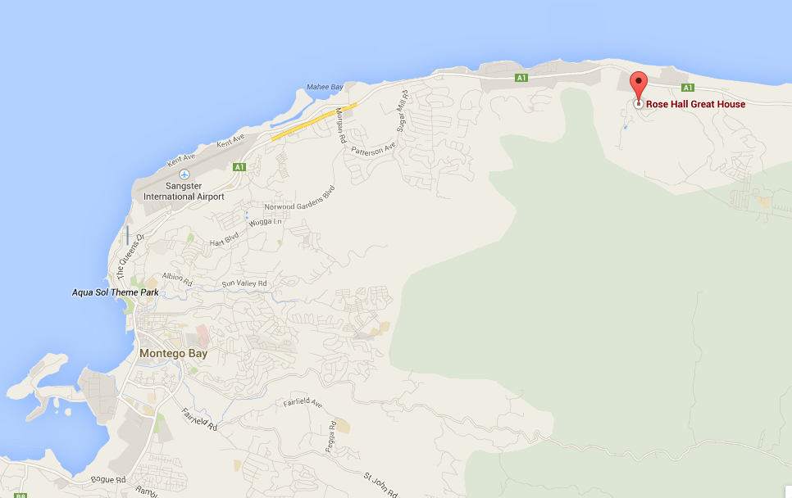
Here’s where fact meets fiction: which is witch? • According to reports: Annie was "beautiful beyond compare; she had a rich throaty voice with black penetrating eyes . . . Her complexion was smooth, and she could shift from a gentle smiling creature to a haughty, cruel, sensual, cat-like woman, gracefully exuding both anger and sensuality . . . Annie had strength besides her cruelty. She had the power of a mind trained in sorcery. She believed in spirits and had the ability to project death fears in her slaves” (Radford 2011). • Benjamin Radford is a research fellow at the Committee for Skeptical Inquiry. His 2007 report on Rose Hall claims “definitively” that Annie Palmer never existed (2011).

Slide 11
Works Cited Porter, Darwin and Prince, Danforth. “Frommer’s Jamaica.” New York: John Wiley & Sons, 2 September 2010. Print. 16 April 2014. Radford, Ben. “Heeding (Or Ignoring) Skeptical Investigation.” Center for Inquiry, http://www.centerforinquiry.net/blogs/entry/heeding_or _ignoring_skeptical_investigation/, 22 October 2011. Print. 16 April 2014.

