Slide 1

SMB Consulting
SHINE A LIGHT ON YOUR BUSINESS
For Serious Small Business Savings With
Small America Business Consulting
Student Name
Professor Name
Course Title
Date

Slide 2

SMB Sales Projection for 2014
Small America Business Consulting
The sales that are projected are to increased by $150,000 each month for 2014. This is an increased in the sales from 2013 which increased each month by 75%. This is putting the small company on a projected revenue of $1 million by the end of the year. The business is steadily picking up steam.
Small America Business Consulting

Slide 3
SMB Market Share 2014
SMB
0.6%
McKinsey & Company
21%
The Boston Consulting Group, INC
19%
Deloitte Consulting LLP
12%
Bain & Company
18%
Small America Business Consulting is a small percentage in the market share compared to the bigger four competitors that own over 60% of the market share. SMB is steadily closing in on the local market and will expand across the United States.

Slide 4


Top Regional Salespeople Performance 2013
Savings spread across all regions.
The following sales charts shows the top 2 sales people sales performance n the East, West, and Central Locations through the year. It is clear that with each month sales performances increases as new clients are added each week.

Slide 5

CEO
Name
VP Sales
Ann Lion
Marketing Manager
Pam Lee
Jan
Sales Office Support
Tim
Salesperson
Mike Smith
Sales Office Support
Sam
Salesperson
Sally Fields
Salesperson
Greg
Salesperson
John Masse
Sales Office Support
Mary
Salesperson
Bobby
Salesoerson
SMB Organizational Structure 2014
Discover what we can do for any business. The SMB Team is there for any business big or small.

Slide 6
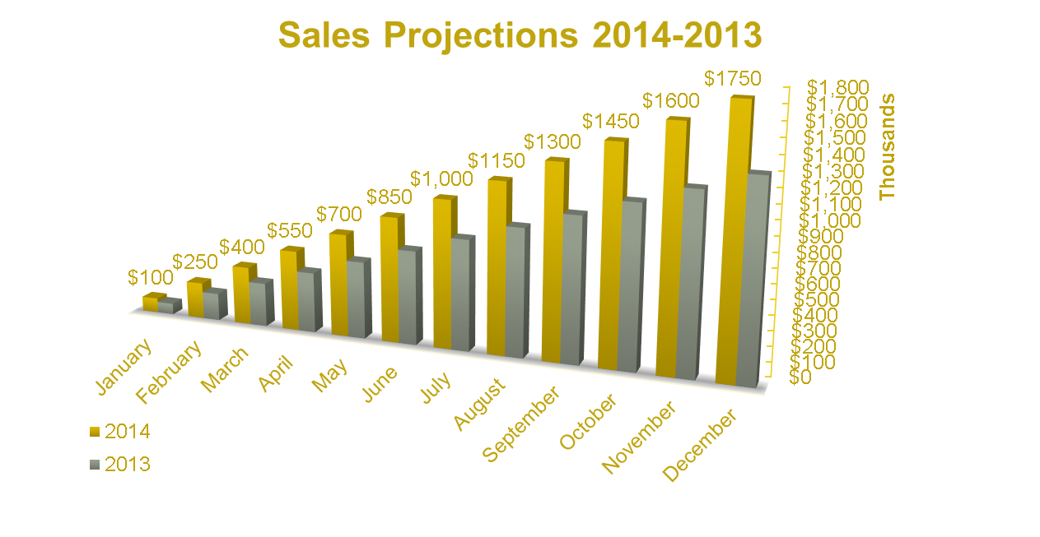
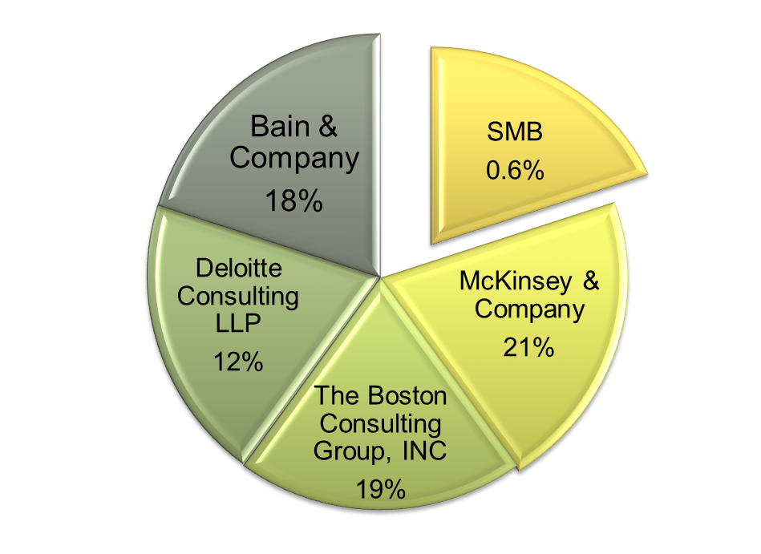

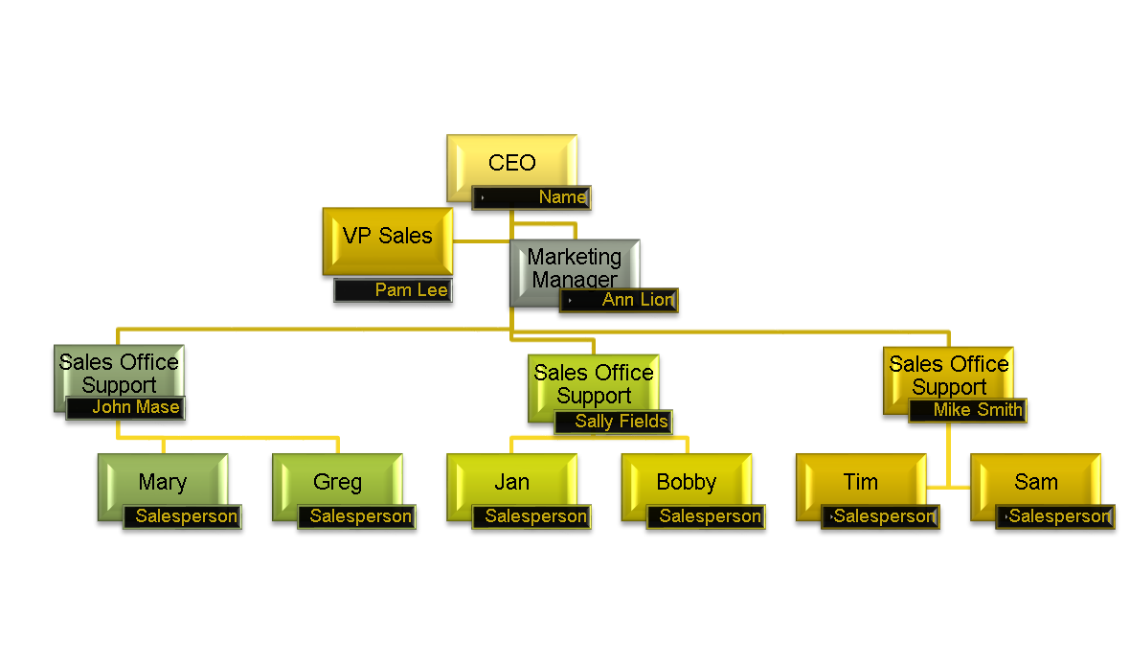


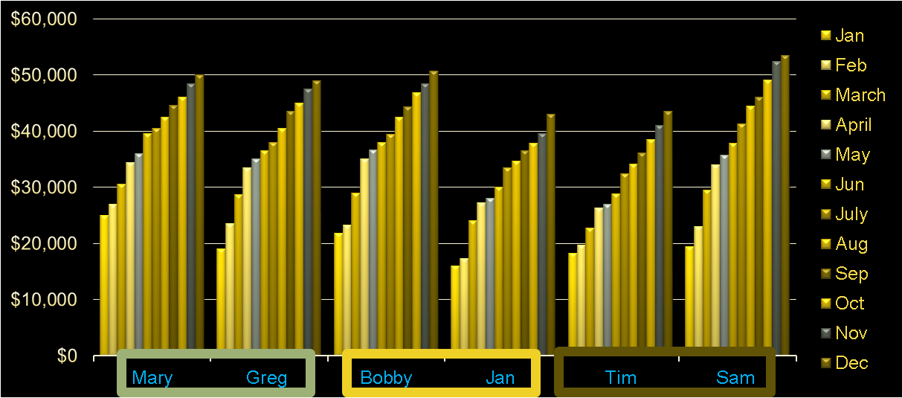
SMB Consulting Sales Presentation
SMB Market Share 2014

Slide 7
Thank You

