Slide 1
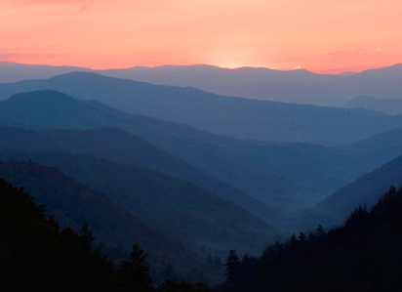
Smokey Mountain National Park
Geology – Earth Science

Slide 2
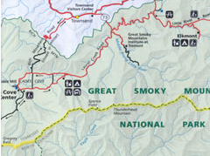
Location
Located in Tennessee and North Carolina
One of America’s most frequented national parks
The ancient Appalachian Mountains
Designated an “International Biosphere Reserve”

Slide 3
Geologic History
Amongst the oldest types of rocks are sedimentary layers formed in the Proterozoic Era around 800 million years ago.
Rocks of the old highlands are considered to be over a billion years old
The highest peaks in the Smokies, contain metasandstone like that at Clingmans Dome
Notes:
http://www.nps.gov/grsm/naturescience/geology.htm
Geology, Great Smokey Mountains
Nps.gov National Park Service, US Department of the Interior

Slide 4
Geological Processes
Comprise sedimentary layers of accumulated clay, silt, sand, gravel, and minor amounts of calcium carbonate in flat-lying layers
Other early sites include that of ocean bottom deposition contained along the ancient margin of the North American continent when the supercontinent broke up.
Notes:
http://www.nps.gov/grsm/naturescience/geology.htm
Geology, Great Smokey Mountains
Nps.gov National Park Service, US Department of the Interior

Slide 5
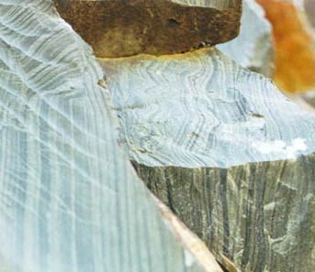
Ancient Geological Formations
The oldest rock exposures in the park are to be found in the Mount Le Conte area containing metasandstone and metasiltstone
Other exhibits include is fine-grained laminated green metasiltstone referred to as Pigeon Siltstone

Slide 6
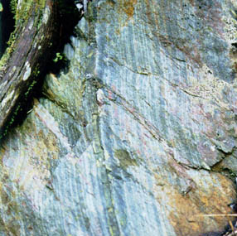
Geological points of interest
Mount Le Conte quadrangle has rock samples from the Late Proterozoic period. These comprise elements of metamorphosed sandstone, siltstone, shale, and others
Notes:
APPALACHIAN BLUE RIDGE PROJECT
http://geology.er.usgs.gov/eespteam/smoky/ResearchAreas/smokys/MountLeConte/geology1.htm
USGS, Geology, 2011

Slide 7
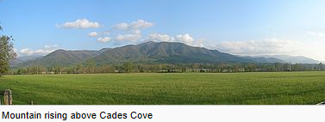
Geological Formations
Clingmans Dome – Highest point in the Park
Mount Le Conte – Rock Formations
Alum Cave Bluffs and Arch Rock
Cades Cove is a type of valley known as a "limestone window

Slide 8
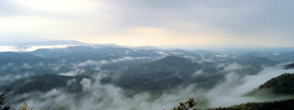
Weather and Climate
Moderate Climate year round - elevations in the park range from approximately 875 feet to 6,643 feet; the weather changes drastically according to altitude
Temperatures often vary between10-20 degrees Fahrenheit from ground base to mountain top
Notes:
http://www.nps.gov/grsm/planyourvisit/weather.htm
Smokey Mountains National Park Weather

Slide 9
Environmental Factors
human-caused factors such as air and water pollution and non-native species have had a significant impact on natural resources–both here and worldwide
geologic processes, climatic shifts, weather, and fire shaped this environment, producing an ever-changing ecosystem.

Slide 10
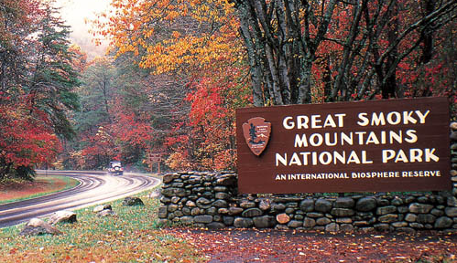
A Natural Wonder
USA Today™ has named The Great Smoky Mountains National Park one of 10 great places in North America to explore geologic wonders.

