Slide 1
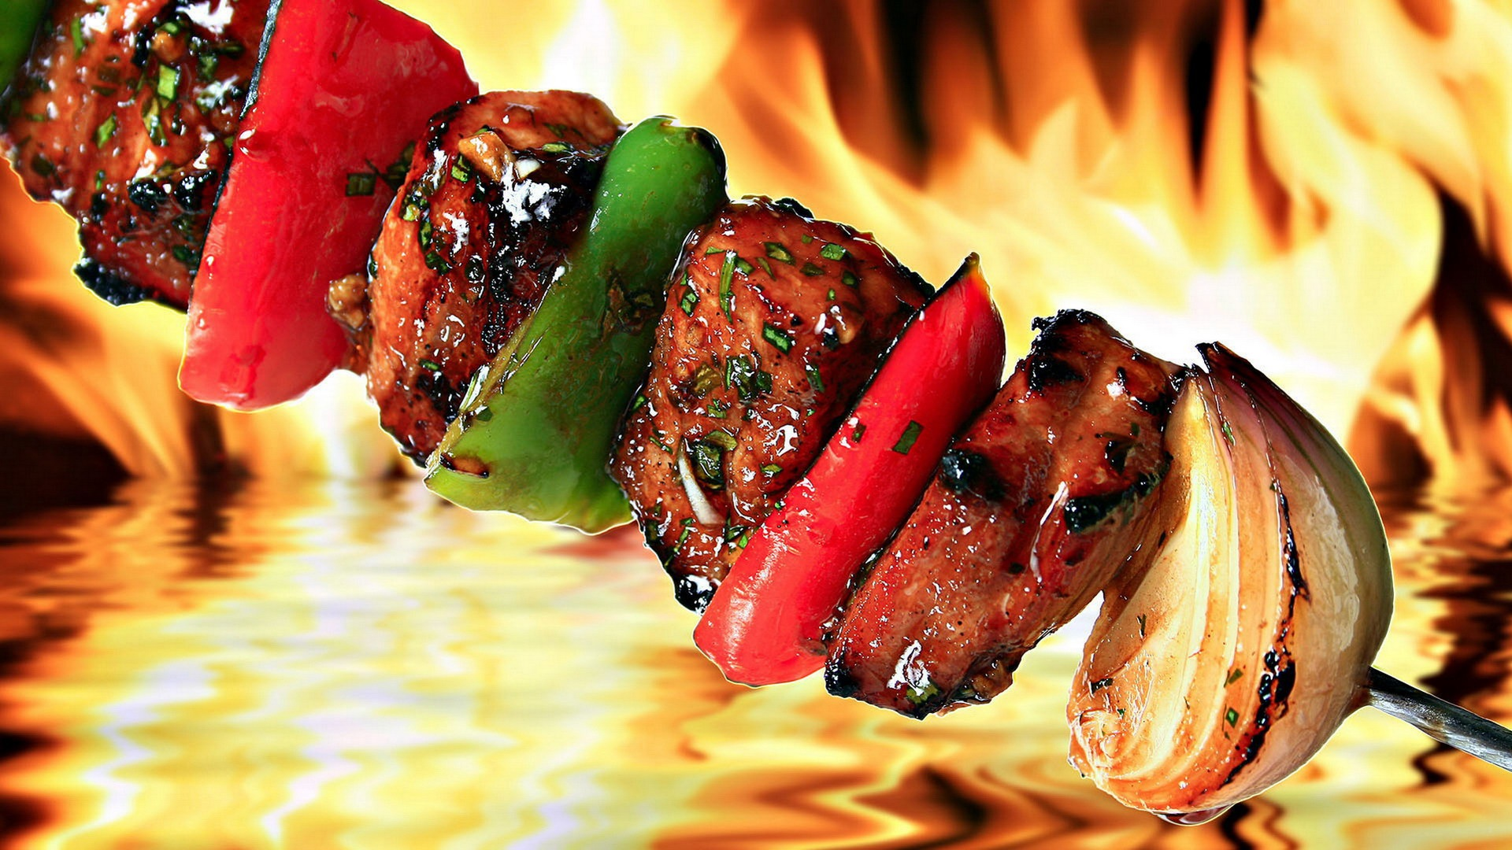
The Geographical History of Shish Kebab
Student Name
Course Name and Number
Professor
Date

Slide 2
Table of Contents
Purpose
Introduction
Region
Diffusion Defined
Diffusion of the Shish Kebab
Cultural Landscape Defined
Cultural Landscape of the Shish Kebab
Distance Decay Defined
Distance Decay of Shish Kebab
Conclusion
References

Slide 3
Purpose
The purpose of this presentation is to demonstrate how geographical concepts of region, diffusion, cultural landscapes, and distance decay can be understood by tracing the history of the Turkish Shish Kebab. The Shish Kebab was selected as the subject of this demonstration for its relevance and familiarity to me and my family background.
Notes:
The purpose of this presentation is to demonstrate how geographical concepts of region, diffusion, cultural landscapes, and distance decay can be understood by tracing the history of the Turkish Shish Kebab. The Shish Kebab was selected as the subject of this demonstration for its relevance and familiarity to me and my family background.

Slide 4
Introduction
The term “shish kebab” is based on the Turkish words for “skewer” and “roasted meat.” Nomadic tribes in ancient Turkey found the shish kebab to be a convenient way of preparing meat that had been stored and dried. Marinating the dried meats in oil and spices prepared them for heating over fire, making the meat tender and flavorful.
Notes:
The term “shish kebab” is based on the Turkish words for “skewer” and “roasted meat.” Nomadic tribes in ancient Turkey found the shish kebab to be a convenient way of preparing meat that had been stored and dried. Marinating the dried meats in oil and spices prepared them for heating over fire, making the meat tender and flavorful.

Slide 5
Region
Turkey is at the northeast end of the Mediterranean Sea, situated between Southeast Europe and Southwest Asia
Turkey historically served as a route connecting many parts of the ancient world, and customs and cultural traditions from the region have been carried around the globe
The traditional kebab was a staple of nomadic Turks and is now found throughout the world
Notes:
Turkey is at the northeast end of the Mediterranean Sea, situated between Southeast Europe and Southwest Asia
Turkey historically served as a route connecting many parts of the ancient world, and customs and cultural traditions from the region have been carried around the globe
The traditional kebab was a staple of nomadic Turks and is now found throughout the world

Slide 6
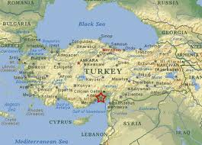
Region
Map
Notes:
Map of Ancient Turkey

Slide 7
Cultural Diffusion Defined
Diffusion – The spatial spreading or dissemination of a culture element (such as a technological innovation) or some other phenomenon ( e.g., a disease outbreak). For the various channels of outward geographic spread from a source area, see contagious, expansion, hierarchical, and relocation diffusion.
Notes:
Diffusion – The spatial spreading or dissemination of a culture element (such as a technological innovation) or some other phenomenon ( e.g., a disease outbreak). For the various channels of outward geographic spread from a source area, see contagious, expansion, hierarchical, and relocation diffusion.

Slide 8
Diffusion of the Shish Kebab
The Shish Kebab was carried throughout the Middle East, Asia, and Europe. Arabian cultures have a similar food, spelled shish kabab, and the traditional preparations of spiced meats roasted on skewers is found as far away as Japan and China to the East and the United States to the West.
An alternative version of the shish kebab, the Doner Kebab, uses ground lamb and other meats roasted on a vertical skewer. This meat is served on pita bread, and this method is also known in Greece and other regions as the gyro
Notes:
The Shish Kebab was carried throughout the Middle East, Asia, and Europe. Arabian cultures have a similar food, spelled shish kabab, and the traditional preparations of spiced meats roasted on skewers is found as far away as Japan and China to the East and the United States to the West.
An alternative version of the shish kebab, the Doner Kebab, uses ground lamb and other meats roasted on a vertical skewer. This meat is served on pita bread, and this method is also known in Greece and other regions as the gyro

Slide 9
Cultural Landscape Defined
Cultural Landscape – The forms and artifacts placed on the natural landscape by the activities of various human occupants. By this progressive imprinting of the human presence, the physical (natural) landscape is modified into the cultural landscape, forming an interaction unity between the two.
Notes:
Cultural Landscape – The forms and artifacts placed on the natural landscape by the activities of various human occupants. By this progressive imprinting of the human presence, the physical (natural) landscape is modified into the cultural landscape, forming an interaction unity between the two.

Slide 10
Cultural Landscape
Restaurants throughout the U.S. and the world serve shish kebabs and other traditional Turkish foods.
The Doner Kebab is a popular fast food item around the world, and is offered with regional variations in preparation and presentation. The Greek version, the gyro, is a popular item in restaurants in the U.S.
Notes:
Restaurants throughout the U.S. and the world serve shish kebabs and other traditional Turkish foods.
The Doner Kebab is a popular fast food item around the world, and is offered with regional variations in preparation and presentation. The Greek version, the gyro, is a popular item in restaurants in the U.S.

Slide 11
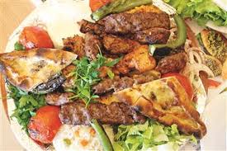
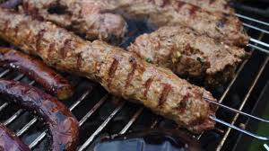
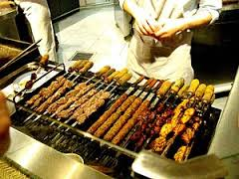
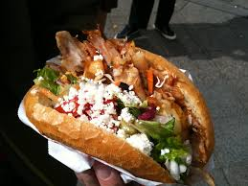
Cultural Landscape
Notes:
These are some of the variations on the shish kebab in terms or preparation and presentation

Slide 12
Distance Decay Defined
Distance Decay - The various degenerative effects of distance on human spatial structures and interactions.
Notes:
Distance Decay - The various degenerative effects of distance on human spatial structures and interactions.

Slide 13
Distance Decay
Although Shish Kebab and other Turkish foods are found around the world, they have not been assimilated into other cultures in the same way that some foods have.
Kebabs are still strongly associated with their regional backgrounds, and in the U.S. they are most often served in restaurants that offer Turkish, Middle Eastern or Greek dishes.
Notes:
Although Shish Kebab and other Turkish foods are found around the world, they have not been assimilated into other cultures in the same way that some foods have.
Kebabs are still strongly associated with their regional backgrounds, and in the U.S. they are most often served in restaurants that offer Turkish, Middle Eastern or Greek dishes.

Slide 14
Conclusion
Shish Kebabs have become a popular food around the world. They have maintained most aspects of their original form, though regional variations can be found in different countries. Turkish restaurants around the world serve traditional shish kebabs along with other traditional offerings, and the influence of this Turkish staple is seen in foods ranging from Greece to East Asia to the United States.
Notes:
Shish Kebabs have become a popular food around the world. They have maintained most aspects of their original form, though regional variations can be found in different countries. Turkish restaurants around the world serve traditional shish kebabs along with other traditional offerings, and the influence of this Turkish staple is seen in foods ranging from Greece to East Asia to the United States.

Slide 15
References
Cliffordawright.com. 2014. Did You Know: Food History - On Shish Kebabs. [online] Available at: http://www.cliffordawright.com/caw/food/entries/display.php/topic_id/7/id/7/ [Accessed: 30 Jan 2014].
Encrypted-tbn1.gstatic.com. 2014. Map of Ancient Turkey. [online] Available at: https://encrypted-tbn1.gstatic.com/images?q=tbn:ANd9GcSyQYoYm1MOQhvkPn7YhL5rVGUzlU56S__zPzr-8zaHMi0Y8bDi6g [Accessed: 30 Jan 2014].
Encrypted-tbn2.gstatic.com. 2014. [online] Available at: https://encrypted-tbn2.gstatic.com/images?q=tbn:ANd9GcRRoBx6Vg1IBUlpn9GaGIQJpfyE39PJE4mBb2UxVjyHVoWDLWEJGA [Accessed: 30 Jan 2014].
Geraniumhomes.com. 2014. [online] Available at: http://www.geraniumhomes.com/blog/wp-content/uploads/2013/06/Shish-Kebab.jpg [Accessed: 30 Jan 2014].
Turkishfoodandrecipes.com. 2014. History of Shish Kebab. [online] Available at: http://www.turkishfoodandrecipes.com/2008/11/history-of-shish-kebab.html [Accessed: 30 Jan 2014].
Yelp.com. 2014. The Kebab Shop. [online] Available at: http://www.yelp.com/biz/the-kebab-shop-san-diego [Accessed: 30 Jan 2014].

