Slide 1
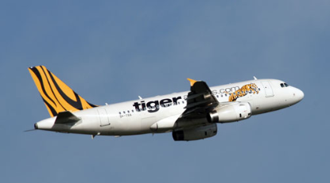
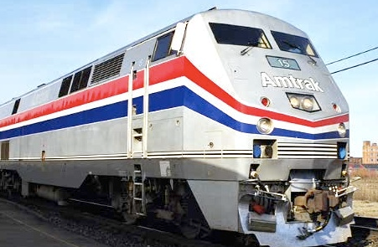
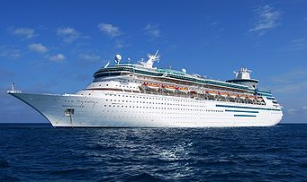
Travel Policy
Faster Inc. Travel
Notes:
This is the title page

Slide 2
Faster Inc. Travel Policy
Guidelines for employees incurring travel expenses whilst on Company business
The documentation required for accounting, audit and travel purposes
Enables the Company to maximize discounts and preferential rates to reduce expense costs
Notes:
Purpose:
To provide guidelines and establish procedures for employees incurring business travel and entertainment expenses on the company’s behalf. To ensure that all employees have a clear and consistent understanding of policies and procedures for business travel and entertainment. To provide documentation for internal and external audit purpose. To maximize the company’s ability to negotiate discounted rates with preferred suppliers and reduce travel expenses.
Coverage:
This travel policy applies to all employees of Faster Inc. who travel on approved company business.

Slide 3
Responsibility & Compliance
Traveler must comply with Company policy
All reasonable expenses will be reimbursed
Company does not assume responsibility for any expenses that contravenes the policy
VP Finance and VP have the right to question any expenses not falling within policy guidelines
All employees have a duty to familiarize themselves with the Company policy
Notes:
Responsibility and Enforcement:
The traveller is responsible for complying with the travel policy. The approver is responsible for accurately reviewing expense reports for compliance.
The company will reimburse employees for all reasonable and necessary expenses, as outlined within this policy, while traveling on authorized company business.
The company assumes no obligation to reimburse employees for expenses that are not in compliance with this policy.
The VP of Finance and the Vice President have the right to question any/all expenditures and are the final decision-makers for all the company business related expense approval.
Failure to read the travel policy does not prevent an employee from adhering to company policy as stated herein, nor obligate the company to pay for unapproved expenses or expenses not covered within policy.

Slide 4
Travel Authorization
Domestic airline travel over $500 requires VP approval
International travel requires advance VP approval
Other policies include:
Airline class of service
Upgrades on domestic and international air travel
Hotel Spending guidelines
Car and rental car guidelines
Phone and internet guidelines
Personal Expenses
Notes:
Obtaining Travel Authorization:
All domestic airline travel over $500.00 needs approval by the Vice President.
All international travel must be approved in advance by the Vice President.
Airline Class of Service:
All Domestic air travel must be in coach class. Employees are expected to use the lowest logical airfare available.
Upgrades for Domestic Air Travel:
Upgrades at the expense of the company are not permitted. Upgrades are allowed at the traveller's personal expense.
Upgrades for International Air Travel:
Upgrades at the expense of the company are not permitted. Upgrades are allowed at the traveller's personal expense.
Hotel Spending Guidelines:
Hotel rooms not to exceed $130.00, with the exception of high cost cities such as Los Angeles, Boston, New York, etc.
Travellers are expected to use negotiated or preferred rates whenever possible. Travellers will be reimbursed for actual and reasonable hotel room costs. All costs for lodging must be documented on a detailed invoice.
Company Car Usage Guidelines:
Company car will be used for customer visits of 350 miles one way or less. Any sales trips exceeding 350 miles are eligible for commercial flights. Employee spouses and children 25 years or older are eligible to drive the Faster Inc. company car assuming they have a valid operator’s license.
Monthly Car wash expense not to exceed $20.
Rental Car Guidelines:
Rental car – mid size unless traveling with large group.
Cellular Phone Reimbursement:
Monthly Cell Phone reimbursement not to exceed $200.00 unless traveling abroad.
Original copy of the cell phone bill needs to be attached to the expense report form.
Home Phone & Internet:
Monthly Home phone and internet not to exceed $125.00 combined. Original copies of both bills needs to be attached to the expense report forms.

Slide 5
Entertaining Expenses
Personal Meals Expenses
Breakfast $11
Lunch $18
Dinner $30
Business Meals
Based upon actual and reasonable costs
Entertaining Clients
Must follow IRS guidelines as allowable marketing expenses. Must be accompanied by receipts to be reimbursed. Unauthorized charges on company credit cards will be deducted from pay checks
Notes:
Personal Meal Expenses:
Personal meals are defined as meal expense incurred by the traveller when dining alone on an out-of-town, overnight business trip.
Travelers will be reimbursed for personal meal expenses on a per diem basis which consist of the following maximums.
Breakfast $11.00
Lunch $18.00
Dinner $30.00
Reimbursement for breakfast will be made when the scheduled departure time of a commercial carrier is prior to 8:00 am. Reimbursement for dinner will be made only when the scheduled return of a commercial carrier is after 7:00 pm.
A proportionate amount will be paid for less than a full day’s travel.
No reimbursement for meals will be made if provided by any other source.
Business Meal Expenses:
Business meals are taken with clients, prospects or associates during which a specific business discussion takes place.
Employees will be reimbursed for business meal expenses according to actual and reasonable cost.

Slide 6
Documentation Requirements
Expense reports submitted in inked, signed and dated by the employee
Specific details – Includes name of individuals, title, company name, location of event, purpose and amount of event
Specific business topic discussed
All copies of air/rail vouchers with expense claim
Hotel bills & credit card receipts
Car Rental agreements
Miscellaneous billing receipts e.g. car parking
Notes:
Documentation Requirements:
Expense reports must be completed in ink, and must be signed and dated by the employee.
Travellers must provide the following information in order to be reimbursed for expenditures:
Name of individuals present, their titles and company name
Name and location of where the meal or event took place
Exact amount and date of the expense
Specific business topic discussed
Travellers must submit the following documentation along with their expense report form:
Air/Rail-original passenger coupon plus invoice/itinerary
Hotel-hotel folio plus original credit card receipt or other proof of payment
Car Rental-Rental car agreement plus original credit card receipt or other proof of payment
Meals/Entertainment-original credit card receipt or cash register receipt (restaurant tear tabs are not acceptable receipts)
Receipts for all miscellaneous expenses

Slide 7
Reimbursement of Expenses
Completed and submitted weekly
Approved expenses sent to employees weekly
Properly documented expenses paid out the week of submission
Incorrect submissions will be returned for correction and may be delayed
Ensure the appropriate level of signed authorization accompanies all expense claims
Notes:
Reimbursement of Expenses:
Expense reports are to be completed and submitted weekly. Any expense report submitted outside of 3 weeks of occurrence will not be processed.
Reimbursement for approved expenses will be sent to employees weekly. Properly documented expense reports will be paid the week they are submitted.
Incorrect or incomplete expense reports will be returned and may result in delay or non-reimbursement of specific items.

Slide 8
Question and Answers
Notes:
Open Forum
Please ask questions and we will clarify any policy matters.

