Slide 1
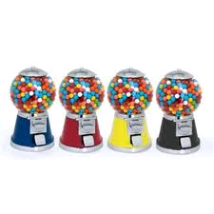
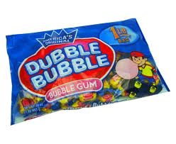
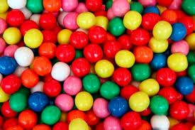
Bubblegum Consumption
Context, Consumption, Cosmetics, Cravings, and Consumerism
Notes:
SLIDE #1: Title Slide
Bubblegum Consumption: Context, Consumption, Cosmetics, Cravings and Consumerism

Slide 2
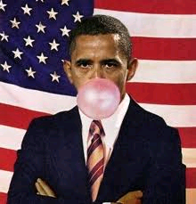
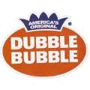
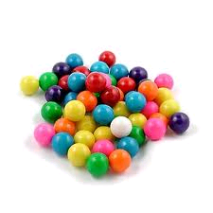
Contextual History
Walter Diemer, 1928
Philadelphia Pennsylvania
Fleer Chewing Company
Notes:
SLIDE 2: Contextual History
Walter Diemer, 1928 – Walter Diemer worked at Fleer Chewing Gum Company in Philadelphia, Pennsylvania (IdeaFinder.com, 2008).
As a side interest, Diemer toyed with new recipes for chewing gum. When he came across a blend that was less sticky and more stretchy than regular chewing gum. When he began to sell this new formula, the newer chewing gum was a tremendous success.

Slide 3
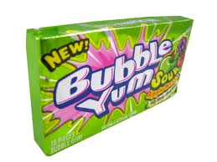
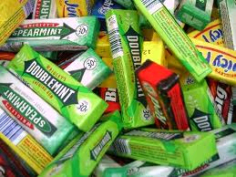
Consumer Preferences
#1 Brand of Bubblegum in America: Bubble-Yum
#1 Brand of Chewing Gum in America: Wrigley’s
Notes:
SLIDE #3: Consumer Preferences
Bubble Yum is the most popular brand of bubblegum in the United States. It is marketed by Hershey.
Wrigley’s Gum is the highest selling brand of chewing gum in the United States.

Slide 4
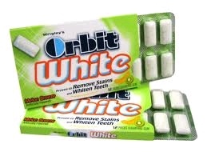
Cosmetic Appeal
Sex Appeal
-Doublemint Twins
Teeth-Whitening
Notes:
SLIDE #4: Cosmetic Appeal
Sex Appeal – Sex appeal was the new marketing stratagem of the Doublemint gum brand (stanford.edu, 2007). By showing two beautiful, provocative twin women enjoying the doublemint, the commercials sought male interest in the product.
Teeth-Whitening – Teeth Whitening has become a new fad. And along with the fad, gum has popularized the use of whitening formulas in its campaign toward gaining new consumers.

Slide 5
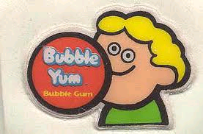
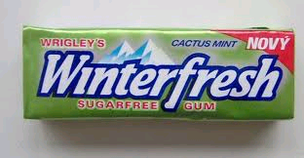
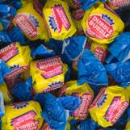
Cravings and Possible Addition
There is a lot of debate over the subject of addiction and bubblegum
Notes:
SLIDE #5: Cravings and Possible Addiction
There is a lot of debate over the subject of addiction and bubblegum. According to the Article “Am I Addicted to Sugar-Free Gum” (2008), it is unlikely that an addiction to gum can manifest even after years of consumption.
Rather, the addiction can be the feel of having something in your mouth or the dependence on its sweet taste. The actual ingredients of gum are all non habit-forming. Addictive properties have been noted in sugar itself, but more testing needs to be done.

Slide 6
References
Katz, David L. “Am I Addicted to Sugar-Free Gum?”. (2008). Retrieved on October 8, 2010 from Oprah.com: http://www.oprah.com/omagazine/Sugar-Free-Gum-Addiction-Health-Advice
“Bubble Gum At a Glance”. (2008). Retrieved on October 8, 2010 from IdeaFinder.com: http://www.ideafinder.com/history/inventions/bubblegum.htm
Wallace, William. “Gum”. (2007). Retrieved on October 8, 2010 from Stanford.edu: http://www.stanford.edu/group/ccr/blog/ads_and_advocacy_class/
Notes:
SLIDE #6: References
**Katz, David L. “Am I Addicted to Sugar-Free Gum?”. (2008). Retrieved on October 8, 2010 from Oprah.com: http://www.oprah.com/omagazine/Sugar-Free-Gum-Addiction-Health-Advice
**“Bubble Gum At a Glance”. (2008). Retrieved on October 8, 2010 from IdeaFinder.com: http://www.ideafinder.com/history/inventions/bubblegum.htm
** Wallace, William. “Gum”. (2007). Retrieved on October 8, 2010 from Stanford.edu: http://www.stanford.edu/group/ccr/blog/ads_and_advocacy_class/

