Slide 1
ITCO103-1002B-01 Introduction to Computer and Network Hardware Unit 5
Network integration

Slide 2
Watch Network Components
162 Workstations
2 Data bases (SQL Server, Oracle)
AS 400
DLT Drives
Linux Print Server
Apache Web Server
Linux DNS Server
Domain controller

Slide 3
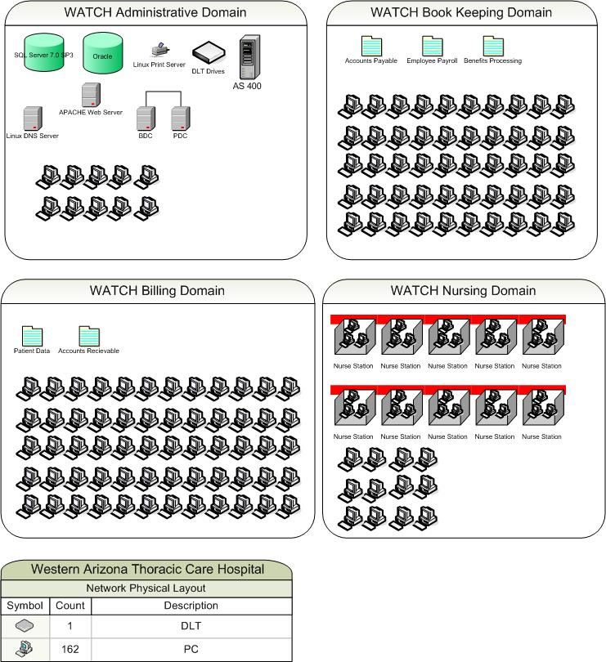
Watch Network Layout

Slide 4
SHG Network Components
Database
Windows 2003 Server
Active Directory

Slide 5
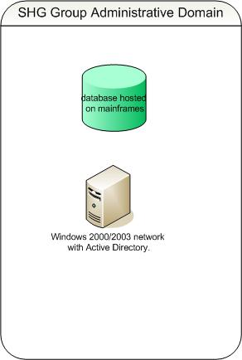
SHG Group Network Layout

Slide 6
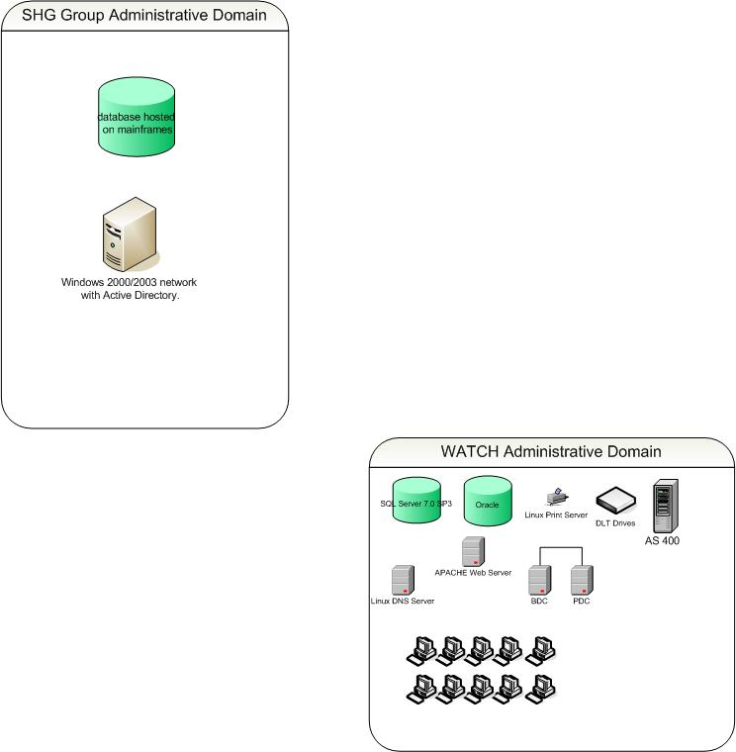
Integration of Administrative Domains

Slide 7
Step 1
Updating the NT Domain
Updating Windows NT PDC to Windows Server 2000 / 2003

Slide 8
Step 2
Protocol Used for Synchronization
LDAP (Light Weight Directory Access Protocol)
Wikipedia describes its present usages as :
“LDAP deployments today tend to use Domain Name System(DNS) names for structuring the topmost levels of the hierarchy. Deeper inside the directory might appear entries representing people, organizational units, printers, documents, groups of people or anything else that represents a given tree entry (or multiple entries).”

Slide 9
Step 3
Creating VPN Tunnel
The VPN Server will be installed at the SGH site.
The VPN client will be installed on the WATCH site.

Slide 10
Step 4
Configuring DNS
In order to forward the traffic to the SGH site, DNS server will be added to the VPN tunnel configuration for resolving request from both the networks.

Slide 11
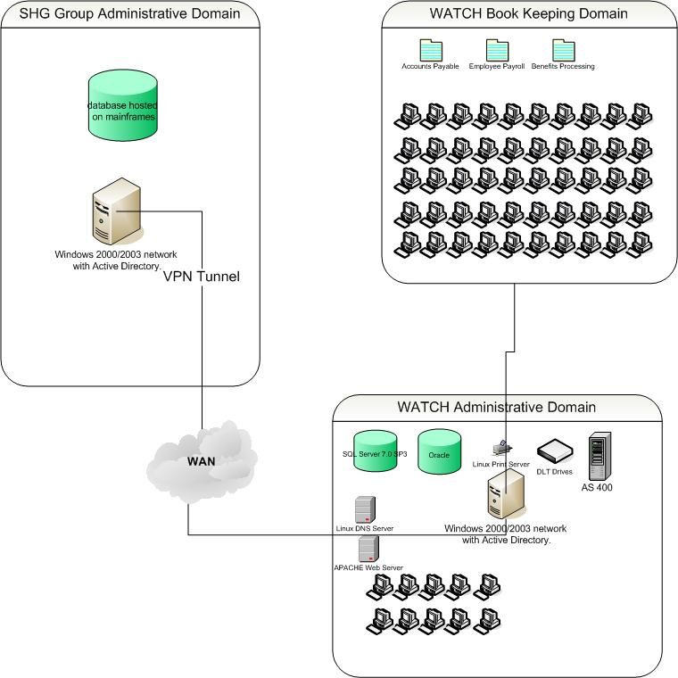
VPN Tunnel Layout

Slide 12
Configuring VPN Tunnel
How to Configure VPN Tunnel
What Network information required for configuration
Active directory Configuration
NTP Setup

Slide 13
How to Configure VPN Tunnel
Configure the address range in the same subnet
OR
Configure the address range with different subnet

Slide 14
Configuring VPN with the same subnet
Configuration of SSL312 IP Address
Configuration of Gateway IP Address
Configuration of DNS

Slide 15
Configuration Of Active Directory
Configuration of NTP (Network Time Protocol)
Active Directory operates on “Kerebos” protocol for authenticating users on the domain
To make “Kerebos” operational, the actual time between the Server and the client must be 10 minutes less.

Slide 16
Conclusion
By updating the domain controller, it is synchronized with the forest of the SHG Group.
No impact on the Web based services.
WATCH Domain Controller can be controlled and monitored by the SHG Group.

Slide 17
References
Sasl/external, Using The. "LDAP." Wikipedia, the Free Encyclopedia. Web. 26 May 2010. <http://en.wikipedia.org/wiki/LDAP>

