Slide 1
Criminal Justice
The history of US Prisons
Notes:
Title Page

Slide 2
COLONIAL AMERICA
Jails were first public structures built in colonial America
Mainly used for emigrants as part of bondage system
Originally stone and brick built
Puritans used jails for Quaker heretics
Described by Nathaniel Hawthorne in “The Scarlet Letter” (1850)
Notes:
Jails were first public structures built in colonial America
Mainly used for emigrants as part of bondage system
Originally stone and brick built
Puritans used jails for Quaker heretics
Described by Nathaniel Hawthorne in “The Scarlet Letter” (1850)

Slide 3
18th Century : Enlightenment
Criticism of American prison trade increased
American colonists agreed to end convict transport
This was a time of civil unrest
The period led to the American revolution
Notes:
Criticism of American prison trade increased
American colonists agreed to end convict transport
This was a time of civil unrest
The period led to the American revolution

Slide 4
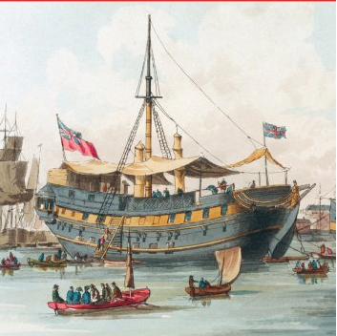
The American Revolution
The British and Rebels held large numbers of captured soldiers in make shift prisons
New York city was converted to a prison camp by the British; they held thousands of rebel prisoners
Britain used antiquated ships as prisons. 11,500 died on HMS Jersey alone
The war ended convict transport to America
Notes:
The British and Rebels held large numbers of captured soldiers in make shift prisons
New York city was converted to a prison camp by the British; they held thousands of rebel prisoners
Britain used antiquated ships as prisons. 11,500 died on HMS Jersey alone
The war ended convict transport to America

Slide 5
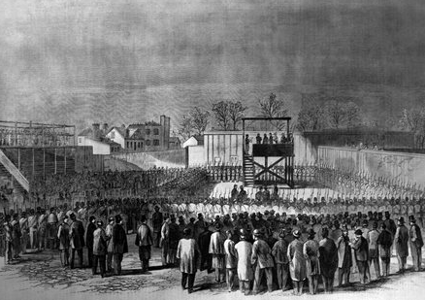
The Civil War and Aftermath
North held over 220,000 confederate prisoners
South held over 126,000 unionist prisoners
30,212 killed in confederate prisons
26,774 killed in union prisons
After the war 4 million slaves had been freed from bondage

Slide 6
The Great depression
1930’s witnessed greater use of prisons
From 1925-39 incarceration = 132/100,000 residents
Black prisoners 3 X that of whites
1930’s heralded 100 years of American penal systems
The 2nd world war saw a decline in prisoners
Notes:
1930’s witnessed greater use of prisons
From 1925-39 incarceration = 132/100,000 residents
Black prisoners 3 X that of whites
1930’s heralded 100 years of American penal systems
The 2nd world war saw a decline in prisoners

Slide 7
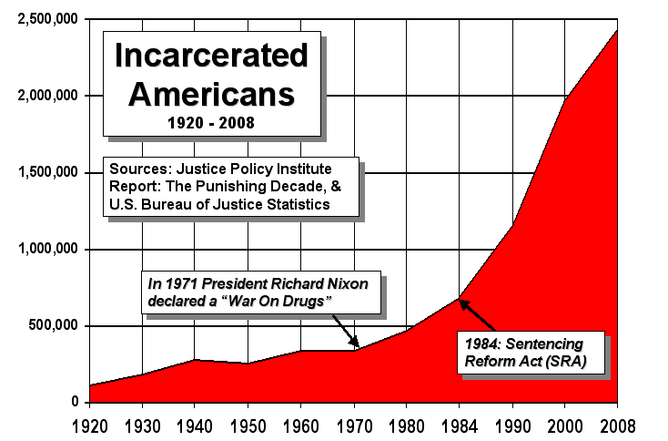

Slide 8
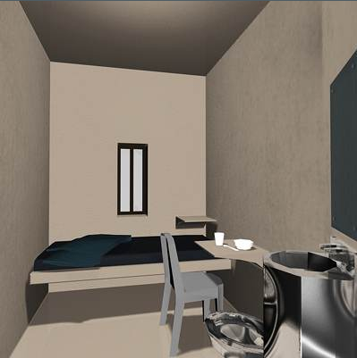
1960’s and 1970’s
Prisoner incarceration stable till 1974
1972 : 162/100,000 residents
1984 : 318/100,000 residents
1995 : 600/100,000 residents
Most inmates on drug related offences
7 blacks to 1 white ration in prison
Notes:
Prisoner incarceration stable till 1974
1972 : 162/100,000 residents
1984 : 318/100,000 residents
1995 : 600/100,000 residents
Most inmates on drug related offences
7 blacks to 1 white ration in prison

Slide 9
REFERENCES
Prisons: History, early jails and workhouses
Scott Christenson, 2010
http://law.jrank.org/pages/1786/Prisons-History.html

