Slide 1
5 Megatrends in Fashion
China will influence the casual wear industry
Increased use of bolder colors in casual wear
China leading the front of mainstream fashion with a revival in a variety of Chinese cultural forms
Designs are likely to become much more futuristic in concept reflecting the high tech age we live in
Multiculturalism (globalization) will see a revival of cultural influences on fashion and design. For example in Mexico it may be influenced by bold Aztec images and designs
Notes:
The trends in fashion over the next 10 years will be influenced by the emerging global markets of Asia i.e. India, China, S.E. Asia as they start to be more influential in the textile commodities market. The Designers of Europe will continue to direct and influence fashion trends around the fabrics and materials produced in the far east. It is the concept of globalization that will make fashion more adventurous as it embraces cultural concepts from around the world. There will be a tendency towards more flamboyant colours as the younger people in China strive towards more self espressionism. We are already witnessing this in Japan and other parts of South East Asia. Futuristic concepts refer to more adventurous designs that will reflect the age that we live in i.e. the age of technology, the internet and space exploration. There will be a move towards more relaxed casual wear away from the trend of power dressing for the office. See the google office concept as an example.

Slide 2
Megatrends in Fashion
The Next Ten years

Slide 3
Lifestyle changes & Fashion Industry
The move will be away from more formal clothing to that of leisurewear and relaxing informal clothing
Power dressing in the Offices may be replaced by the more collaborative style as adopted by Google
Quality may become a thing of the past – the move towards more affordable, cheaper, short lived disposable clothing that can be recycled
The Fashion industry is likely to become more eco friendly and adopt “greener” products and marketing policies
Asia will remain a dominant force in the textiles and fashion market influencing the shopping malls and main retail clothing stores
We will have more leisure time devoted to sports and this will influence fashion wear

Slide 4
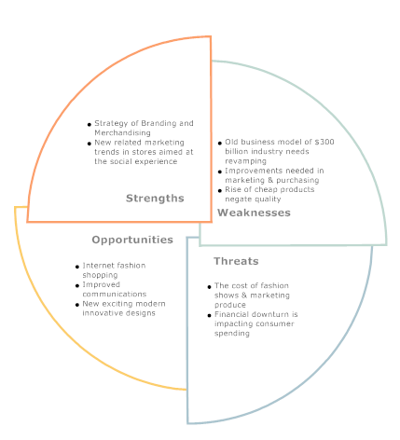
SWOT of Current Business Practices

Slide 5
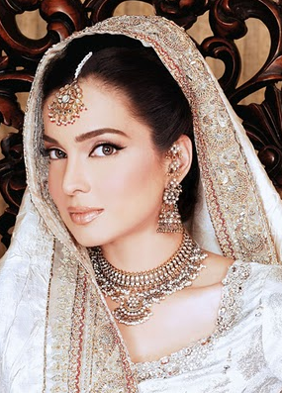
Trends over the next 10 years
Increased concepts of globalization and cultural integration will influence fashion trends and design
Technological advancements will move to more m-commerce opportunities for online purchasing
People still like the Malls but this will become more a social event building in meetings, parties, etc.
Designs will become much more futuristic with a leaning towards casual wear
Clothes will adopt new materials and the emphasis is likely to move from quality to disposable short lived goods
Lifestyles will move more towards work / life balanced lifestyles and people will have longer working lives. The move towards less formality in our lives

Slide 6
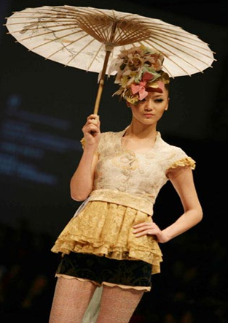
Predicted Fashion future for apparel industry
Future apparel styles would emphasize individuality, comfort, casualness, unisex, and ethnicity.
Design and product development processes would be heavily dependent on digital technology; as a result, the role of technical design would grow in importance.
China is expected to become the “supplier of choice” for most U.S.importers (the large apparel companies and retailers) because of its ability to make almost any type of textile and apparel product at any quality level at a competitive price

Slide 7
Fashion Future Scenario - Apparel
Futuristic Designs
Casual
Wear
Increased Innovation
Ten Year Prediction
Increased online distribution
Cheaper, short life & disposable
Asian Influenced
Notes:
Increased online distribution refers to clothing designs being linked to stores and being able to order directly online. This concept already applies now but the technology is likely to improve the way this is handled. For example : You may be able to design your own clothes online through graphics and use of artificial intelligence software. This could then be passed direct to a manufacturer and forwarded directly to your address.

Slide 8
REFERENCES

Slide 9
REFERENCES
Works Cited
Fashion Products. Fashion Apparel Industry Overview » Industry Overview. 2010. 1 11 2010 <http://www.fashionproducts.com/fashion-apparel-overview.html>.
Ming, Ming. The development trend of China's casual garment industry analysis in the next decade . 29 4 2010. 1 11 2010 <http://www.goarticles.com/cgi-bin/showa.cgi?C=2839380>.
MOORE, BOOTH. The fashion industry's old business model is out of style. 13 9 2009. 1 11 2010 <http://articles.latimes.com/2009/sep/13/entertainment/et-future-fashion13>.
Schwartz, Ariel. What Will the Fashion Industry Look Like in 2025? . 24 2 2010. 1 11 2010 <http://www.fastcompany.com/1561484/what-will-the-fashion-industry-look-like-in-2025>.

