Slide 1
Fast food consumption by teens who otherwise choose healthy diets
Your Name MGT600-0801A-01 Professor Name

Slide 2
Abstract
Fast food is a significant part of teen diets
Quick
Socially popular
Tastes good
Convenient
Notes:
Fast food is a significant part of many teen diets. For many high school teens, fast food is convenient, quick, and appealing. There is also a social component to fast food lunches in high school. Teens tend to hang out with their friends during the lunch break. If a teen’s friends visit a taco shop over lunch, that teen is likely to join in the food choices of his peers as well as in the fellowship. According to Boyles (2004), teens who regularly eat at fast food restaurants tend to become overeaters and develop obesity and other physiological problems at higher rates than those who do not.

Slide 3
Introduction
Healthy Eaters
Convenience & Peer Pressure
Healthy Eaters Fast Food Junkies
Notes:
This study was designed to see if teens who made healthy food choices as a general rule were less likely to partake of fast food fare than those who opted for a less healthy eating routine. The question relates to the power of convenience and social pressure to make otherwise healthy eaters choose fast food options.

Slide 4
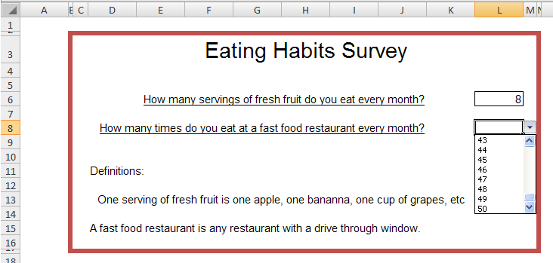
Surveys, Assessment Tools, & Instruments
Notes:
For this study, a simple survey was used. The survey was created in Excel and contained two questions. How many servings of fresh fruits do you eat every month? How many times to you eat at a fast food restaurant every month? Definitions for “servings of fresh fruit” and “fast food restaurant” were provided. Each question was answered with a numerical value. To eliminate formatting inconsistencies in answers, both answers used a drop down list with ranges of 1 to 50.

Slide 5
Hypothesis & Variables
Hypothesis
Male high school seniors who eat fresh fruit every day are less likely to eat in fast food restaurants than those who eat less than 5 servings of fresh fruit per month.
Variables
Fruit consumption
Fast food consumption
Notes:
Fruit consumption was selected as the variable to represent a tendency toward health eating choices. According to the Health News Digest (HND, 2010), children entering the teen years tend to dramatically reduce their consumption of fruits and vegetables. Given this fact, one could surmise that teens who do eat fruit on a daily basis are more inclined to choose a more healthy dies than those who do not. Both the subject and control groups were limited to male high school seniors. This specificity limited the potential corruption of study data by eliminating extraneous variables such as gender or age.

Slide 6
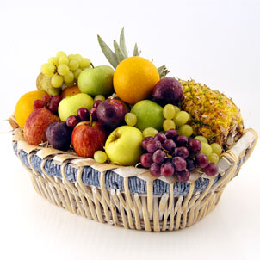
Methodology
Fruit Eaters
Non Fruit Eaters
Notes:
Study participants were selected by asking potential subjects how many servings of fresh fruit they ate per month. Male seniors who are at least 30 were put in the sample group. Respondents who ate less than 5 servings per month were put into the control group. No mention of fast food was made during the initial assignment of participants

Slide 7
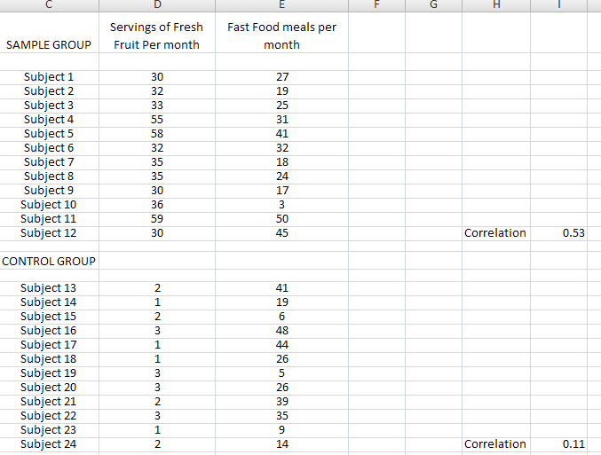
Notional Data & Sample
Notes:
Each person in the study was assigned a subject number. Using an online random number generator, I generated 12 numbers for the sample group between 30 and 60 for fruit servings then a set of random numbers between 1 and 50 for the quantity of fast food meals consumed. For the control group I ran random numbers between 1 and 4 for fruit and a set between 1 and 50 for fast food. Using the correlation function in Excel, I found the comparative relationship between fruit eaters and fast food consumption and non fruit eaters and their fast food habits.

Slide 8
Results
Fruit Eaters eat more Fast Food than Non Fruit Eaters
Correlation method used
Two known variables
T-Test not used
No random variables
Graphical method not used
There are no linear variables
Notes:
The correlation method was used for this study. This method was selected because there are only two variables and both are known. The study was intended to examine the relationship between the two known variables.

Slide 9
Accepted/Rejected Hypothesis & Why
The hypothesis is rejected.
According to the data (generated by the random number generator), the average fruit eater ate at fast food restaurants 27.66 times per month, whereas the non fruit eaters only ate fast food 26 times per month.
Notes:
According to the data created by the random number generator, the fruit eaters were NOT less likely to eat at fast food restaurants than non fruit eaters. The correlation difference between the two groups was .42. While this difference is minimal, it is significant enough to reject the null hypothesis.

Slide 10
Implications & Contribution to Scholarly Literature
Implications are unclear.
More research is needed
Notes:
The implications of this study may or may not be significant. Was variable #1 (the consumption of fresh fruit) an appropriate variable to reflect an overall tendency to select healthy foods? If it was a good variable to use, then the results of the study would tend to indicate that convenience, peer pressure or other factors tend to influence teens who might otherwise choose healthier meals than fast food. If however the regular consumption of fruit was not a good indicator for the tendency to eat right, then the entire study would have been based on a false presumption. The validity of this study could be reinforced by another study of the same participants. This study would correlate the relationship between fruit eating and the non-fast food dietary habits of the subjects. If this subsequent study found that teens who eat fruit and had healthy diets overall actually do succumb to external factors regarding fast food. In this case, the regular consumption of fruit would have been a good variable and the first study valid.

Slide 11
Conclusion
Scientific validity of research studies is dependent on:
Proper methodology
Proper variables
Notes:
Selecting the right variables is important in research. It is otherwise east to skew results in a certain direction. For example, a TV commercial might claim that 4 out of 5 doctors recommend a certain product. This “result” is questionable. How many doctors were surveyed? (5, 50, 500, 50,000) What kind of doctors were they? (Medical doctors, PhD doctors). The core concept for this study was valid. If the statistical result was significant in favor of supporting the hypothesis, these results might be satisfactory. In that the hypothesis was rejected, the researcher might consider a second study to confirm the validity of the first.

Slide 12
Reference List
(Boyles S 200406 Fast food leads teens to overeat)Boyles, S. (2004, June). Fast food leads teens to overeat. Retrieved from http://www.webmd.com/parenting/news/20040615/fast-food-leads-teens-to-overeat
(HND 20101023 Fruit and vegetable consumption on the rise in young children but down in teens)HND. (2010, October 23). Fruit and vegetable consumption on the rise in young children but down in teens. Retrieved from http://www.healthnewsdigest.com/news/Food_and_Nutrition_690/Fruit_and_Vegetable_Consumption_on_the_Rise_in_Young_Children_but_Down_in_Teens_printer.shtml

