Slide 1
My Dream Vacation
Eastern Caribbean Cruise
Deborah Farrell

Slide 2
Itinerary
Travel: From Greenville, SC – plan and shuttle car to Port Canaveral, FL, via Orlando
7-Day Cruise along Eastern Caribbean – Royal Caribbean Owner’s Suite
Destinations include Cococay, Bahamas; Charlotte Amalie, St. Thomas; and Philipsburg, St. Maarten

Slide 3
Attractions
Destinations include:
Shopping
Activities (such as kayaking)
Cultural Buildings
Cruise Ship Activities:
Dining
Sports
Spa/Luxury
Casino and other events

Slide 4
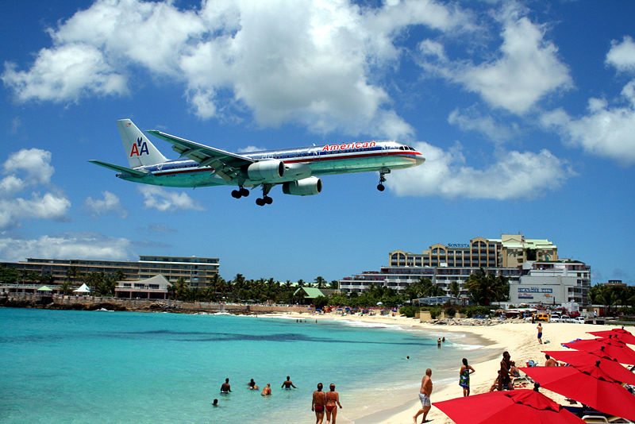
Destination Highlights
Aircraft views in Philipsburg
Shopping district in Charlotte Amalie
Water activities in Cococay
Other sights on and off the cruise ship in the Caribbean

Slide 5
Budget

