Slide 1
Summarizing the Professional School Counselor
A Presentation
Student Name
School Name

Slide 2

Ethics in School Counseling
There are several ethical situations that affect professional school psychologists, and counselors.
In the realm of fostering open communication with student-parent-school superiors.
According to Welfel (2012) the issues are:
Conflict between open communication and confidentiality with the profession
Obligation to assist students through several social and personal issues
Responsibility to the schools in their several issues
Conflict of Federal and state laws
Obligation to informing the school on serious student issues
Ethical Challenges (peer, group counseling, and minors)

Slide 3

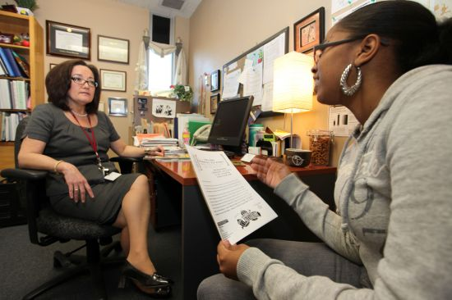
Role in Open Communication
The roles of School Counselors are different in the academic setting.
Client communications are confidential and disclosure is limited to the parent/client privilege, and the permission acting in the best interest of the student.
School staff and principals must be aware of the requirements and ethical standards of disclosure to avoid inferences of counselors not being team players, or withholding information.
School counselors are caught between building a collaborative atmosphere with the teachers and parents, and their obligations to the protect the interest of the students.
In certain situations there are ethical dilemmas that Counselor’s standards must be called in.

Slide 4
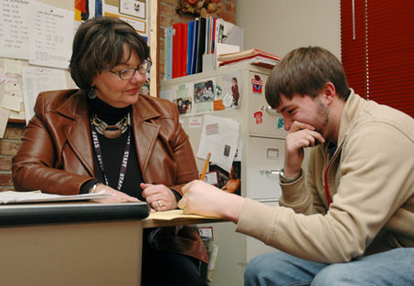
Reggie’s Case
Reggie a 5th grader that has social disengaged from his class and friends.
Found out his mother did drugs when she was pregnant with him, and she has been newly diagnosed with HIV.
The counselor is obligated to adhere to the request of Reggie and his mother to not disclose this information to school officials.
The principal is prodding the counselor for information, but legal and ethical standards require the counselor to fulfil the requests of the parent/student.
In this situation the counselor must communicate with the teachers and principal that there is certain information that cannot be disclosed, however communicate with them that a family member is suffering from a chronic disease in order to find a productive solution.
Communication of the ASCA Standards to the staff is pertinent in the counselor building a collaborative setting.
  Confidentiality
  Parents/Guardians and Confidentiality
  Sharing Information with other Professionals.

Slide 5

Gloria’s Case
Gloria is a high school student that is particularly shy student whose mother was killed during a bank robbery, and father that has potential psychological problems.
Teachers at lunch time are discussing the last episode of Gloria’s father coming to the school. The counselor sits to eat with the students, and they ask her opinion.
The counselor is caught between an ethical and legal crossroad, where the counselor ‘s professional obligation must supersede their human desire to discuss a situation where they have no ethical ties to.
According to the ASCA Ethical Standards for School Counselors, they have an obligation to the school;
  Support and protect student’s interest
  Knowledgeable and supportive of the school mission
  Promote the counselor’s role and meet the needs of those serviced.

Slide 6

School Policies and the Role of School Counselor
School counselors can be subpoena to show up in court if they violate the confidentiality of the student.
Schools needs to be aware of the laws in each state.
The ASCA identifies the mission of the counselors and their duty to be a fundamental part in the student’s social and personal development within their educational career.
  Responsibilities to the Cool
  Professionalism
  Responsibilities to Students
  Parent Rights and Responsibilities
Counselors must follow the policies in the schools and the legal ramifications in the state.

Slide 7

Within eat state there are several legal issues that school counselors must follow. The Family Educational Rights and Privacy Act (EFRPA) is statute that is still used today in all academic settings, and they used four major parts.
Federal Funding to Parental Access to School Records
Requires Parental Consent
Prohibits unauthorized people from viewing education records
U.S Secretary of Education has the power to create regulations that are relevant to student privacy
FERPA does not bock the confidentiality communications that counselors have, but does allow counselors to have separate records than school records.
The school must provide a clear policy on how to adhere to the legal issues in the state and school policies.
Legal Issues: State and Federal Statutes

Slide 8
References
Welfel, Elizabeth. (2012). Ethics in Counseling & Psychotherapy, 5th Edition. Cengage Learning. California.

