Slide 1
The Counterculture and Sixties Movements
Source: Hippie Designs (2010)

Slide 2
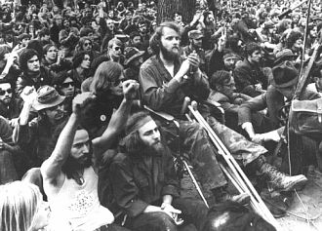
Source: Hippy.com
Music while indeed a source of contention during the 1960’s was certainly not the only source of contention among the Hippies and the Straights but as well the Vietnam War was a source of contention. Many young people protested the Vietnam War. Shown in the picture above is a group of individuals who protested in Washington, D.C. against the Vietnam War.

Slide 3
Sex, Drugs, and Rock-n-Roll
One source of contention during the 1960’s was the music of that time. Music was replete with references to drug use and illicit sex,, all of which challenged the societal standards of that time. The previous decade characterized by wholesomeness faded away into the psychedelic 1960’s which were years characterized by societal transformation.

Slide 4
The Woodstock Festival
One of the musicians of the 1960’s and one that performed at Woodstock was Jimi Hendrix shown in the photograph below.
Source: Gordon (2010)

Slide 5
Janis Joplin: A Statistic
An unfortunate statistic of the 1960’s counter culture was that of musician Janis Joplin who died in October 1970 due to a drug overdose. Joplin also performed at the Woodstock Festival however, her performance is reported to have been poor due to her use of drugs and alcohol.
Source: Gordon (2010)

Slide 6
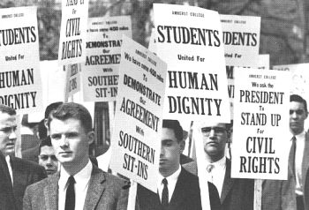
The Civil Rights Movement
No report of the 1960’s
would be complete
without a mention
of the Civil Rights
Movement.
This movement
is woven throughout the very
fabric of the history of that decade.
Source: Hippy.com

Slide 7
THE END

Slide 8
Sources: Hippie Designs (2010) TopPun.com. Online available at: http://www.toppun.com/Peace-Signs/Hippie-Designs-Products-Merchandise-Store-Shop.html Gordon, Keith A. (2010) Woodstock 1969 Revisited: Blues-rock artists that performed at the festival. About.com: Blues. Online available at: http://blues.about.com/od/bluesrockessentials/tp/Woodstock69.htm The Civil Rights Movement (2003) Hippy.com online available at: http://www.hippy.com/modules.php?name=News&file=article&sid=195 The Anti War Movement (2003) Hippy.com online available at: http://www.hippy.com/modules.php?name=News&file=article&sid=203 Elshaw, Gary ( 2000 ) The Depiction of the Late 1960’s Counter Culture in the 1968 Films of Jean-Luc Godard. Victoria University of Wellington, November 2000. Online available at: http://www.garyelshaw.com/jlg/Thesis.pdf A Trip Through the Sixties ( 2003 ) Hippy.com online available at: http://www.hippy.com/modules.php?name=News&file=article&sid=209

