Slide 1
BP OIL SPILL : Barack Obama’s Speech
Reported by the Daily Telegraph 16-6-2010
The Impact of the BP Oil Spill crisis in the Gulf of Mexico

Slide 2
The Presidents First Speech on the BP Oil Spill
Informs the nation on the status of the BP Oil Disaster
Examines the current impact to people, jobs, environment and costs
Defines the position of the Federal Government in terms of support, aid and assistance
Defines the expected responsibility of BP to the nation
The President defines his pledge and responsibility to the nation

Slide 3
The Early Facts
Oil is spilling out at 5000 barrels per day into the Gulf of Mexico
Spill is 100 miles long and 48 miles wide
Tragedy from BP Deep Horizon rig drilling over a mile below sea level represents difficult and hazardous conditions
It could take weeks or months to stop the leak and as such there will be environmental consequences
US Coast Guard is in charge of the operation

Slide 4
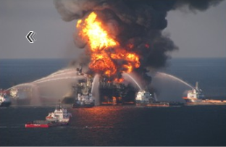
Pres. Obama : The Situation
The disaster is the result of our addiction to fossil fuels for our prime source of energy
This disaster is a reminder that the US needs to pursue safer, cleaner green energy policies
At the moment we spend $1billion per day to foreign countries for importation of oil
Today we find ourselves being menaced by a cloud of black crude

