Slide 1
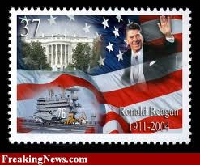
The Trends of the 1980s

Slide 2
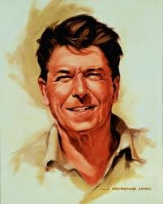
Economic Culture
Source: Manlyrash.com (2010)
The 1980’s witnessed the Presidency of Ronald Reagan. Known as ‘Reaganomics” the economic policy of President Ronald Reagan served to end the inflation of the 1970’s however the U.S. was burdened with high deficits and economic inequality on the increase.

Slide 3
Social Culture
The decade of the 1980’s witnessed American culture being defined by “a triumphant political and social conservatism.” (Encyclopedia.com, 2010)

Slide 4
The 1980’s social culture was characterized the Cold War, the wedding of Princess Diana and Prince Charles and mind-bending attempts at solving Rubik's Cube. The social ills were clearly affected by the Crack Cocaine use in minority neighborhoods and the disparate sentencing to prison of African American street dealers.

Slide 5
According to John Ehrman in the work entitled: “The Eighties: America in the Age of Reason” the decade of the 1980 was “above all a time of transition.” (2005)

Slide 6
Political Culture
The political culture of the 1980s was impacted by conservatism and the Cold War as well as the Iran Contra Affair.

Slide 7
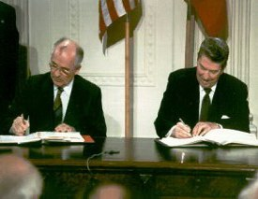
The End

Slide 8
References
"The 1980s: Lifestyles and Social Trends: Overview." American Decades. 2001. Retrieved September 30, 2010 from Encyclopedia.com: http://www.encyclopedia.com/doc/1G2-3468303113.html
John Ehrman. The Eighties: America in the Age of Reagan. New Haven: Yale University Press, 2005.

