Slide 1
A training model for risk mitigation
Lateral Violence in the clinical environment

Slide 2
Lateral Violence in the Clinical Setting
According to the Center for American Nurses (2008), the presence of lateral violence in healthcare organizations is extensive
The U.S. Federal Bureau of Labor and Statistics reports that nearly half of all nonfatal injuries in the workplace result from violent acts against co-workers in the healthcare sector, and in many if not most states, the healthcare sector ranks amongst the top five locations for incidents of workplace violence
The American Association of Occupational Health Nurses (AAOHN) definition of workplace violence “any action that may threaten the safety of an employee, impact the employee’s physical or psycho­logical well-being, or cause damage to company property”
Of those reporting, nurses, nurse’s aides and orderlies are predominantly the victims of those injuries

Slide 3
LV Training: Malpractice mitigation
Significant to nursing training is the legal malpractice issue of negligence and ‘a duty to a reasonable standard of care’ within U.S. Federal law
From the perspective of healthcare organizations, the standards of compliance and legal rule provisions for the management and conflict resolution of clinical care settings is unique
Due to structural position and intense levels of responsibility to patients in urgent or clinical care in practice settings, nurses are faced with multiple hazards that put them at risk for harm from urgent care to serious nursing shortages
Solutions to violence in healthcare organizations must come from a range of considerations that include both patient related risk and intentional negligence by colleagues

Slide 4
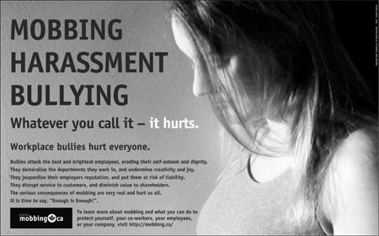
Nurses work together: Lateral Violence & Risk

Slide 5
References
American Nurses Association. (2001). Code of ethics for nurses with interpretive statements. Silver Spring, MD.: American Nurses Association.
Center for American Nurses. (2007). Bullying in the workplace: Reversing a culture. Silver Spring, MD: Center for American Nurses.
Cook, J. K., Green, M., & Topp, R. V. (2001). Exploring the impact of physician verbal abuse on perioperative nurses. AORN Journal, 74(3), 317-318, 320, 322-327, 329-330.
Dunn, H. (2003). Horizontal violence among nurses in the operating room. AORN Journal, 78(6), 977-980, 982, 984-988.
Gerardi, D. (2004). Using mediation techniques to manage conflict and create healthy work environments. AACN Clinical Issues: Advanced Practice in Acute & Critical Care, 15(2), 182-195.
Griffin, D. (2004). Teaching cognitive rehearsal as a shield for lateral violence: an intervention for newly licensed nurses. The Journal of Continuing Education in Nursing, 35(6), 257-263.
Sheridan – Leos, N. (2008). Understanding Lateral Violence in Nursing. Clinical Journal of Oncology Nursing, 12 (3), 399-403. DOI: 10.1188/08.CJON.399-403
Schwartz, M. E. (2010). Nurses Confront Violence on the Job . Retrieved from: http://www.youtube.com/watch?v=chkOM058U2E

