Slide 1
The Trickster
Ancient and Modern

Slide 2
The Trickster
Often associated with a god, goddess, man, woman, or animal that plays tricks and disobeys conventional behaviour
The Fox, Coyote are often depicted as tricksters of the animal world
The Clown, Jester, magician and illusionist are more modern figures

Slide 3
Capt Jack Sparrow
Pirates of the Caribbean Film, with Captain Jack Sparrow played by actor Johnny Depp.
Featured in Pirates of the Caribbean and the Curse of the Black Pearl
The pirate genre was a perfect cover to bring out the trickster character
A master of trickery and situation inverting turning the position to his advantage

Slide 4
Common elements of the trickster
Deception
Illusion
Lying, Cheating & Tricking
Shape shifter : use of disguise
Situation invertors
Imitator of the gods
Transformer

Slide 5
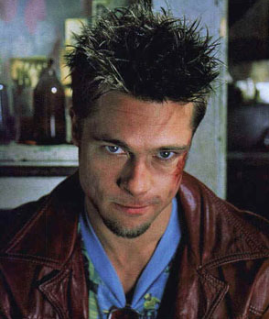
Trickster Comparison
Capt Jack Sparrow is the loveable trickster who is self-indulgent who uses tricks to secure women, rum and gold.
Compared to Tyler Durden (Fight Club) a modern trickster who destroys the qualities of the ancient mythological tricksters.

Slide 6
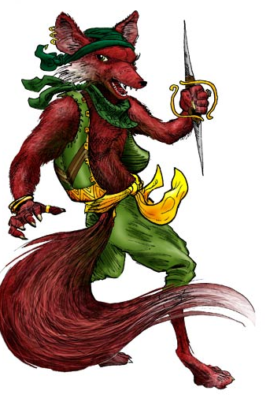
Reynard Cycle
The Fox has been used to depict the trickster throughout the ages:
Reynard the Fox in German Folklore
Renert the Fox in Luxembourg
1937 Tale of the Fox
The Black Fox (1962) – Hitler’s rise to power
Zorro ( means fox in Spanish)
Chaucer – Tales of Canterbury
Marie de France – Forest of dreams

Slide 7
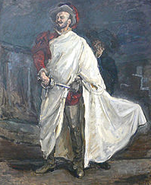
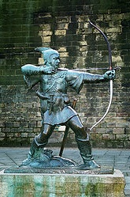
Classical Mythology
EROS – The son of Aphrodite was said to be a mischievous and
cunning trickster
DON JUAN – Was the trickster in Spanish folklore and mythology. The seducer of women by trickery and deceit
The legendry figure of ROBIN HOOD from English
Folklore. He tricked an unscrupulous Sherriff of
Nottingham in order to help the persecuted poor

Slide 8
REFERENCES
The Trickster: A gods evolution from ancient to modern times, 24.6.2010, by WA Conner, 22.9.2008 Associated Content
http://www.associatedcontent.com/article/1055309
The history of Reynard the Fox, Henry Morley 1989, 24.6.2010
http://www.bestiary.ca/etexts/morley1989/morley1889.htm
Hyde Lewis, Trickster Makes the World: Mischief Myth and Art, North Point Press, New York 1998
Pirates of the Caribbean: The curse of the black pearl, Dir by Gore Verbinski, Screenplay by Ted Elliot and Terry Rossio 2003, DVD Disney 2003

