Slide 1
Bullying in Healthcare
Notes:
Good Morning: This is an presentation on Bullying in Healthcare

Slide 2
Agenda
Bullying Defined
Aggression
Effects of Bullying
Abuse of Authority
Psychological and Physical
Bullying Activities
Signs of Corporate Bullying
Workplace Bullying Resources
Signs of Corporate Billing
Bullying Workplace Statistics
Bullying Consequences
Survey Results Bullying Problems
Survey Results Public and Private Sector
Types of Bullying Complaints
Notes:
This is the Bullying in Healthcare agenda which is a list each area we will be covering today(Read the List)

Slide 3
Bullying Defined
Workplace bullying among health care employee is defined as the repetitive irrational actions of the employees which are focused toward specific employees or a collection of employees. The workplace bullying behaviors are intended to be actions of intimidation, degradation and humiliation which undermine the capacity of the health care employees to perform their job related functions
Notes:
We must define Bullying in the Workplace in order discuss the effects of Bullying
Bullying in the Workplace bullying among health care employee is defined as the repetitive irrational actions of the employees which are focused toward specific employees or a collection of employees. The workplace bullying behaviors are intended to be actions of intimidation, degradation and humiliation which undermine the capacity of the health care employees to perform their job related functions

Slide 4
Aggression
Single Incidents of aggression
Repetitive attacks
Unwelcome behavior
Leadership aggression
Isolated aggression
Behavioral aggression
Supervisor bullying
Management bullying
Notes:
Single Incidents of aggression Isolated aggression
Repetitive attacks Behavioral aggression
Unwelcome behavior Supervisor Bullying
Leadership aggression Management Bullying
One of the first signs of Bullying is Aggression which indicates the manager has anger issues or they often abuse their power. Each incident should be commented before reporting HR, Workplace aggression is a specific type of bullying which occurs in the workplace. Workplace aggression can include a wide range of behaviors, ranging from verbal acts , spreading rumors to physical abuse.

Slide 5
Effects of Bullying
Decreased self esteem
Physical disabilities which include musculoskeletal dysfunctions
Increased employee down time.
Digestive and sleep disorders
Enhanced states of depressive behavior.
Domestic problems in the home environment due to work related stress
Economic difficulties which are the result of increased indexes of employee
Ariza- Montes, A., Muniz, N. M., Montero- Simó, M. J. & Arranque- Padilla, R. A. (2013). Workplace bullying among healthcare workers. Int J Res Public Health, 10(8): 3121- 3138.
Notes:
The employee can become mentally or physically ill because of the negative effects of bullying. Over long periods of time the employee becomes withdrawn or introvert.
According to WorkplaceBullying.org
80% of bullied employees have Debilitating Anxiety
52% of bullied employees experience Panic Attacks
49% of bullied employees experience Clinical Depression
30% of bullied employees experience Post-Traumatic Stress(PSTD)

Slide 6
Abuse of Authority
Controlling
Vindictive
Unreasonable
Unethical
Personal Isolation
Violates personal space
Micro managements unnecessary
Derogatory comments
Unfair treatment
Notes:
Your supervisor at work may have authority given by upper management. In addition to his official position, he or she may have added power because of his friendship with upper management, his reputation and record, or his willingness to reward or punish employees. There's nothing wrong with having power, unless he abuses it. Abuse manifests in many different ways. Some abusive bosses are constant critics who put down, insult and belittle you. Others intimidate you with angry, out-of-control rants and emotional explosions. Abuse may not be obvious: Some supervisors appear nice when they're face to face with you, then back stab you later.

Slide 7
Psychological and Physical
Lack of self-esteem
Digestive problems
Sleep problems
Enhanced depression
Emotional breakdowns
Domestic problems
Nervousness(fear of losing job)
Physical disabilities
Severe stress missing days from work
Ariza- Montes, A., Muniz, N. M., Montero- Simó, M. J. & Arranque- Padilla, R. A. (2013). Workplace bullying among healthcare workers. Int J Res Public Health, 10(8): 3121- 3138.
Notes:
The impact of constant bullying can impact an employee mentally and physically. These types of warning sign can show up in many different ways:
Lack of self-esteem Domestic problems
Digestive problems Nervousness(fear of losing job)
Sleep problems Physical disabilities
Enhanced depression Severe stress missing days from work
Emotional breakdowns

Slide 8
Bullying Activities in Office
Unnecessary criticism
Placing wrongful blame on employee
Offensive words and behavior
Isolation
Humiliation
Micro management
Assigned impossible deadlines
Excluded from activities
Notes:
There are indications or warning signs in the office when management is bullying an employee or group of employees. This is a list of the most common type of behaviors or activities might exist when management is in the act of bullying:
Unnecessary criticism Humiliation
Placing wrongful blame on employee Micro management
Offensive words and behavior Assigned impossible deadlines
Isolation Excluded from activities

Slide 9
Signs of Corporate Bullying
Failure to meet company goals
Inability to meet deadlines
Increase number of grievances
Increased number of resignations
Increased number of transfers
High levels of stress in office
High number of employees calling out sick
Notes:
Its very difficult for the employee to se they are being bullied because the power of a manager can be subtle. Here are some ways for the employee to recognized if they are being bullied:
You feel like throwing up the night before the start of your work week
Your frustrated family demands that you to stop obsessing about work at home
Your doctor asks what could be causing your skyrocketing blood pressure
You feel too ashamed of being controlled by another person at work to tell your spouse or partner
All your paid time off is used for "mental health breaks" from the misery

Slide 10
Workplace Bullying Resources
Human Resources
Employee Bullying Hotline
Report to Corporate Complaints Internal
Labor Representative
Report to immediate manager
Report to anonymous hotline
Make formal compliant in writing
Report to Union Rep(If union)
Contact Equal Employment Opportunity Commission(EEOC) for complaint
Notes:
The employees have options to reporting the Bullying in the workplace. Some companies may not have hotlines but most have anonymous hotlines to report
Work related problems: Remember that human resources is liable and accountable for addressing your bullying complaints. When all possible the Human
Resource department is an excellent place to start.

Slide 11
Bullying Workplace Statistics
Reduces the performance of their victims by half, and that of other employees by up to 33%
41.9% of the employees who participated in the survey documented having experienced psychological aspects of aggression in the workplace
13% of fifteen million employees in the United States have been recipients of psychological aggression every week
Schat, A., & Frone, M. R. (2011). Exposure to psychological aggression at work and job performance: The mediating role of job attitudes and personal health. Work Stress, 25(1): 23- 40.
Notes:
There statistics that support the serious problem of Bullying in the work place:
Reduces the performance of their victims by half, and that of other employees by up to 33%
41.9% of the employees who participated in the survey documented having experienced psychological aspects of aggression in the workplace
13% of fifteen million employees in the United States have been recipients of psychological aggression every week

Slide 12
Bullying Consequences
Replacement of personnel
Training cost of new personnel
Increased resignations
Lawsuits
Lost work hours due to illness
Poor morale
Lack of team work
Unhappy employees
Notes:
The consequences of bullying can destroy an organizations internal processes and workflows. In addition, the missed deadlines that lead to loss of revenue:’
Replacement of personnel Lost work hours due to illness
Training cost of new personnel Poor Morale
Increased resignations Lack of team work
Lawsuits Unhappy employees

Slide 13
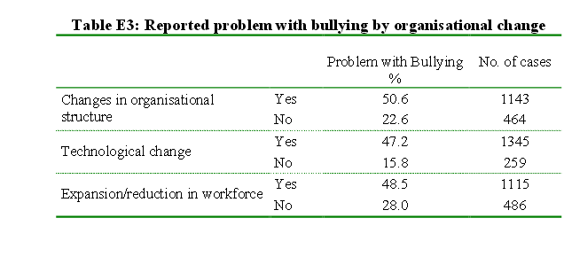
Survey Reported Bullying Problems
International distribution
Address distribution strategies
Discuss issues specific to international distribution
International pricing strategy
Localization issues
Highlight requirements for local product variations
Notes:
This is a survey that reported bullying problems. It indicates at over 4812 cases. That is an enormous amount of bullying complaints.

Slide 14
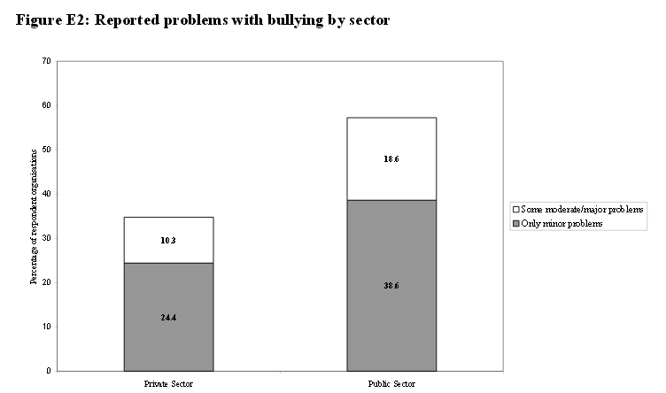
Survey Bullying Report by Sector
International distribution
Address distribution strategies
Discuss issues specific to international distribution
International pricing strategy
Localization issues
Highlight requirements for local product variations
Notes:
This is a survey reporting bulling by Private and Public Sector.

Slide 15
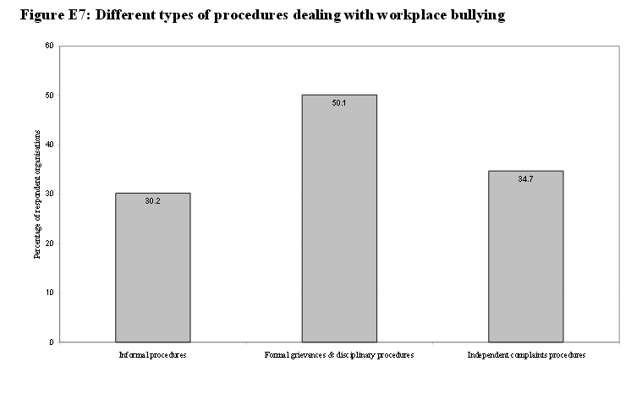
Types of Bullying Complaints
International distribution
Address distribution strategies
Discuss issues specific to international distribution
International pricing strategy
Localization issues
Highlight requirements for local product variations
Notes:
There are three types of bullying complaints which are informal, formal grievances and individual complaints.

Slide 16
Thank you
Any questions

