Slide 1
Aero Mexico Flight 498
Analysis of an Air Crash Tragedy

Slide 2
Introduction
Aero Mexico Flight 498 en route to Los Angeles from Mexico City
On August 31st a Piper PA-28-181 Archer privately owned plane was en route from Torrance to Big Bear City CA.

Slide 3
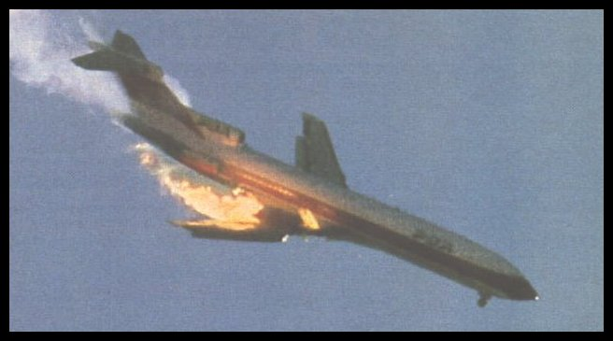
A Personal Tragedy
The two collided in Mid Air over Cerritos CA killing all 67 people in both aircraft and 15 on the ground. 8 other persons sustained minor injuries from the crash

Slide 4
The crash site on the ground
The DC9 Inverted and fell to earth in the densely populated area of Cerritos in California. The square box above illustrates the crash site before hand.

Slide 5
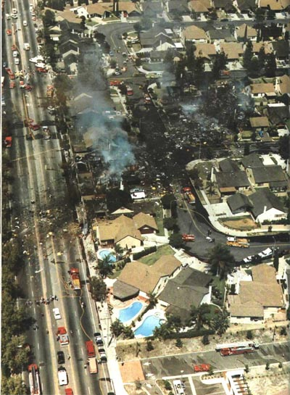
A scene of devastation on the ground
The crash site spilled across the highway and it was a miracle that more people were not killed. Only 8 suffered minor injuries with 15 fatalities.

Slide 6
Faults with the Piper
The Archer was operating VFR and had not received a clearance to enter the Los Angeles Terminal Control Area. Radar data showed that the aircraft had penetrated the LA TCA eight minutes after departing Torrance, straying into the path of Aero Mexico 498. Both aircraft should have been able to see one another!

Slide 7
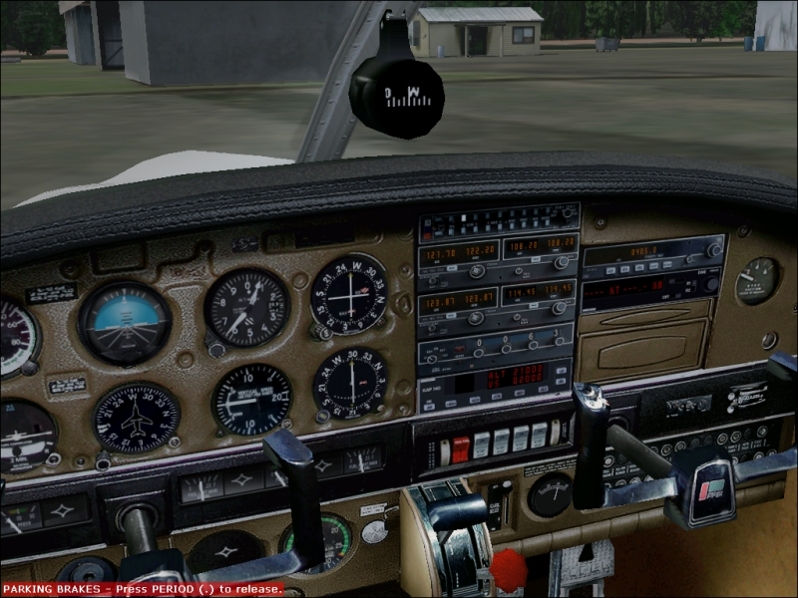
Lessons for the future
Because of this accident, the FAA now requires that all aircraft flying in a 30nm radius of the primary airport of a TCA/Class B airspace be equipped with an altitude-encoding transponder.

Slide 8
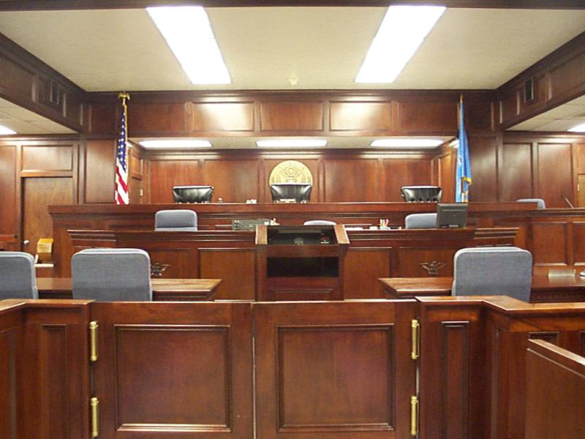
The legal verdict
As a result of the incident, a jury ruled that the airline had no fault. The jury said that Kramer and the FAA each acted equally negligent and held equal responsibility. U.S. District Judge David Kenyon agreed with the notion that the FAA shares responsibility

Slide 9
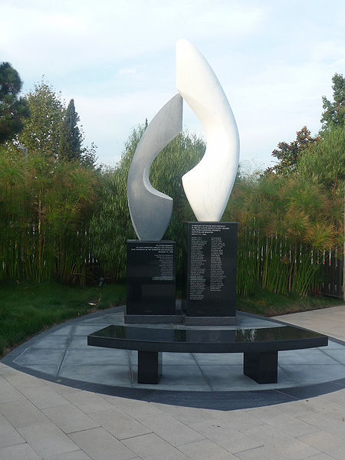
A lasting Memorial
On March 11, 2006, the City of Cerritos dedicated a new sculpture garden featuring a memorial to the victims of the accident. The sculpture, designed by artist Kathleen Caricof.

