Slide 1
Me, My Brother, and Autism
A Children’s Guide to Understanding Autism
Prepared by: <Name>

Slide 2
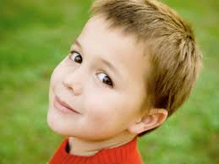
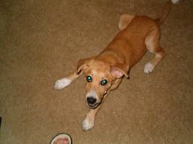
Me
Hi, my name is Brian and I’m in 4th grade. I live with my mom, dad, younger brother Ricky, and my dog Snout. There’s nothing too special about me – or at least, that’s what anyone would think when they see how much more attention my little brother gets than I ever do.

Slide 3
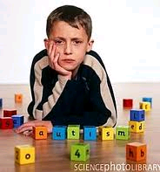
My brother, Ricky
This is my younger brother, Ricky. He gets all the attention from my parents even though he doesn’t seem to want any of it. In fact, he won’t play with me or hug or kiss my parents. They spend all of their time trying to get close to him, while I sit on the side, practically unnoticed by anyone but my dog Snout. I used to try to play games with Ricky, but I don’t try anymore. He just wants to be by himself.

Slide 4
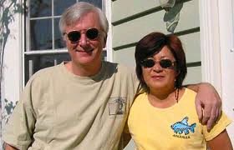
My Parents
Even though Ricky tries to be by himself, my parents are always trying to get him interact with them. Sometimes he throws things and gets upset when they spend so much time with him.
I really don’t understand it. I’d be happy if they ever paid that much attention to me.

Slide 5
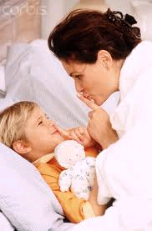
What is Autism?
One day I heard my parents talking about Ricky and his special needs. They mentioned the word ‘autism’ a few times. I asked my mom that night what autism was and why Ricky was so different from other kids his age.

Slide 6
Autism
Basically, my mom explained everything that Ricky was experiencing through his autism. Besides unique intelligence, autistic individuals are virtually emotionless and often have trouble forming attachments to others. Social interaction abnormalities preclude the formation of relationships partly because a simple touch – hug, pat, handshake – are rejected because of hyper arousal. Autistic children cannot stand to be touched; a simple hug from a parent or friend might send the child into a screaming fit.

Slide 7
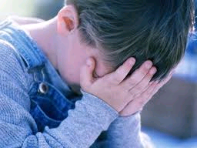
A New Understanding
Now knowing the difficulties my brother was enduring gave me a new understanding and a compassion that I never had before. In the past, I resented all the attention he got. Now I understood that he needed every bit of assistance he could get.

Slide 8
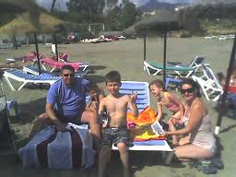
Compassion and Understanding
Now that I understood my brother’s difficulties, I made new efforts to help him myself. I stopped resenting all the attention he got from my parents. Just learning about autism and special needs brought my whole family closer together.

