Slide 1
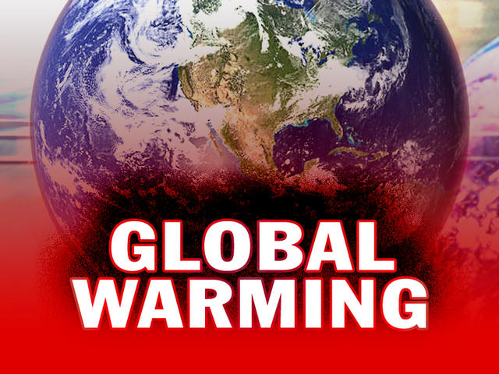

Western Governors University
RINT Task 1

Slide 2
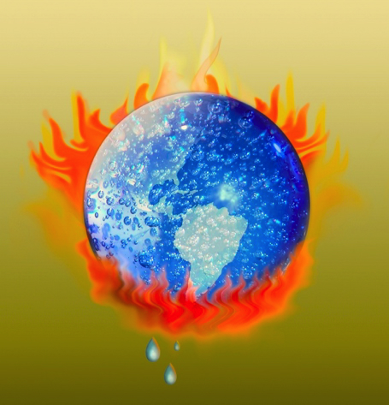
Global Warming
What is Global Warming?
Global warming is the observed and projected increases in the average temperature of Earth's atmosphere and oceans (especially a sustained increase that cause climate change).
When causes global warming?
Global warming is the combined result of anthropogenic (human-caused) emissions of greenhouse gases and changes in solar irradiance (Nodwin).
For approximately 200 years the burning of fossil fuels, such as coal and oil, and deforestation have caused the concentrations of heat-trapping “greenhouse gasses” to increase enormously in our atmosphere. There gases keep heat from escaping to space, somewhat like the glass panels of a greenhouse.

Slide 3
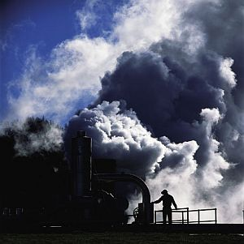
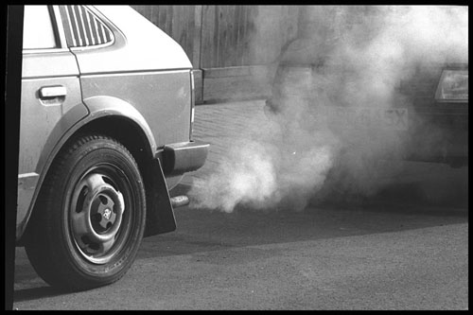
Scientists have spent decades figuring out what is causing global warming. They've looked at the natural cycles and events that are known to influence climate. But the amount and pattern of warming that's been measured can't be explained by these factors alone. The only way to explain the pattern is to include the effect of greenhouse gases (GHGs) emitted by humans.
The United Nations Intergovernmental Panel on Climate Change issued in February 2007, concludes that "The global increases in carbon dioxide concentration are due primarily to fossil fuel use and land-use change, while those of methane and nitrous exide are primarily due to agriculture." The report goes on to note that these findings come with a "very high confidence rate [words emphasized in italics in the report summary] that the globally averaged net effect of human activities since 1750 has been one of warming."

Slide 4
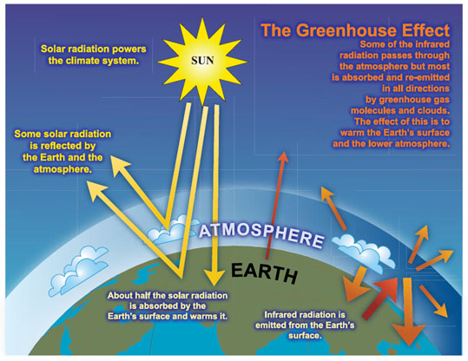
Greenhouse Effect
In the 19th century, scientists realized that gases in the atmosphere cause a "greenhouse effect" which affects the planet's temperature.
At the turn of the century, Svante Arrhenius calculated that emissions from human industry might someday bring a global warming.
In 1938, G.S. Callendar argued that the level of carbon dioxide was climbing and raising global temperature, but most scientists found his arguments implausible.
It was almost by chance that a few researchers in the 1950s discovered that global warming truly was possible.
In the early 1960s, C.D. Keeling measured the level of carbon dioxide in the atmosphere: it was rising fast.
Researchers began to take an interest, struggling to understand how the level of carbon dioxide had changed in the past, and how the level was influenced by chemical and biological forces. They found that the gas plays a crucial role in climate change, so that the rising level could gravely affect our future.

Slide 5
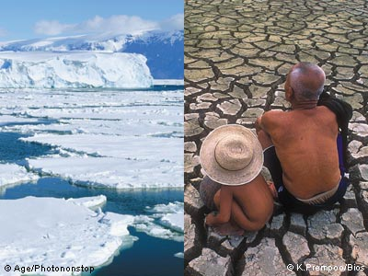
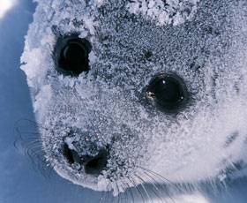

Effects of Global Warming
Shrinking of the polar ice caps- Ice is melting worldwide, especially at the Earth’s poles. This includes mountain glaciers, ice sheets covering West Antarctica and Greenland, and Arctic sea ice.
Drastic increase in the sea level.
Precipitation (rain and snowfall) has increased across the globe, on average.
Hurricanes and other storms are likely to become stronger.
Ecosystems will change—some species will move farther north or become more successful; others won’t be able to move and could become extinct.
(National Geographic)

Slide 6

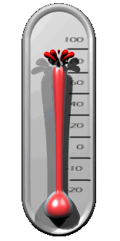


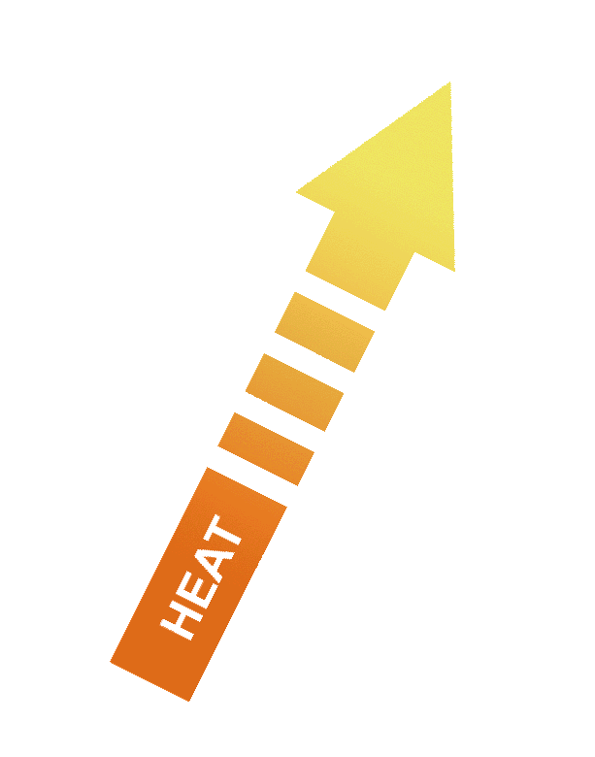
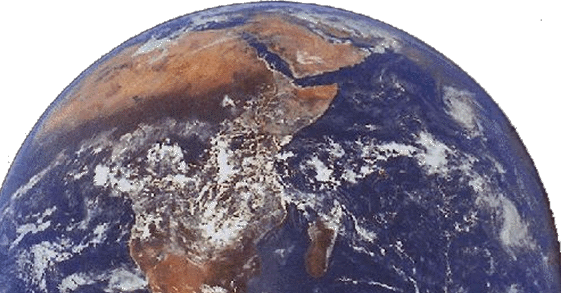


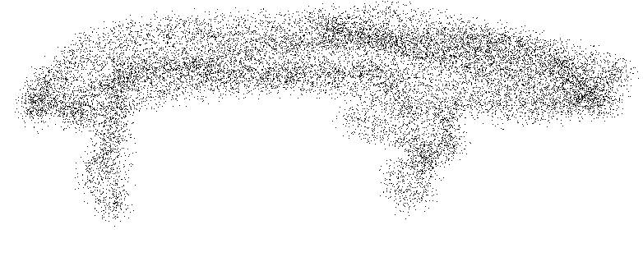
How Global Warming Works
Carbon Dioxide (CO₂)
Fossil fuels (coal, oil, natural gas)

Slide 7
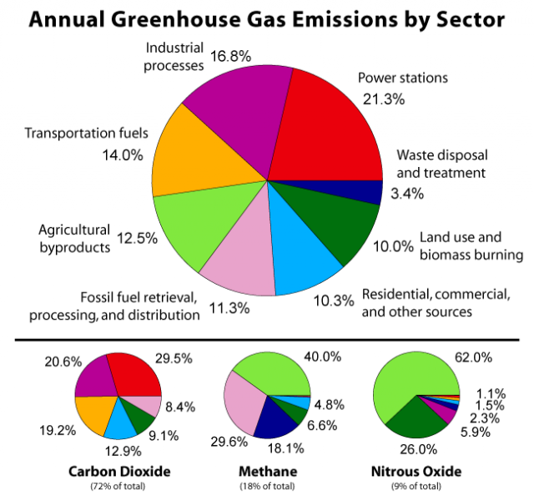
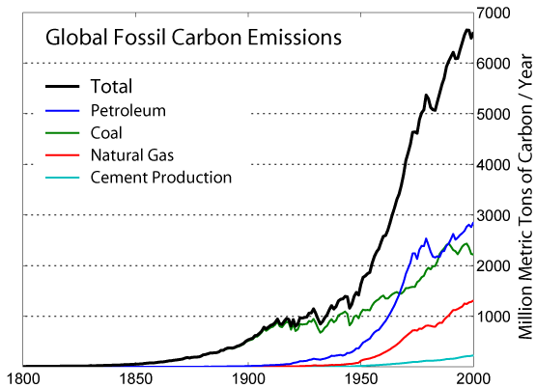
The emission of carbon dioxide into the environment mainly from burning of fossil fuels (oil, gas, petrol, kerosene, etc.) has been increased dramatically over the past 50 years, see graph below.

Slide 8
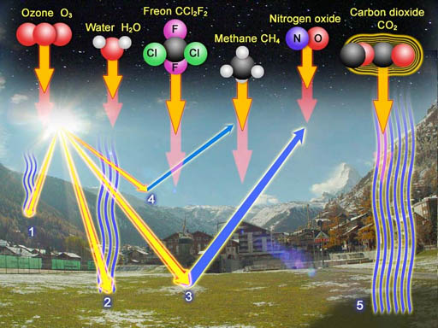
Greenhouse Gases
Carbon dioxide is a major culprit to global warming. That's because the molecules of carbon dioxide let the visible light from the sun pass right through the atmosphere; however, when that visible light heats up the surface of the Earth, the Earth radiates out some of this heat as infrared light (infrared radiation). Carbon dioxide (like other greenhouse gases) will absorb infrared radiation and radiate most of it back towards the Earth.
Methane is responsible for nearly as much global warming as all other non-CO2 greenhouse gases put together. Methane is 21 times more powerful a greenhouse gas than CO2. While atmospheric concentrations of CO2 have risen by about 31% since pre-industrial times, methane concentrations have more than doubled.

Slide 9
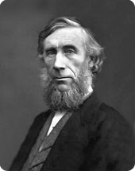
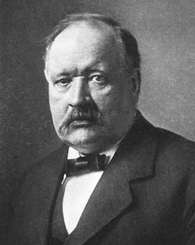
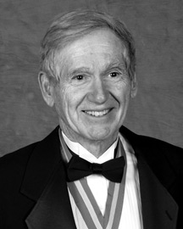
Carbon Dioxide Greenhouse Effect
Example 1: Scientists learned that the major gas responsible for the most warming is carbon dioxide, also called CO2.
In July 1859, the Irish physicist John Tyndall, one of the great scientists of the 19th century, established that certain atmospheric gases absorb heat quite strongly and provided the solution to one of the great riddles of science: the famous ‘greenhouse effect’.
John Tyndall
In 1896 Arrhenius in numerical computation suggested that cutting the amount of CO2 in the atmosphere by half could lower the temperature in Europe some 4-5°C (roughly 7-9°F) — that is, to an ice age level. With Högbom he found that human activities were adding CO2 to the atmosphere at a rate roughly comparable to the natural geochemical processes that emitted or absorbed the gas.
Svante Arrhenius
Charles David (Dave) Keeling with the help of Revelle, Suess and funding from the International Geophysical Year, measured CO2 with precision around the world. In 1960, with only two full years of Antarctic data in hand, Keeling reported that this baseline level had risen. The rate of the rise was approximately what would be expected if the oceans were not swallowing up most industrial emissions (Keeling, 1960)
David Keeling

Slide 10
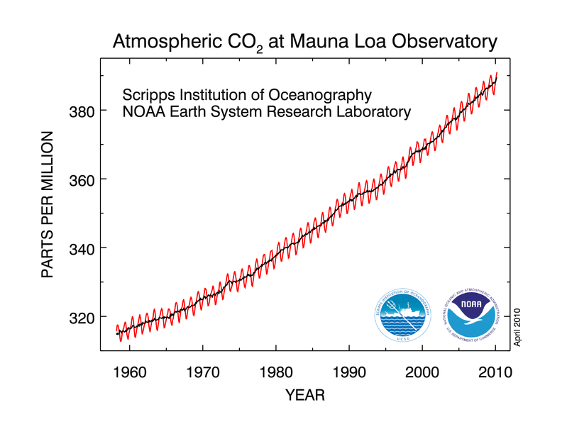
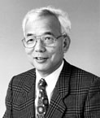
.
In 1967 Manabe and associates demonstrated that increasing atmospheric carbon dioxide concentrations would increase the altitude at which the earth radiated heat to space. Throughout the 1970s and 1980s Manabe produced complex but plausible computer models which show a temperature rise of several degrees for doubled CO2 adopting the General Circulation Models of Climate. These models helped to explore the sensitivity of Earth's climate to changing greenhouse gas concentrations.
Syukuro Manabe
In 1992, Kyoto Protocol International conference produces Kyoto Protocol, setting targets to reduce greenhouse gas emissions if enough nations sign onto a treaty.

Slide 11
Other Greenhouse Gases
Example 2: Scientists discovered that Methane could bring as much damage as carbon dioxide itself in the process of global warning.
In 1859 John Tyndall observed that besides water and Carbon Dioxide, "an almost inappreciable mixture of any of the stronger hydrocarbon vapors" such as methane would change the climate (Tyndall, 1863).
In 1948, methane was detected in the atmosphere.
in the 1960s and 1970s, scientists found out that harmful emissions from biological sources outranked mineral sources. Specially important were bacteria, producing the methane ("swamp gas") that bubbles up in wetlands, that included rice paddies (Koyama 1963).
In 1997 V. Ramanathan identified methane as a significant greenhouse gas, and studies of its role in global carbon cycles accelerated.
By 1988, collection of air samples showed that the actual rate of increase of Methane was about 1% a year, bringing a shocking 11% increase of methane in the past decade alone.
In 2005 study of the complex chemical interactions in the atmosphere calculated that adding methane was even more powerful in bringing greenhouse warming than previous studies had estimated.

Slide 12
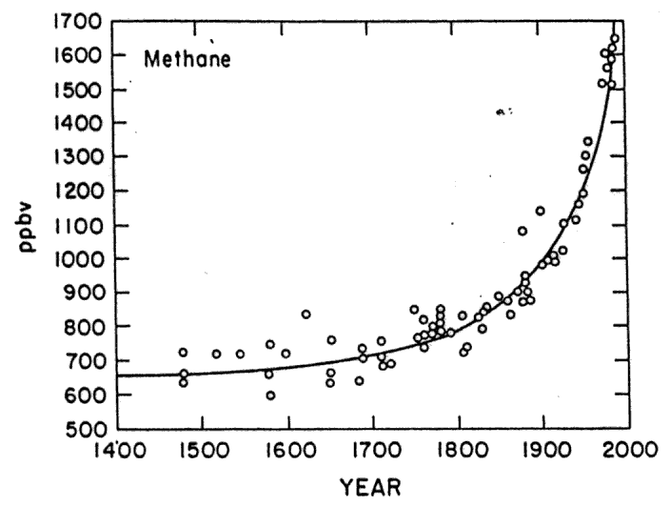
Methane is Increasing

Slide 13
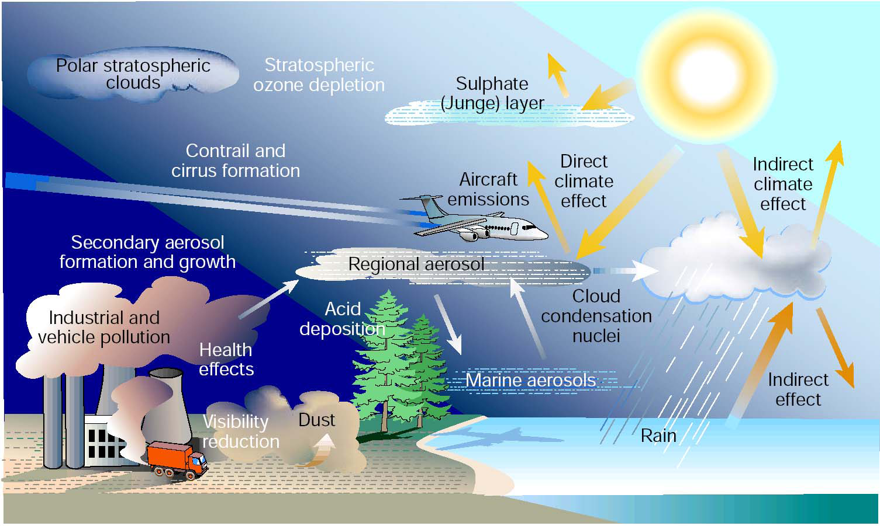
Aerosols modify the energy balance
Example 3: A study led by Drew Shindell of NASA's Goddard Institute for Space Studies says that, in the high latitudes the impact of aerosols (sulfates and black carbon) may account for 45% or more of the observed warming which has occurred in at the poles over the past three decades. Over that time Arctic temperatures have risen by 1.7°C, while Antarctic regions have witnessed 0.35°C temperature increases.
C.E. Kolb, Nature, 2002

Slide 14
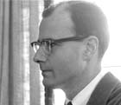
In 1961, The climate scientist J. Murray Mitchell, Jr. took up the question, with the help of improved data on how minuscule particles (aerosols) moved through the upper atmosphere.
Aerosols is defined as a suspension of the fine solid particles or liquid droplets in a gas. Aerosols are generated naturally from dust, volcanoes, forest, storms and grassland fires, living vegetation, and sea spray.
Ten percent of the aerosols are generated by human activities, such as the burning of fossil fuels. In the atmosphere it refers to atmospheric particles such as dust, sea salt, sulphates, smoke and black carbon.
Aerosols not only intercepted sunlight, but might also affect climate by helping to create clouds.
It was becoming plausible that aerosols emitted on an industrial scale could alter the climate of an entire region.
J. Murray Mitchell

Slide 15
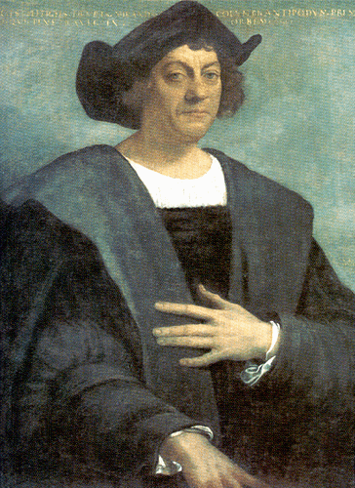
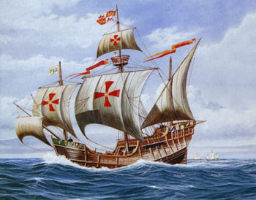
Western Governors University
RINT Task 2
By. Catherine Venzke

Slide 16
The Influence of Christopher Columbus’s Discoveries
Christopher Columbus was a famous explorer whose discovery of the Western Hemisphere was a published abroad and made known the existence of new continents to the people in Europe (Christopher Columbus, 2009) His historical findings changed our scientific understanding of the natural world. We acknowledge the spherical Earth, the use of the trade winds, and new plant and animal life he introduced to the “New World.” During his lifetime, Columbus lead a total of four expeditions to the New World discovering many of the Caribbean Islands, the Gulf of Mexico, and the South and Central American mainlands. He had discovered the New World, with riches over the next century to help make Spain the wealthiest and most powerful nation on earth (Tirado, 2000).
On October 12, 1492, after a thirty-three-day voyage form the Canary Islands, Columbus landed in San Salvador in the eastern Bahamas. He thought San Salvador was an outer island of Japan. His knowledge of geography was based on Marco Polo’s account of his years in China during the thirteenth century and a global map by Martin Behaim. This global map called Nuremberg map-maker, showed only ocean between the west coast of Europe and the east coast of Asia. (Tirado, 2000). Columbus estimated that a westward route from Iberia to the Indies would be shorter than the overland trade route through Arabia. The lack of geographic knowledge during the time forced Columbus to take an inefficient route that severely underestimated the circumference of the Earth. Columbus’s initial 1492 voyage was during a critical time of growing national imperialism and economic competition between developing nation states; between developing nation states; seeking wealth from the establishment of trade routes and colonies (Tirado, 2000).
Columbus’s first voyage marked the beginning of more than three centuries of Spanish conquest, exploration, and administration of a vast American empire (Tirado, 2000)

Slide 17

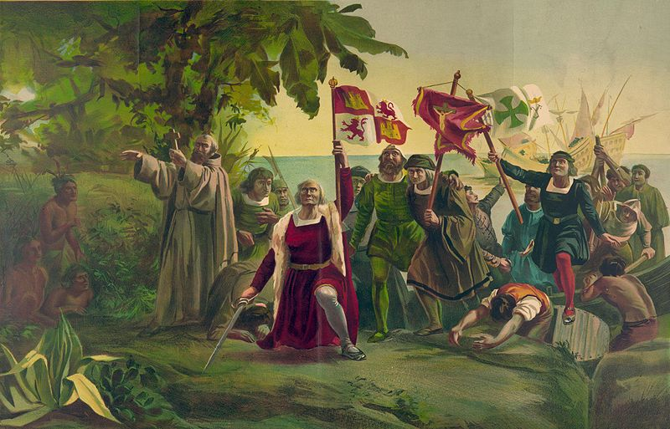
HISTORICAL CONTEXT
The discovery of Christopher Columbus marks an era of dynamism – it was a century of change. Western Europe was impacted by three historic factors during that particular era focusing on the age old conflict between Christians and Muslims.
Conquest of Ceuta in North Africa by the Portuguese in 1415
Fall of Constantinople to the Muslim Turks in 1453, and
Defeat of Muslim Granada by the Christian Spaniards in 1492.
Columbus Voyage led to the discovery of a New World which had a profound intellectual. During the Age of Discovery (15th and 16th centuries), Western Europeans could exchange information with the rest of the world. Columbus was one of the great thinkers of the age and one who led the way, deserves the deserves recognition for the intellectual transformation that took place. As a result, a new era was ushered in, the Modern Age, and after 1500 the world would never be the same, nor would the human race.

Slide 18
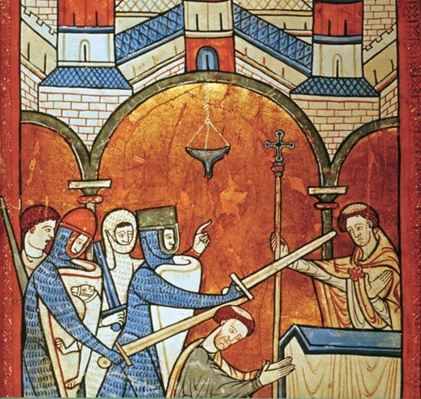
SOCIAL CONTEXT
Christopher Columbus sailed during the
Medieval period, when there was
Supremacy of the church and the people
thought that earth was the centre of the
Universe.
The Middle Ages, a time during which there was no mechanism for the influx of new, uncensored, and raw information. In a segmented Europe there were no public schools , no news media and no means of percolation of new information could enter the knowledge base easily.
The church in the Medieval Ages
Church were controlling nearly all centers of learning and with other privileged groups in society were able to stay in power and resist new ideas that threatened their existence. By 1500, however, a new class of people , the bourgeoisie emerged. Having been the major beneficiaries of Medieval commerce, the bourgeoisie now embraced the Age of Discovery enthusiastically. This was especially true after 1453 when the Byzantine capital of Constantinople fell to the Muslim Turks. For the first time the North Italian merchants were excluded from the Middle East marketplaces. Their only hope of reacquiring their lost markets was to seek new trade routes around the Muslim-controlled lands.

Slide 19
HISTORICAL IMPACT OF THE VOYAGE ON THE KNOWLEDGE OF THE WORLD
Columbus Voyage led to the discovery that humankind inhabited a third planet which had its own axis and revolved around a fixed sun, contrary to the Geocentric view of the Middle ages.
In 1530, Copernicus advanced the heliocentric view that earth and other planets revolve round the sun.
In the next century the Italian astronomer Galileo Galilei (1564-1642) advanced the Copernican theory significantly with observations made with a telescope.
The next thinker was the German Johannes Kepler (1571-1630). He too accepted the Copernican theory but went further by deducing that the orbits of the planets were elliptical and not circular.
The beneficiaries of the discovery has lead people have a clear picture of the universe, than the most learned scholars of the Ancient, Medieval, and Early Renaissance periods.

Slide 20
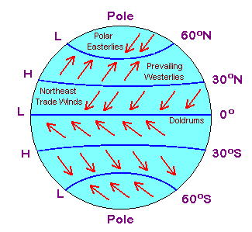
Columbus and Trade Winds
Trade Winds
Christopher Columbus (1451-1506), discovered the trade winds. These winds help him to carry his three modest-size sailing vessels all across the Atlantic at its widest, from the Canary Islands to the Bahamas, a distance of 5400 miles, in 36 days, in 1492.
Many centuries later (in 1970), the Norwegian seaman and archeologist Thor Heyerdahl showed with his experiments that the trade winds are capable of blowing a sailing vessel built of reeds (made to resemble an Egyptian craft) from Morocco to the Caribbean.

Slide 21
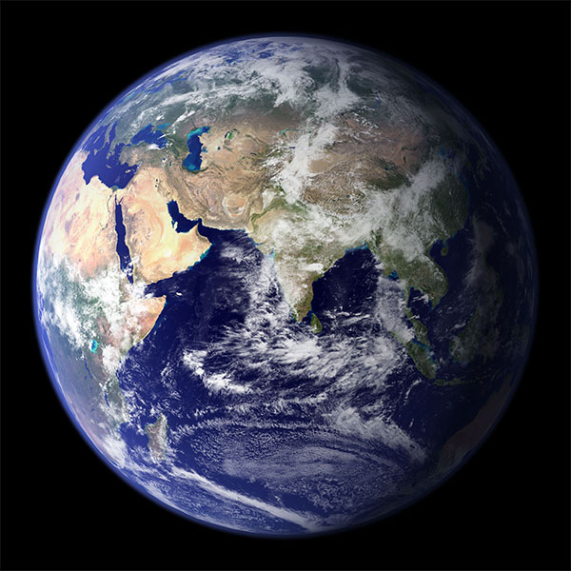
SHAPE OF EARTH
The Medieval people believed that the earth was flat . However, Columbus brought them to reality when he proved through his expeditions that the first to admit that to the scientific world that the Earth was round.
Spherical shape of Earth

Slide 22
References
Craig M. A., Graham A. W., Kagan, D., Ozment, S., Turner, M. F., (2002) The Heritage of World Civilizations. Upper Saddle River, NJ: Prentice Hall.
EPA., (2009) Climate Change. United States Environmental Protection Agency. Retrieved November 4, 2009 from http://www.epa.gov/climatechange/basicinfo.html
Le Treut, H., R. Somerville, U. Cubasch, Y. Ding, C. Mauritzen, A. Mokssit, T. Peterson and M. Prather, 2007: Historical Overview of Climate Change. In: Climate Change 2007: The Physical Science Basis. Contribution of Working Group I to the Fourth Assessment Report of the Intergovernmental Panel on Climate Change. Cambridge University Press, Cambridge, United Kingdom and New York, NY, USA.
Tirado, T.C. (2000) Christopher Columbus. Encarta encyclopedia. Retrieved (2010. March 27) from http://www.millersville.edu/~columbus/columbus.html

Slide 23
National Geographic, nd, from http://environment.nationalgeographic.com/environment/global-warming/gw-effects/
CHM-107 Lab, nd, Chemistry & Society, nd, from
http://www.chemistryland.com/CHM107Lab/Exp04_biodiesel/BiodieselLab/Exp4Biodiesel.html
Antimatter, nd, 150th anniversary of Tyndall’s greenhouse effect, from
http://coraifeartaigh.wordpress.com/2009/06/29/150th-anniversary-of-tyndalls-greenhouse-effect/
Weart, S. (2000) The Discovery of Global Warming, from
http://www.aip.org/history/climate/simple.htm#L_0141
Climate Change, nd, Trade Winds and the Hadley Cell,
http://earthguide.ucsd.edu/virtualmuseum/climatechange1/08_1.shtml

Slide 24
Time for Change, nd, Cause and effect for global warming from
http://timeforchange.org/cause-and-effect-for-global-warming
Stanford Solar Centre, nd, Global Warming from
http://solar-center.stanford.edu/sun-on-earth/glob-warm.html
Tyndall (1863); Tyndall (1861); Tyndall (1873), quote p. 40. BACK
A pioneer especially for rice paddies was Koyama (1963); wetlands: Ehhalt (1974). BACK
Wyslouzil, B. (2007) Global Warming: What is the role of Aerosol?
http://iee.osu.edu/education/downloads/Aerosolandglobalwarming.pdf
Ezine Articles, nd, Aerosols Make Global Warming Worse, from
http://ezinearticles.com/?Aerosols-Make-Global-Warming-Worse&id=3189015
Tirado, C. T. (2000) Christopher Columbus,
http://www.millersville.edu/~columbus/columbus.html

