Slide 1
Interpretation of Home: Hua Mulan and This Way for the Gas
Name

Slide 2
Part I: Hua Mulan
War Song
Hua Mulan’s home is at war and she is at war with them to prove she is valuable. This song reflects how she feels about her war-torn land.

Slide 3
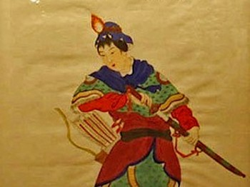
Mulan at War
This image depicts Mulan in her armor. It demonstrates the difficulties that she is willing to face in order to protect her friends and family. The image is entitled “Hua Mulan Goes to War”.

Slide 4
Modern Understanding of Hua Mulan
This Disney clip is representative of Hua Mulan’s struggle to become physically strong to fight for her home. Since bravery was not enough, she managed to overcome even this barrier.

Slide 5
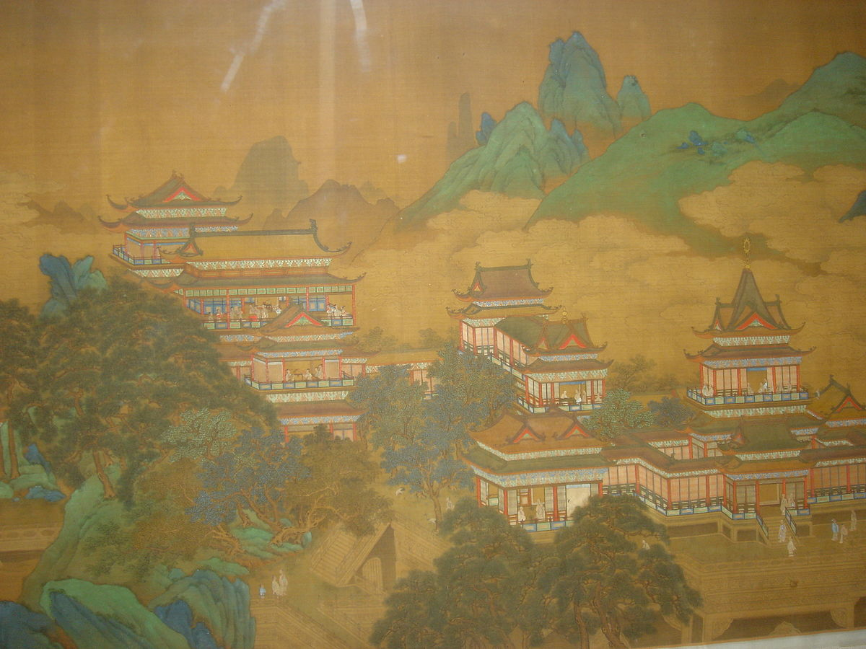
Hua Mulan’s Home in Peace
This painting was created for the Peach Festival of the Queen Mother of the West during early around 1200 A.C. Hua Mulan lived only 100 years after and it is expected that her home’s appearance was similar. This calm and beautiful home is what Hua Mulan sacrificed her life to keep.

Slide 6
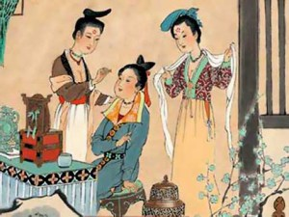
Hua Mulan, the Woman
This image represents what Hua Mulan’s home expects of her. Women of her time were expected to be concerned with enhancing their beauty and finding a proper husband.

Slide 7
Home and the Written Tales of Hua Mulan
This excerpt is from the “Poem of Mulan” and is representative of what Hua Mulan’s home expects of her.

Slide 8
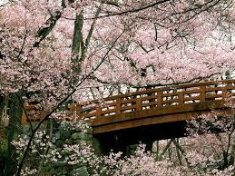
The Ideal Image of Home

Slide 9
Part II: This Way for the Gas
Loss of Home
This video and its accompanying music represents the loss of home that many individuals living in Nazi Germany had to face.

Slide 10
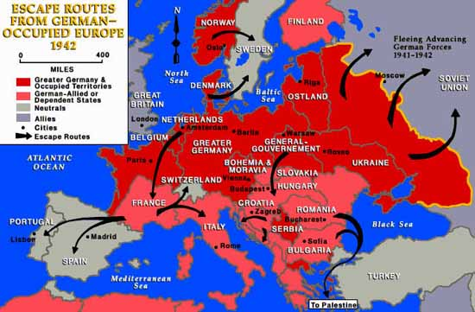
The Loss of Many Homes
The Nazi’s took over countless homes. The prisoners at Auschwitz potentially came from all over Europe.

Slide 11
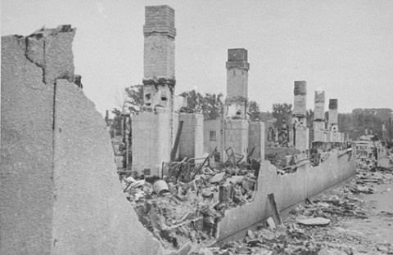
Destruction of the Ghetto
Ruins of a ghetto building that was destroyed when Germans attempted to force Jews out of hiding.

Slide 12
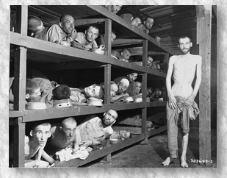
Concentration Camp
Concentration camp prisoners had to constantly redefine their definition of home.

Slide 13
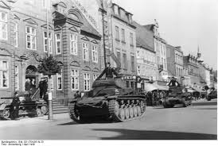
No Comfort in Home
Home is typically associated with protection. This was untrue for the Jews of Europe.

Slide 14
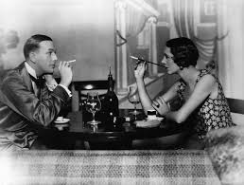
The Calm Before the Storm
Life in the 1930’s was grand for many. However, this was doomed to change during the war-torn climate of World War II.

Slide 15
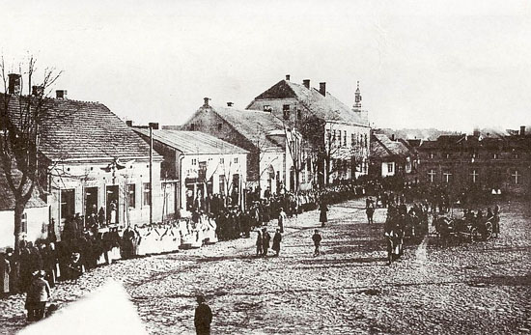
Normalcy
Piaski Square in Poland before the war.

Slide 16
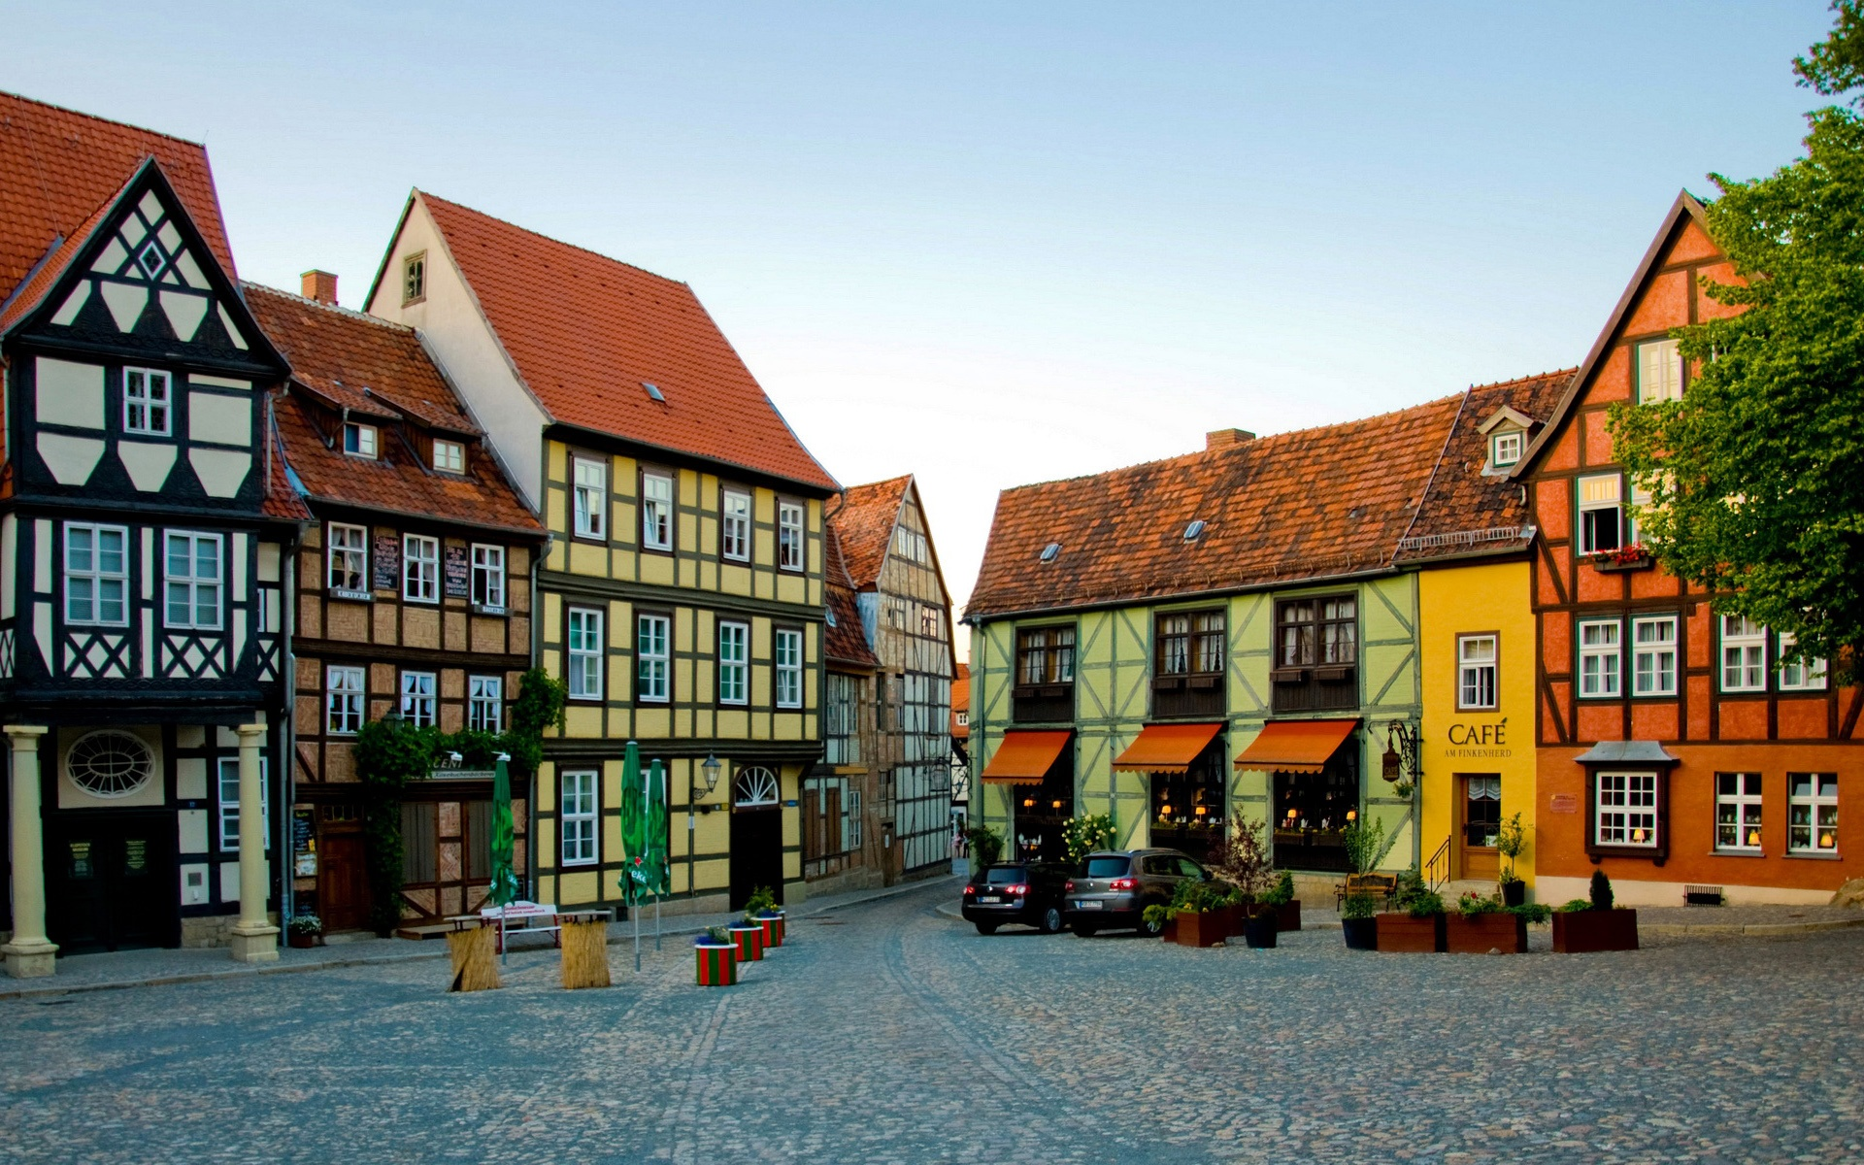
The Ideal Image of Home

Slide 17
References
Anonymous. “Poem of Mulan”. Unknown. 22 April 2014.
Busterwolf123. “Chinese War Theme 1”. Online video clip. YouTube. YouTube, 28 July 2012. Web. 22 April 2014.
Cook, Barry, Tony Bancroft, Pam Coats, Rita Hsiao, Ming-Na, B D. Wong, Soon-Teck Oh, Eddie Murphy, Freda F. Shen, Harvey Fierstein, George Takei, Jerry S. Tondo, Gedde Watanabe, Matthew Wilder, Miguel Ferrer, James Hong, June Foray, Pat Morita, Frank Welker, David Zippel, Jerry Goldsmith, Hans P. Bacher, Ric Sluiter, Michael Kelly, and Souci R. D. San. Mulan. United States: Walt Disney Home Entertainment, 2004.
Djrhythmdave. “Nazi German Hardcore Hell March”. Online video clip. YouTube. YouTube, 15 March 2014. Web. 22 April 2014.
JewishGen. “The Concentration Camps”. N.D. Web. 22 April 2014. <http://www.jewishgen.org/forgottencamps/camps/ConcentrationEng.html>
Jewish Virtual Library. “Rescue and Escape from German-Occupied Europe”. 2014. Web. 22 April 2014. <http://www.jewishvirtuallibrary.org/jsource/Holocaust/escapemap.html>
Kuwalek R. “Piaski”. 2007. Web. 22. April 2014. <http://www.holocaustresearchproject.org/ghettos/piaski.html>
Shen T & Sommer G. “The Legend of Mulan”. 31 August 2011. Web. 22 April 2014. <http://www.theepochtimes.com/n2/china-news/the-legend-of-mulan-61005.html>
Ricky. “Cherry Blossom Season Has Started”. 29 March 2014. Web. 22 April 2014. <http://www.dls-eikaiwa.com/ricky/?cat=14>
Stolzenberg. “German Panzer II and Panzer I light tanks in a town in Denmark”. 1940. Web. 22 April 2014.
The Smithsonian’s Museums of Art. “The Peach Festival of the Queen Mother of the West”. ca. 1225-1264. Web 22. April 2014. <http://asia.si.edu/collections/singleObject.cfm?ObjectNumber=F1908.170>
Unknown. “The Evolution of Cosmetics”. 16 May 2012. Web. 22 April 2014. <http://itsabeautyfullworld.files.wordpress.com/2012/05/ancient-chinese-makeup.jpg?w=300&h=224>
Unknown. “House of German Town HD Wallpaper For Desktop”. N.D. Web. 22 April 2014. <http://loopele.com/house-of-german-town-hd-wallpaper/house-of-german-town-hd-wallpaper/>
US Holocaust Memorial Museum. “Ghettos”. N.D. Web. 22 April 2014. <http://www.ushmm.org/wlc/en/media_ph.php?ModuleId=10005059&MediaId=957>

