Slide 1
Knowledge Collaboration
MKT 690 Corporate Communications Analysis
Notes:
The research question which will be reviewed in this corporate communications analysis is: What is the most effective means of developing a workforce which is committed to the collaboration of knowledge within an organization? Studies have demonstrated that organizational knowledge is increased by the application of collaborative endeavours between organizational personnel (Bartol & Srivastava, 2002; Casimir et al., 2012; Gorelick & Tantawy- Monsou, 2005; O’ Neill and Adya, 2006; Xue et al, 2011).

Slide 2

Knowledge Collaboration in Corporate Communication
Notes:
The organizational increase of knowledge is a result of the combination and the exchange of knowledge which is present between the members of an organization. In consideration of the importance of the collaborative endeavours which increase knowledge in an organization, the scholars have shown an interest in classifying the tools which would enable the collaboration between employees with regards to knowledge formation (Bartol & Srivastava, 2002; Casimir et al., 2012; Gorelick & Tantawy- Monsou, 2005; O’ Neill and Adya, 2006; Xue et al, 2011).

Slide 3

Knowledge Collaboration
Notes:
The application of new ways of communicating and administrating the information assets in an organization means that there must be an adjustment in the professional perspectives of the members of the organization. These adjustments may have the outcome of the organizational personnel having the perceptions that the characteristics of the psychological agreements with the administrative staff of the organization being enhanced. The psychological agreements which are referred to as PC are conceptual systems which the organizational personnel maintain in respect to the characteristics and circumstances of the exchange which takes place between the members of the organization and the organizational administrators and stakeholders (O’ Neill and Adya, 2006; Xue et al, 2011).

Slide 4
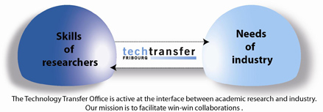
Knowledge Collaboration
Notes:
The majority of organizations are motivated by the effective management of human resources and intellectual capital. As a result, the academic and scientific assets which are held by the members of the organization’s human resources departments have become assets which are extremely liquid and desirable. These assets are essential in corporate communications with regards to the organizations’ ability of maintianing a competitive advantage. The members of the organizational staff who have more substantive commitments to their professional growth need to be motivated with regards to the unrestricted collaboration of the experiential knowledge in the corporate communication environment (Gorelick & Tantawy- Monsou, 2005).

Slide 5
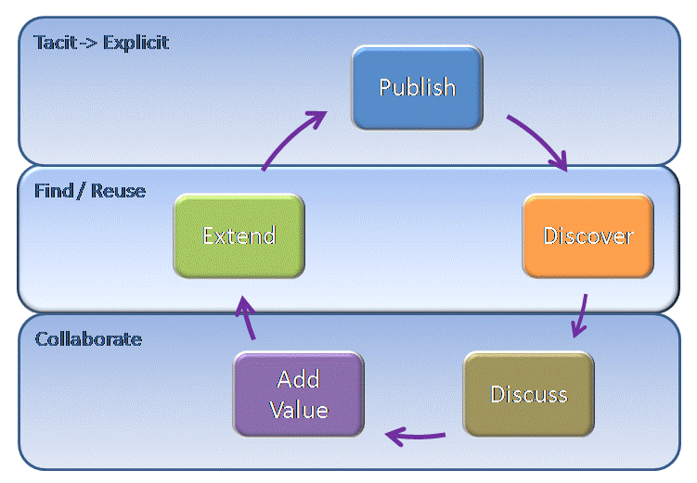
Knowledge Collaboration
Notes:
The behaviors which are conducted in corporate communication with regards to the knowledge collaboration between organizational staff members are the behaviors which surpass the normal employment responsibilities and are applied at the discretion of the organizational members. This is normally conducted in the absence of announced implicit or explicit compensations in the organization. These volunteer behaviors which occur as a result of effective corporate communication have the outcome of adding value to the services and products offered by an organization (Casimir et al., 2012).

Slide 6
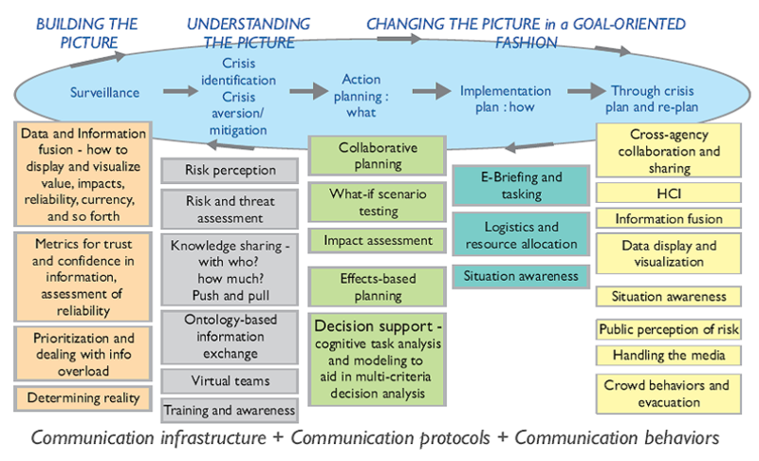
Knowledge Collaboration
Notes:
The collaboration of knowledge between members of an organization in corporate communication has the need for cooperating with the staff members of an organization. The deficiency of knowledge collaboration may result in decision making processes which are faulty due to the lack of accurate data. The nature of the integrity of the knowledge which is communicated in a corporate environment is important as a result of the assimilation of knowledge which takes place in an organization. The quality of the assurance of the integrity of the knowledge which is being conveyed in corporate communications enables the organizational staff members and the organization in attaining a competitive advantage (O’ Neill and Adya, 2006).

Slide 7
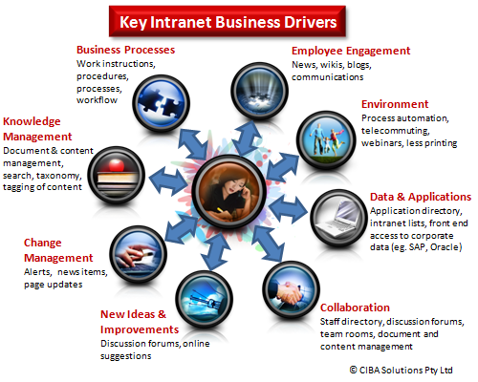
Knowledge Collaboration
Notes:
A number of the knowledge collaboration aspects may be added by the shared guidelines of the organizational intranet. The possible contributions of the knowledge which is communicated in an organizational environment by the users may surpass the capacities of the organizational intranet. Meta- knowledge communication methods may be applied in order to enable the transfer of communication of knowledge which occurs between the senders and the receivers of the communications. The application of the communication and information technological implementations may be effective in diminishing the restrictions which take place in the collaboration of knowledge Casimir et al., 2012.

Slide 8
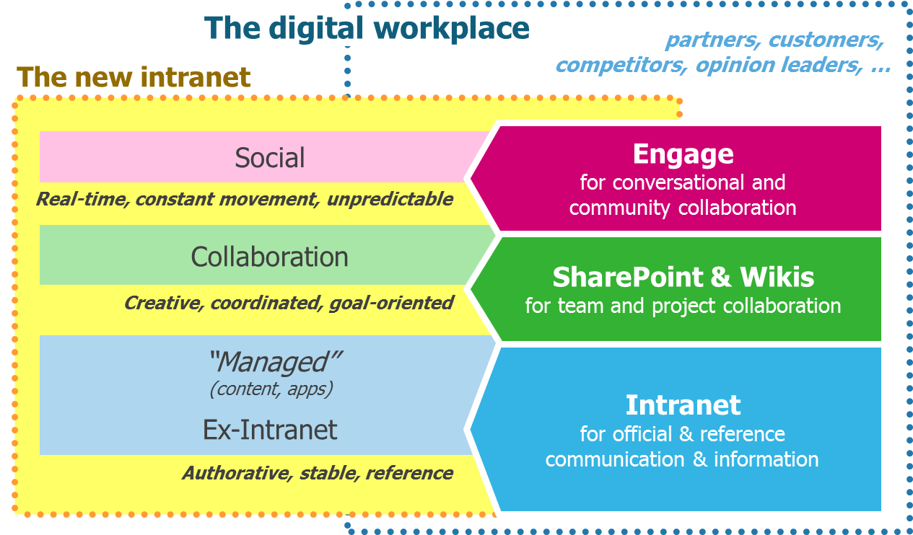
Knowledge Collaboration
Notes:
The characteristics of the communication and information technological methods may serve as warehouse functions for the knowledge which is explicit, tacit and socially categorized. The communication and the information technology enable the transfer of knowledge which is conveyed by the organizational members in the corporate communications environment. The distinct knowledge collaboration constructs which are applied in organizational communications are serial transference, near transference, far transference, organizational cognitive capacity and expertise transfer. The serial transference involves the transfer of knowledge on to a print or electronic medium for future application. The near transference involves the replicating of knowledge which is explicitly held by organizational members too other units in the organizational environment (Casimir et al., 2012).

Slide 9
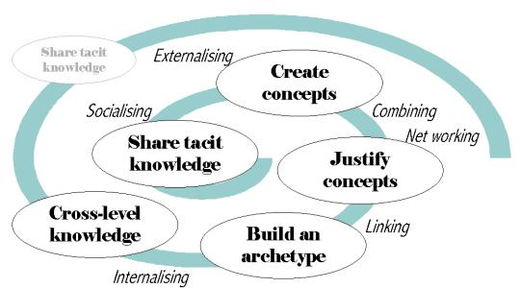
Knowledge Collaboration
Notes:
Far transfer implies the use of communication or information mediums in order to transfer the knowledge to others in a close or far proximity. Organizational cognitive capacity is applied in the instances where the members of the organization are addressed with the instances where the application of organizational knowledge which held by the members. Expertise knowledge transfer infers that the knowledge which is communicated by experts in the field, either through direct or indirect means is transferred and stored (Casimir et al., 2012).

Slide 10
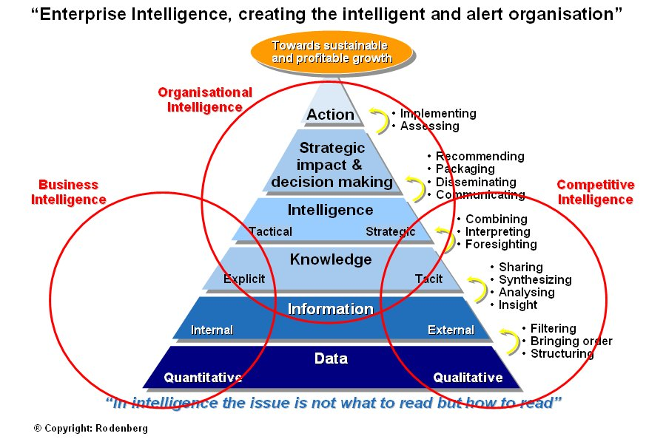
Knowledge Collaboration
Notes:
Conclusion
Research has demonstrated that the choice of the accurate knowledge collaboration procedures in an organization is dependent on the categories of the regularity of the knowledge collaboration procedures, the personnel, information and communications systems which are receivers of knowledge. Five distinct models of knowledge collaboration have been defined. These five models are far transference (the duplicating of tacit knowledge that is shared by a team in the organizational context), near transference (the duplicating of explicit team knowledge by teams in the organization), expertise transfer (when the organizational team needs expert consultation), organizational cognitive ability (which is applied in rare events which require experiential knowledge and serial transference which implies that the knowledge is explicitly held for a future application.

Slide 11
References
Notes:
Bartol, K. M. & Srivastava, A. (2002). Encouraging knowledge sharing: The role of organizational reward systems. Journal of Leadership and Organizational Studies, 9(1): 64- 76.
Casimir, G., Lee, K, & Loon, M. (2012). Knowledge sharing: Influences on trust, commitment and cost. Journal of Knowledge Management, 18(5): 740- 753.
Gorelick, C. & Tantawy- Monsou, B. (2005). For performance through learning, knowledge management is critical practice. The Learning Organization, 12(2): 125- 129.
O’ Neill, B. S. & Adya, M. (2006). Knowledge sharing and the psychological contract: managing workers across different stages of employment. Journal of Management Psychology, 22(4): 411- 436.
Xue, Y., Bradley, J. & Huigang, L. (2011). Team climate, empowering leadership and knowledge sharing. Journal of Knowledge Management, 15(2): 299- 312.

Slide 12

References
Notes:
References
http://mdde.nomadlearner.com/wp-content/uploads/2011/06/MDDEWordleClrMtchBoldweb.jpg
http://www.novell.com/connectionmagazine/2009/01/img/kablink1.jpg
http://cibasolutions.typepad.com/.a/6a01156e6430ac970c0115713986f0970b-pi
http://www.xasa.co.za/resources/Tools/images/KnoC_spiral.jpg
https://blog.zyncro.com/wp-content/uploads/2012/06/collaboration-readiness.jpeg
http://www.lhasalimited.org/getimage.aspx.ID-350497.gif
http://blog.euranova.eu/wp-content/uploads/2013/07/knowledge-sharing-image-cropped_10.jp
http://jboye.com/wp-content/2013/03/Digital-workplace-at-Alcatel-Lucent.png
http://media.contentperspective.se/2007/04/emergency_system.png
http://www.tt-fr.ch/fileadmin/_migrated/pics/tto_en_01.jpg
http://zenexmachina.files.wordpress.com/2012/07/tacit-vs-explicit-knowledge.png?w=300&h=194
http://www.rodenberg.nl/publications/62003-slide1.jpg

