Slide 1
The Actual Needs of the Oppressed
Mariategui’s Ideology of the Needs of the Oppressed

Slide 2
Socialist Revolution
Mariategui believed that Peruvian Indians needed nothing short of a socialist revolution that would help them realize socioeconomic progress, overcome poverty, racial prejudice and post-colonialist exploitation
In his opinion, the indigenous masses would soon realize this revolution where the socialist, economic and political system would drastically change.
The optimistic prediction by Mariategui that Indians would soon relaize a socialist revolution is reflected in the ideologies, concepts and theories of Marxists.

Slide 3
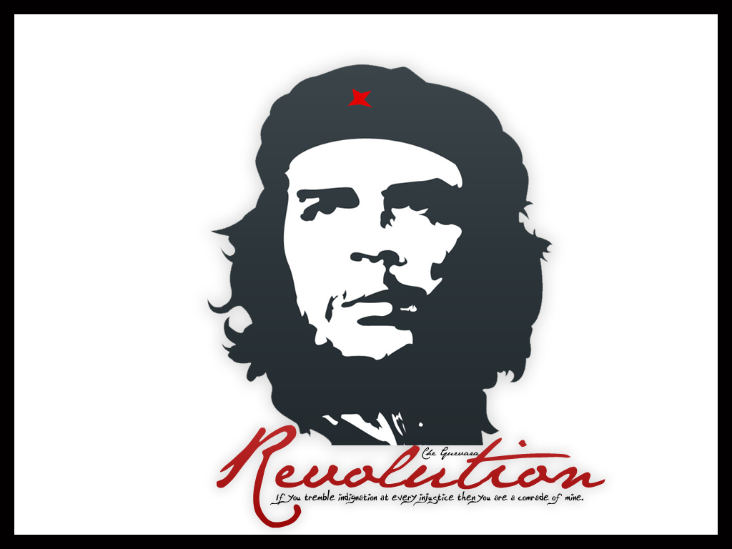
When one puts into consideration the actual behaviour of the Peruvian Indians against the offer of socialism, Mariategui’s opportunism seems vulnerable to the objection that people’s actual behaviour almost always refutes the very prediction.
The prediction about Peruvian Indians has been ultimately proven false. Guerrilla movements operating in rural areas of Peru and Bolivia have persistently failed to advance the socialist cause among the population
Other socialist guerrilla movements have failed in their endeavour to push the socialist agenda among the population. Monteros of Argentina and Tupac Amaru of Uruguay are good examples

Slide 4
The “Indigenous question” was more complex than Mariategui had perceived. The Indians readily neglected concepts of socialism, ideologies held by the very Europeans who had destroyed Indian cultures.
The solution to the “indigenous question” as appears to presuppose a false picture of the relationship between the material conditions of a certain group and their psychology.
Those who are oppressed, it seems, are not always interested revolution, even when they stand to gain by a radical reordering of social and economic relations.

Slide 5
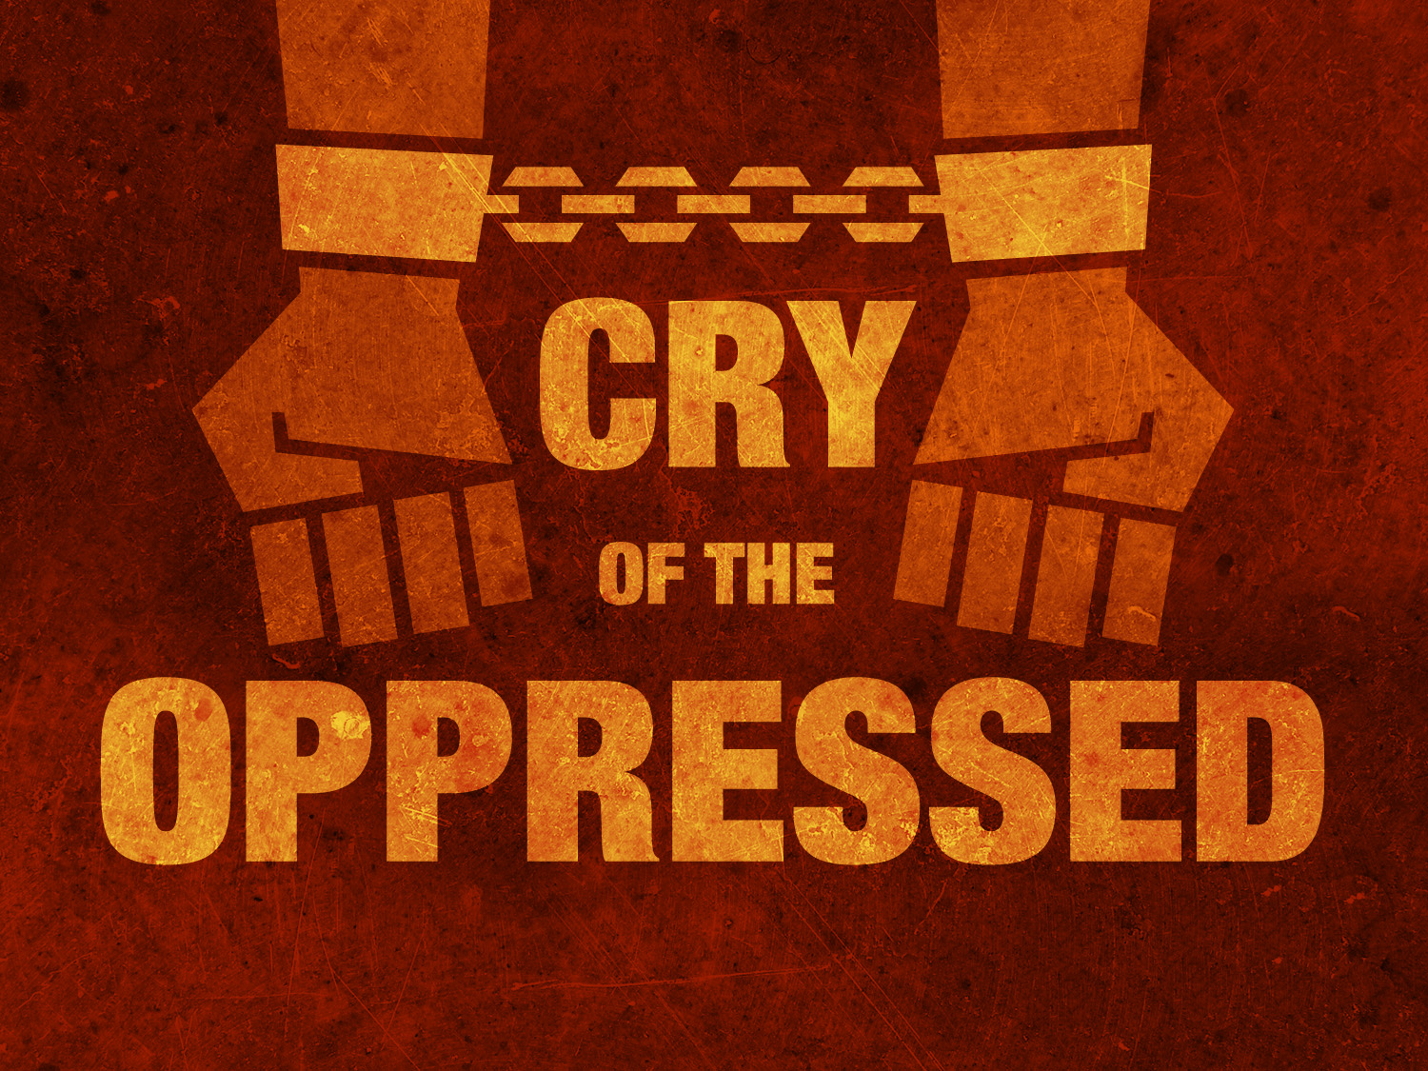
One can scarcely doubt that Mariategui was a Marxist. It is a well-known principle of scientific method that, when a theory has been clearly refuted by the evidence, if its proponents attempt to save it by adding further assumptions so that the theory is thereby made invulnerable to counter examples, then they have at the same time made that theory non-scientific.
If Mariategui were to attempt such a move by restoring to the false consciousness assumption as above, his theory would then have the same status as astrology or palm reading.

