Slide 1
Mental Retardation
The Developmental and Educational Issues Faced by Children with Severe and Profound Mental Retardation
Notes:
TITLE PAGE: MENTAL RETARDATION
The Developmental and Educational Issues Faced by Children with Severe and Profound Mental Retardation

Slide 2
Outline of Presentation
Parental /Professional Interventions
Students with Mental Retardation
Challenges facing Parents
Challenges facing Instructors
Curriculum Planning and IEP
Educational Outcomes for Students with Severe and Profound Mental Retardation
Educational Interventions
Discussion Questions
Notes:
OUTLINE OF PRESENTATION
Parental /Professional Interventions
Students with Mental Retardation
Challenges facing Parents
Challenges facing Instructors
Curriculum Planning and IEP
Educational Outcomes for Students with Severe and Profound Mental Retardation
Educational Interventions
Discussion Questions

Slide 3
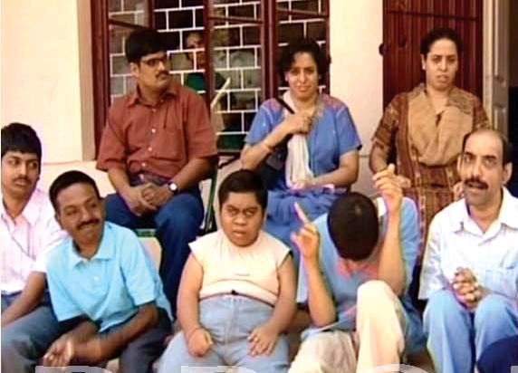
Parental and Professional Interventions
IDEA – Individuals with Disabilities Education Act
Equal Opportunity
Notes:
PARENTAL AND PROFESSIONAL INTERVENTIONS
IDEA Individuals with Disabilities Education Act requires public schools to provide free and appropriate accommodations for children with MR.
Children have access to all community resources and are given the chance to work with similarly-challenged peers in an educational atmosphere.

Slide 4
Students with Severe and Profound Mental Retardation
Mental Retardation/Intellectual Disability (MR/ID)
Originates during the developmental period (contraception to 18 years of age)
Requires a intelligence deficit of two standard deviations below average intelligence quotient (IQ) (i.e. 70-75, in a society where 100 is average)
Severe Retardation: IQ of 20-25 to 35-40 (4-5 SDs below average)
Profound Retardation: IQ of less than 20-25 (which is more than 5 SDs below average)
Notes:
STUDENTS WITH SEVERE AND PROFOUND MENTAL RETARDATION
Mental Retardation/Intellectual Disability (MR/ID)
Originates during the developmental period (contraception to 18 years of age)
Requires a intelligence deficit of two standard deviations below average intelligence quotient (IQ) (i.e. 70-75, in a society where 100 is average)
Severe Retardation: IQ of 20-25 to 35-40 (4-5 SDs below average)
Profound Retardation: IQ of less than 20-25 (which is more than 5 SDs below average)

Slide 5
Challenges Facing Parents
Table
Severe: may learn rudimentary vocabulary, basic self-care skills
Requires extensive, close supervision in a group or family home
Profound: little or no self-care skills; will need constant aid and supervision throughout life
Notes:
CHALLENGES FACING PARENTS:
Severe: may learn rudimentary vocabulary, basic self-care skills
Requires extensive, close supervision in a group or family home
Profound: little or no self-care skills; will need constant aid and supervision throughout life
Children with MR do best living at home. This is very difficult on the parents or other family members however so it is not always an option.

Slide 6
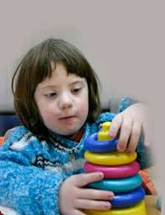
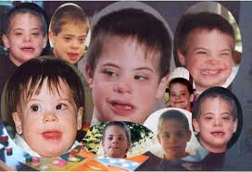
Challenges Facing Instructors
Surrounded by Peers
Taught with patience and kindness
Repetitive Reinforcement of Lessons
Hands-On Training when applicable
Basic Self-Care
Basic skills for any job
Notes:
CHALLENGES FACING INSTRUCTORS
The challenges facing instructors of children with severe-to-profound mental retardation are numerous. Environmentally, it is best for the student to be surrounded by other students of similar intelligence. Instructors must be patient and kind; this is particularly difficult because the challenge of teaching students with severe-to-profound mental retardation is very arduous and often involves exhausting repetition. Additionally, hands-on training is recommended for better retention of lessons.

Slide 7
Curriculum Planning and IEP
Strengths, Interests, Preferences, Accomplishments, Goals
Notes:
CURRICULUM PLANNING AND IEP
The following should be determined to effectively assess and plan the education of a student with severe-to-profound mental retardation:
-Strengths
-Interests
-Preferences
-Accomplishments
-Goals

Slide 8
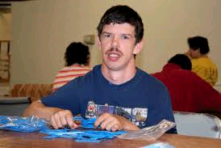
Educational Outcomes for Children with Severe and Profound Mental Retardation
Severe limitations
Life Expectancy
Predilection Toward Behavioral Disorders
10-40% dual diagnosis
Notes:
EDUCATIONAL OUTCOMES FOR CHILDREN WITH SEVERE AND PROFOUND MENTAL RETARDATION
-Severe Limitations
-Life Expectancy: based on the severity of the mental and physical problems
-Predilection Toward Behavioral Disorders: more likely to have explosive outbursts, prone to temper tantrums, physically aggressive – aggression stems from frustration and an inability to communicate and control impulses
-10-40% of students with severe to profound mental retardation have a concurrent medical diagnosis od some mental illness like depression, anxiety

Slide 9
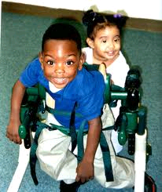
Interventions
Primary Care Doctor
Social Worker
Speech/Occupational/Physical Therapists
Neurologists/Developmental Pediatricians
Various Predictive Tests can be taken during pregnancy
Maternal serum alpha-fetoprotein
Notes:
Primary Care Doctor
Social Worker
Speech/Occupational/Physical Therapists
Neurologists/Developmental Pediatricians
Various Predictive Tests can be taken during pregnancy: blood tests, amniocentesis, chorionic villus sampling used for women at high risk for carrying a baby with Down Syndrome
Maternal serum alpha-fetoprotein – screens for neural tube defects
Most conditions cannot be treated and thus these screenings can only prepare the mother for the birth of a mentally-challenged child or allow the option of abortion to be considered.

Slide 10
Discussion Questions
Best Sites for Parental Help
CEC.SPED.ORG
CommunityInclusion.org
Health.Utah.gov
Notes:
DISCUSSION QUESTIONS:
Best sites for parental help

Slide 11
References
Ratey, John J.. A User’s Guide to the Brain. New York: Pantheon Books. 2001
Steward, Herbert. Mental Illnesses and the Future of Medicine. New York: Pocket Books. 2004

