Slide 1
Persuasive Presentation online Recommendations
The River Oaks management team should be fired. The new management team will maintain the standards of the River Oaks rules and regulations manual.
The River Oaks management team should be fired to protect the majority of employees, to hire qualified workers, and to generate higher production output.

Slide 2
Reasons supporting recommendation
Firing management will protect the majority of employees from management’s negativity and poor management skills.
The management’s negative attributes affect workers in the organization (Akca, 2017).
The decision will protect the employees from being affected within the organization. Usually, the nature of the management determines employees’ productivity (Osborne & Hammoud, 2017). Firing the old management team and bringing in a new management team, will improve the employees performance.

Slide 3
Reasons supporting recommendation
Firing management will result to a more qualified workforce.
1. Hiring qualified workers and firing unqualified friends of management is demanded.
Ethical work conduct should be initiated for all the workers, despite their position or
their friendships (Letendre, 2015). Everyone should adhere to the rules and
regulations. A new management team will be beneficial in forcing ethical and
moral codes of the company, and will contribute to the success of the organization.

Slide 4
Reasons supporting recommendation
Firing management will improve production.
The company will register a high production output by firing an incompetent
management team and creating a new unified management team as per the company’s rules and regulations (Osborne & Hammoud, 2017). It will open ways and paths for the employees to work with management to gain production.
The company should be careful in the procedural vetting of the new management team (Westerman, 2020).

Slide 5
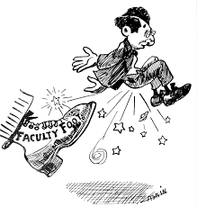
Pictorial representation

