Slide 1
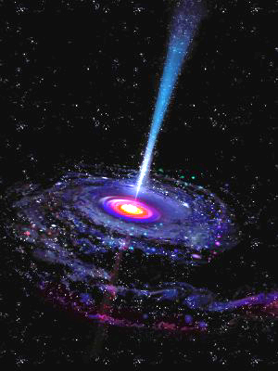
Supermassive black Holes
Customer’s Full name

Slide 2
Black holes
Black holes are extremely compact objects, with ordinary gravity developed to such an extent that it overpowers all other forces in the Universe.
Once inside, nothing can break away from a black hole's gravity, not even a single spot of light.

Slide 3
Black holes’ formation
A massive star runs out of nuclear fuel and is crushed by its own gravitational force
The star can no longer support its own weight. As a result, the core of the star collapses.
If the mass of the core is three or more solar masses, the core collapses into a black hole in a fraction of a second.

Slide 4
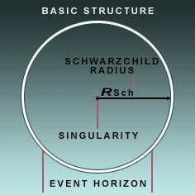
Black hole structure Non-rotating

Slide 5
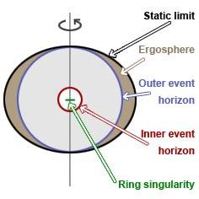
Black hole structure rotating

Slide 6
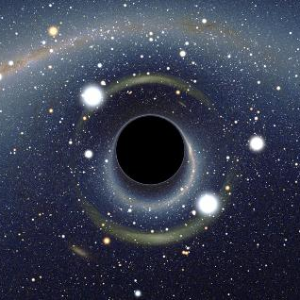
characteristics by which black holes are diversified:
Mass
Spin
Electric Charge

Slide 7
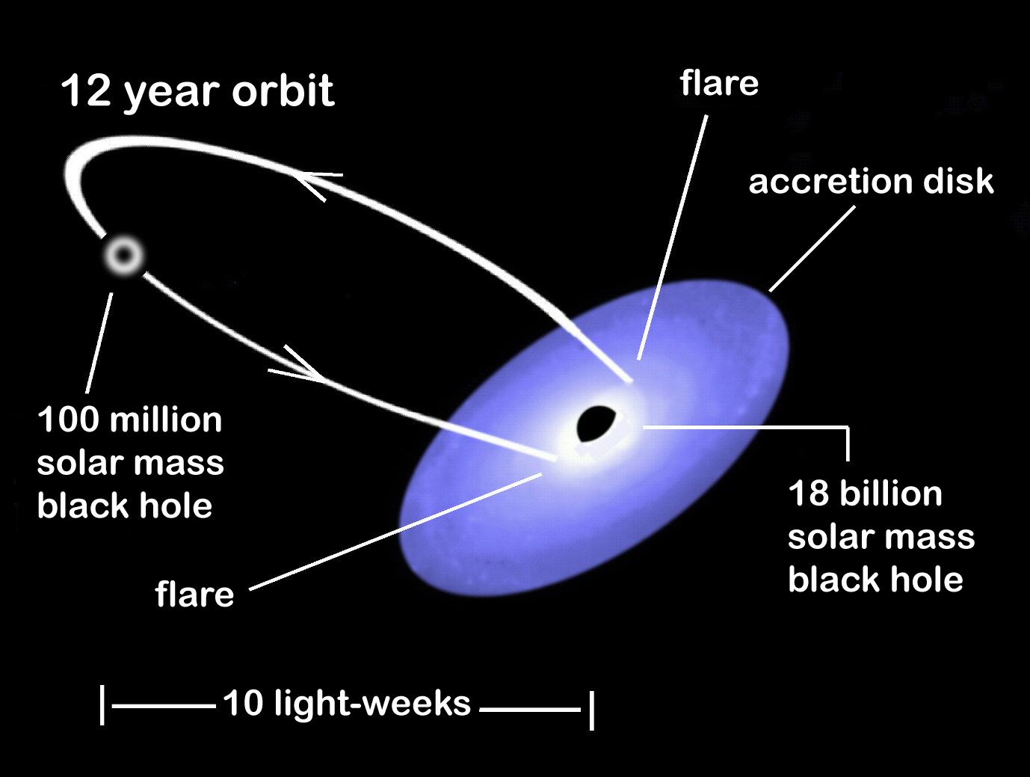
Schematic illustration of OJ 287
Biggest supermassive black hole now discovered: it has a mass of 18 billion solar masses

Slide 8
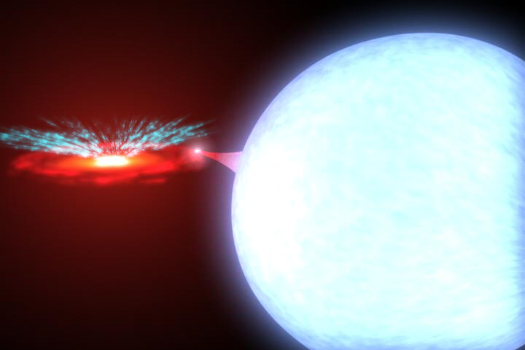
X-Ray Binary System: Locating Black Hole
Black Hole strips gas from a star. As the gas falls toward the black hole, tension between the gas atoms warms up the gas in the vicinity of the event horizon so that its temperature may reach several million degrees. The heated gas gives off X-Rays. That is how a black hole is located. (The World Book Student Discovery Encyclopedia)

Slide 9
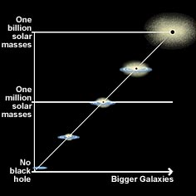
Supermassive black holes are nowadays thought to be positioned in the center of each existing galaxy.
Bigger galaxies normally contain larger black holes.

Slide 10
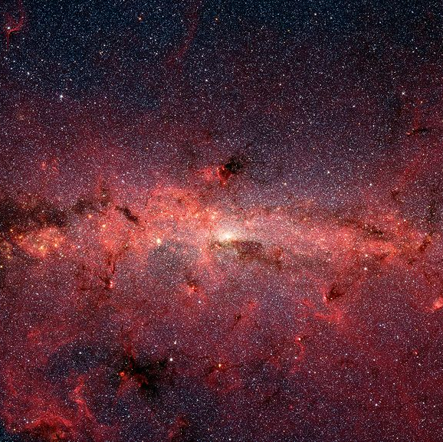
A supermassive black hole exists at the very core of Milky Way:
Positioned 25000 light years away
Has mass of approximately four million suns

Slide 11
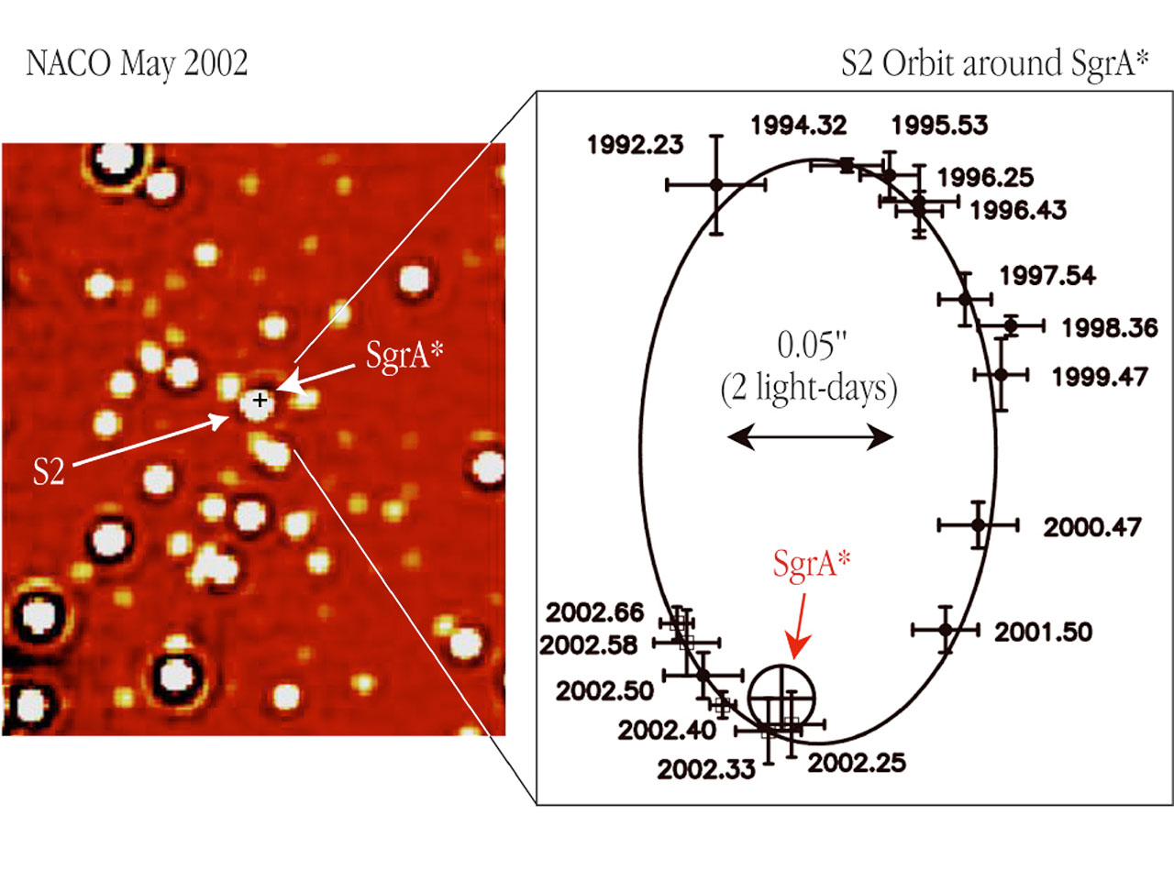
The motion of a star around the central black hole in the milky way
Notes:
“The left panel shows an infrared NACO image of a ~ 2 x 2 arcsec 2 area, centred on the position of the compact radio source "SgrA*" at the centre of the Milky Way Galaxy; it is marked by a small cross. The right panel displays the orbit of S2 as observed between 1992 and 2002, relative to SgrA* (marked with a circle). The positions of S2 at the different epochs are indicated by crosses with the dates (expressed in fractions of the year) shown at each point. The size of the crosses indicates the measurement errors. The solid curve is the best-fitting elliptical orbit - one of the foci is at the position of SgrA* .” (European Southern Observatory)

Slide 12
Works Cited
“Black Hole: Gravity’s Relentless Pull.” HubbleSite. Black Hole Encyclopedia. 29 Apr. 2010. <http://www.hubblesite.org/explore_astronomy/black_holes/encyclopedia.html>.
McClintock, Jeffrey E. "Black hole." World Book Online Reference Center. 2004. 29 Apr. 2010. <http://www.worldbookonline.com/wb/Article?id=ar062594>.
“Supermassive Black Holes.” Chandra X-Ray Observatory. 18 Sept. 2008. 29 Apr. 2010. < http://chandra.harvard.edu/xray_sources/blackholes_sm.html>.
The World Book Student Discovery Encyclopedia. "Black Hole." Chicago: World Book, Inc., 2005.
“18 billions of suns support Einstein.” Calar Alto Observatory. Apr. 2008. 29 Apr. 2010. < http://www.caha.es/18-billions-of-suns-support-einstein.html>.
“The motion of a star around the central black hole in the milky way.” European Southern Observatory. May 2002. 29 Apr. 2010. <http://www.eso.org/public/images/eso0226c/>.

