Slide 1
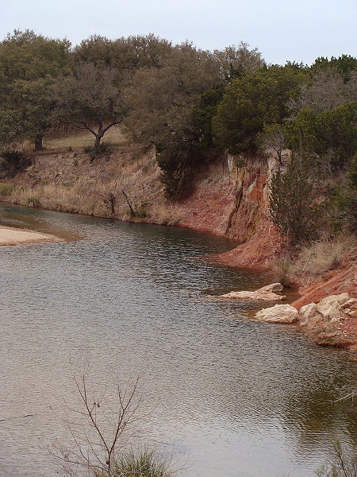
The Edwards Aquifer
An Ecosystem Under Attack
Notes:
The Edwards Aquifer is an aquifer that exists in a delicate balance. That delicate balance is being threatened by human processes such as land development and pollution.

Slide 2
Where and What is the Edwards Aquifer?
The Edwards Aquifer is an artesian aquifer located in south central Texas on the edge of the Chihuahua Desert.
An artesian aquifer is a geologic formation in which water is under sufficient pressure to be discharged to the surface without pumping.
The Edwards Aquifer is part of the larger Edwards-Trinity Aquifer system that runs from southwest Arkansas across into Oklahoma and down into Central Texas.

Slide 3
Map of the Aquifer System

Slide 4
Major Biotic Components of the Edwards Aquifer
There are over 54 species that live within the aquifer system, in the water or in caves. These include plants, fish, amphibians, reptiles, and insects. Some of the most famous residents include:
Texas Blind Salamander, threatened
Fountain Darter, endangered
Robber Baron Cave Spider
San Marcos Gambusia, endangered
Robber Baron Cave Spider
Texas Wild Rice, endangered

Slide 5
Two famous Edwards Aquifer Species
Texas Blind Salamander, (Typhlomolge rathbuni)
Robber Baron Cave spider (Cicurina baronia)

Slide 6
Major Abiotic Components of the Edwards Aquifer
Water! Rain water recharges the aquifer from various recharge zones. Surface water is absorbed through the limestone karst system. This refills the system and keeps the springs and creeks flowing freely.
Limestone bedrock forms the frame of the aquifer. This dissolvable mineral filters surface water and removes impurities, making the aquifer water some of the purist on Earth.

Slide 7
Some Aquifer Images
A Limestone Karst Cave
Here is where surface water flows into the underground aquifer
Flowing Surface Water
Note the fractured limestone creek bottom which allows water to seep back into the aquifer as the water flows over the surface.

Slide 8
The Two Main Human Impacts on the Edwards Aquifer are Contamination and Extraction
Contamination: Run-off from cities is funneled into the aquifer through asphalt covered surfaces instead of permeating through the layers of limestone through the ground.
Extraction: Increasing demand for water from growing cities is resulting in more water being extracted than is replenished.

Slide 9
The Future of the Edwards Aquifer
If the water table drops too low for too long, the water table balance could be upset by an influx of saline water. If this happens, it could mean a serious degradation of the aquifers waters.
If wells dry up, it will mean that many people in rural communities that live off of well water will be without water.

Slide 10
Future Human Impact of the Edwards Aquifer
Development over the aquifer needs to be limited to ensure an adequate sized recharge zone.
Steps will need to be taken to lessen the amount of pollutants that are reaching the aquifer by implementing stricter building codes that allow for more permeable surfaces over the aquifer instead of asphalt.
If proper management is not implemented, it could mean degradation or even destruction of this important water source system.

Slide 11
Living in Harmony With Nature
The Edwards Aquifer provides not only drinking water but also provides for beautiful creeks for the swimming and enjoyment of all. It is important to take steps to ensure that this beautiful system will continue to bring joy to future generations.

Slide 12
References
Eckhardt, Gregg. (2010) The Edwards Aquifer Website. Retrieved May 2, 2010 from http://www.edwardsaquifer.net/
The Edwards Aquifer Authority (2010) Hydrogeology of the Edwards Aquifer Retrieved May 2, 2010 from http://edwardsaquifer.org
The University of Texas at Austin (2010) What is an Aquifer? Retrieved May 2, 2010 from http://www.esi.utexas.edu/outreach/caves/edwardsaquifer.php
Greater Edwards Aquifer Alliance (2010) Pollution Retrieved May 2, 2010 from http://www.aquiferalliance.org/TexasPollution.htm

