Slide 1
The Promotion
Student’s Name
Professor’s Name
Course Code
Date

Slide 2
Structure.
Centralization with Doug Stauber at the top.
Stauber is the second in command with everyone else below him.
Stauber is in charge of all the operations in Donald’s grocery.
Donaldson’s slogan is that the customer always comes first therefore Stauber strives to ensure that.
Notes:
Stauber being the assistant manager is in charge of running the establishment as most of the times the manager is not always present. This leaves him with the obligation to oversee and ensure that all operations run smoothly without any form of interference. He receives all the customer concerns from his office and also from the feedback section found outside the place. He collects feedback from a wide range of customers some of whom are aggressive enough.

Slide 3
Structure Solution.
Decentralization of power is the best solution to solve the issue facing Donald’s grocery.
Management can consider dividing employees into departmental group.
Each department has to have a leader.
Notes:
Coming up with departmental groups will enhance efficiency as all issues concerning the departments are solved instantly rather than requiring the assistant manager to oversee operations. Employees will get accustomed to their department hence raising the possibility of them being more productive. Departmental leaders can then update the assistant manager with observations made and recommendation to improve services in the establishment to promote customer satisfaction.

Slide 4
Path Goal Theory.
This theory specifies a leaders smartness or conduct that are fit for staffs and the working atmosphere.
Stauber applies path goal theory he finds a customer arguing with two of his employees.
Notes:
Generally a leader should have a style of leadership and a conduct that promotes productivity of employees and the environment they work in. Stauber finds a customer and two of the staff members having a heated argument. The customer starts becoming aggressive and Stauber holds his hand and walks with him away from the employees. He does this so as not to disturb the peace at Donaldson’s grocery as the customer had already started shouting which would interrupt other customers in the establishment.

Slide 5
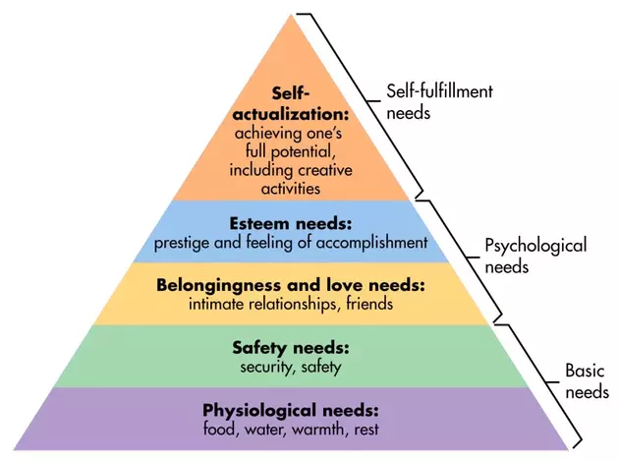
Maslow’s Hierarchy of Needs.
(Mcleod, 1)
Notes:
Stauber’s esteem needs are violated by the staff who do not comply with set working regulations. Donaldson’s grocery ensures that safety needs are catered for by using two fourteen year old guards standing as far away as possible from the establishment. Feedback from the customers also downgrade Stauber’s esteem needs as they are always complaining and never appreciating. Donald’s manager violates Stauber’s belongingness and love needs when he receives a feedback from a customer complaining about three black men using erotic words to refer to her at the parking lot.

Slide 6
Reinforcement Theory.
Reinforcement theory implies that a person behavior receives influence from rewards and punishments they receive.
Though Stauber is an assistant manager he receives intimidation from the manager.
Notes:
The manager gives him a courtesy control jersey to send away the intimidating black boys irritating the customers at the parking lot and later intimidates him together with the board of managers. Stauber is trying to ensure safety for the female customers offended by the boys but the manager claims that they were customers so had the right to hang around the establishment. The manager even forces Stauber to offer a strawberry chew to the boys as a means of apologizing.

Slide 7
Self-Efficacy Theory.
Self-Efficacy theory refers to a person’s set of beliefs that act as a determinant of the best plan of action to take in forthcoming situations.
Stauber applies Self-Efficacy theory as a means of trying to gain advantage over his fellow assistant manager (Entertainment 360, 13.00-15.00).
Notes:
Stauber had the belief that the poster on the refrigeration unit would disadvantage the fellow assistant manager after seeing the board of managers. He had the thought of removing the poster but changed his mind on sighting the managers. The thought was as a result of the other assistant manager taking his Pepsi position in the store. He later receives the reason behind the switch of work which cools him down. Later during an interrogation with the board of managers reports Richard to them about the poster which disadvantages him..

Slide 8
Marketing Concept.
Marketing concept refers to a business establishment prioritizing customer wants and needs rather than their own.
Stauber applies marketing concept when trying to send away the black boys in the parking lot.
Notes:
The boys in the parking lot were sexually offending female customers accessing the store therefore Stauber saw it necessary to send them away so as to increase customer satisfaction when visiting the establishment. However the board of managers have a contrary opinion as they rebuke him for trying to send the boys away claiming that they were also customers therefore deserved a chance to hang out around the establishment. Stauber was only trying to promote customer satisfaction as a marketing strategy.

Slide 9
Works Cited.
Entertainment 360. “The Promotion 2008 Full Movie.” YouTube, uploaded by Entertainment 360, 16 August 2020, https://www.youtube.com/watch?v=kupZFn68xZc/
McLeod, Saul. "Maslow's Hierarchy Of Needs". Simplypsychology.Org, 2020, https://www.simplypsychology.org/maslow.html.

