Slide 1
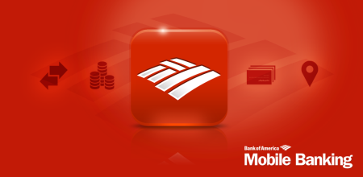
Bank of America Application
Student Name
School Name
Date

Slide 2
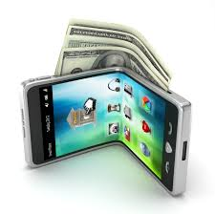
Current Marketing Situation
Bank of America is one of the largest banking institutions in the United States with a market share of over 80%, and over 50 million customers.
They are positioned as the number one mobile and online banking spot.
Launched in 2007 they have gained over 30 million customers in less than six years.
According to Mobile Accelerator Market, Global mobile traffic and penetration will increase significantly in the future with an estimated worth over $3.3 billion by 2018.
Notes:
Bank of America is one of the largest banking institutions in the United States. Found in 1904, over the century they have expanded greatly throughout the world through several acquisitions. By the end of the decade they have become the leader in banking institutions with over 80% of the market share. They have over 50 million customers, and they are leading the mobile banking industry reaching nearly the same amount of customers. Launched in 2007, they have quickly gained users, as the number of users using mobile banking apps, has increased dramatically. The current marketing situation has been to the bank’s advantage, as the Mobile Accelerator Market, has placed that the industry will be worth over $3 billion by 2018. (Markets and Markets, 2012).

Slide 3
SWOT Analysis
Strengths
World’s largest Bank Holding Corporation in the U.S
Weakness
They still don’t have majority on international customers although they are in 150 countries.
Opportunity
Product Development and Market Penetration by Acquisitions
Threats
Second Largest non-oil company in the U.S
The number one in market share
Strong Global Presence and Brand Image
Weak Wholesale Banking Operations
Declining Net Interest Margins
Criticisms from customer with raised interest rates
Expanding globally through joint ventures
Penetrate the Latin Mobile Market
Strong Competition from Chase, Wells Fargo, and Citi Group
Various countries show an increase in political instability
Restrictions in the capital market
Black money issues around the world.
Notes:
The SWOT Analysis of the Bank of America mobile application has drawn up the strengths, weaknesses, opportunities, and threats in the market. The strengths includes that Bank of America is the world’s largest Bank Holding Corporation in the United States based on their assets, and based on their market capitalization are the second largest banking company in the market. Bank of America has considerable size advantage, due in part to being the second largest non-oil holding company in the United States, with their lead position, and growing global presence. Bank of America like many large companies, has a strong brand image and name, which also helps in customer brand recognition, satisfaction, and utilization. The weaknesses however, is although they are in 150 countries, they depend largely on domestic banking. They have weak wholesale banking operations, which has caused it to loose the ability to compete in the international environment. They have recently raised interest rates, and a decline in their net interest margins. Their opportunities however, include the ability to increase their market share by penetrating the domestic and international market through acquisitions, mergers, and joint ventures. By utilizing the mobile app to offer innovative services and products to customers, they can increase their user ship. More importantly be able to branch to the Latino market, and have a foothold on the industry. The threats are that Bank of America faces strong competition from other large financial institutions such as JP Morgan Chase, Wells Fargo, and Citigroup. Bad publicity in the last few years, has also caused a threat to number of users. In other countries that use Bank of America, they is the threat of strong political instability and regulation, which could increase the costs.

Slide 4
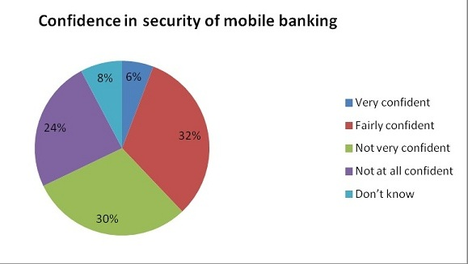
OBJECTIVES AND ISSUES FOR THE APP
Objectives
Issues
As one of the largest banking institution with millions of customer in over 150 customers, the mobile app will access to large array of services easy.
Give customers control and security over their money
Allow for more customers to use banking services
Mobile security is a major issue for all banking and financial applications
Added complexity will discourage users from usage
Bad connection causes lower speed in downloading data, or transactions
Trying to differentiate from other mobile banking apps
Notes:
In order for the mobile app to reach more in the target audience, the objective of the application is to emphasize that Bank of America is one of the largest banking institutions in the United States, and to 150 other countries. They mobile application will provide these users with an array of services that are easily assessable through using the application. The customers are able to have control over their money, through their phone, and allow for the bank to create more innovative services and products. The objective of this marketing plan, is to share with new and old customers the advantages of using the mobile banking app, that will give the customers the control of their own finances in their hand. There are several issues that includes, mobile security, which has become a priority with mobile banking. Other issues includes, the complexity in which discourages users from using the application. Bad connection, and too much data will make the applications slower, and affect the transactions of customers. Lastly is the issue of trying to differientate from other banking applications, that have become prevalent in the market.

Slide 5
MARKETING STRATEGY.
Marketing Tactics
Bank of America services over 50 million customers and their mobile services over 30 million.
Customer Promotion
Utilizing all Digital Channels
Mobile Advertising.
Video Marketing on Website
Direct Mail
Email Marketing
Branch and ATM Marketing
Making it Simple for Customers
Notes:
The marketing strategy for Bank of America mobile application is easy. The company will mainly focus on digital marketing, where they will target their 50 million customers, and additional 30 million mobile customers. The strategy will include customer promotion, in which they will be able to be use additional services not available online. Bank of America will utilize all digital channels which include, online radio, online popular places like Pandora, GrooveShark, Facebook, etc. Mobile Advertising is increasing rapidly, and has grown into a multi-billion dollar industry. Bank of America will utilize these channels, as it will reach younger, and more tech savvy customers. Video marketing is also increasing, as more users are able to see how the application operates. Direct and email marketing will be utilize in helping to reach old and new customers that have used and are using Bank of America services. Marketing in branch and ATM banks, will also reach customers that take advantage of traditional services, looking for a more efficient way to channel the bank’s services. Lastly the most important marketing strategy is to make the application more simple for customers, so that it will be widely accessible to every user.

Slide 6
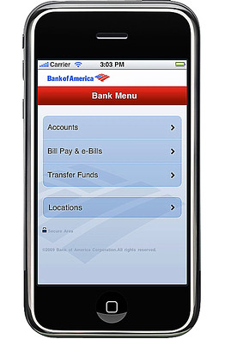
ACTION PLAN
Create a digital flyer to be include in email marketing, as well as print flyer for direct mail marketing.
Create a simple and stylish video on Bank of America landing page.
Mobile Display Ad on Mobile Stores
Digital Video Promotion on social media (Twitter, Facebook, etc.)
Integrate Social Media (Facebook, Twitter, LinkedIn, etc.
Get Users to Promote on Social Media, Blogs, Word of Mouth.
Create digital media for online and mobile advertisements on Google Ads, Mobile Preferred Ads, and Site Links.
Press Releases for Bank of America App.
Notes:
The action plan of the marketing strategy is to create a digital flyer, outlining all of the services, links, and other helpful information to the user through direct mail, and email marketing. This include traditional print advertising that will be displayed on their physical locations, ATMs, and billboards around the banking locations. The action plan includes creating a simple and stylish video that will outline the innovative services of the Bank of America banking application. The video will be displayed on the landing page, as well on other video sharing sites. Their will also be a created mobile display in branches, as well as a digital mobile display in application stores. Digital Video promotion will be used thoroughly on social media sites such as Twitter, Facebook, and other social platforms. The marketing plan includes a integrated social media campaigns that will utilize a variety of sites that will initiate customer interaction and feedback. The users will be able to self promote the application on blogs, social media, and word of mouth. Digital media will also be created to used throughout the intent on Google Ads, Mobile Preferred Ads, and Site links. More traditionally, the bank will send out a press release to share the creation and the availability of the Bank of America application.

Slide 7
BUDGETS and CONTROLS
Controls
Budget
Research of Target Markets
Efficient Advertising
Organizational Controls
Continuous Monitoring of Performance
Marketing Analytics
Bank of America is known spending large amounts on advertising such as 2012 with an upwards of $1 billion in advertising Cost.
The budget will be between $500 million to 800 million.
The budget will focus on mainly Digital Advertising on Mobile and Online Channels.
Marketing Analytics, OmniChannel, and Banking Technology.
Notes:
The budget for Bank of America Marketing plan will be around $500 to 800 million. Bank of America in the past has spent large amounts on advertising, in excess to $1 billion. In 2012, they have spent close to half a billion in order to target customers, in order to revamp their services, after a year of backlash. The budget will focus on several expenses and marketing plans which includes: Digital Advertising on mobile and Online Channels, Marketing Analytics, OminChannel, which is a new marketing concept, that incorporates all channels across the web. More importantly the money will spent on banking technology that will improve the mobile application services for the customer. The controls are used in order to streamline the costs to be used in the way in which it is directed. Also serve as a safety net, in case more funds are needed. These controls includes researching the target markets, efficient advertising, organizational controls, continuous monitoring of the advertising performance in correlation to the number of users, and marketing analytics. These will be used in order to increase the customers, as well as market share in this growing industry.

Slide 8
References
Bank of America. (2014). Bank of America. https://www.bankofamerica.com
Crossman, Penny. (2013). Top 8 Ways Banks Will Spend Their 2014 IT Budgets. American Banker. Retrieved from http://www.americanbanker.com/issues/178_242/top-8-ways-banks-will-spend-their-2014-it-budgets-1064420-1.html?pg=2
Epstein, Zach. (2014). Major security holes found in 90% of top mobile banking apps. BGR. Retrieved from http://bgr.com/2014/01/14/mobile-banking-apps-security-vulnerabilities/
Markets and Markets. (2012). Mobile Accelerator Market: (Web/Content, Network, Application, Device) Global Advancements, Business Models, Technology Roadmap, Forecasts & Analysis (2012 – 2018) . Markets and Markets. Retrieved from http://www.marketsandmarkets.com/Market-Reports/mobile-acceleration-market-830.html
Morris, Patrick. (2013). 3 Things You May Have Missed From the Bank of America Earnings Report. The Motely Fool. Retrieved from http://www.fool.com/investing/general/2013/10/17/3-things-you-may-have-missed-from-the-bank-of-amer.aspx
The Essentials of Mobile App Marketing. (n.d). White Paper. Retrieved from http://www.brandchannel.com/images/papers/531_apppli_wp_mobile_app_marketing_1011.pdf

