Slide 1
Strategic digital marketing and transformation management
FASHION BRANDS
Student’s Name
Institutional Affiliation

Slide 2
Digital vs Cultural Strategies
The two have invested in e-commerce for online influence.
Both have raised their visibility in the search engines through SEO.
Both have increased online engagement with their customers.
Both have websites that are mobile friendly.
Notes:
The two companies have taken three major actions that have seen them lead in digital marketing as well as an online presence. The actions include the increased investment by the companies in e-commerce. Both of them have escalated their influence on their customers online on their elegant sites. Second, the companies have raised their visibility in the search engines. The shift from traditional marketing required the companies to increase their presence online which they did through Search Engine Optimization. Besides, the companies have increased their engagement with their audience on social media. Finally, the two companies have also worked on their mobile propensity. Their sites are mobile friendly therefore their customers can reach them through their mobile devices.

Slide 3
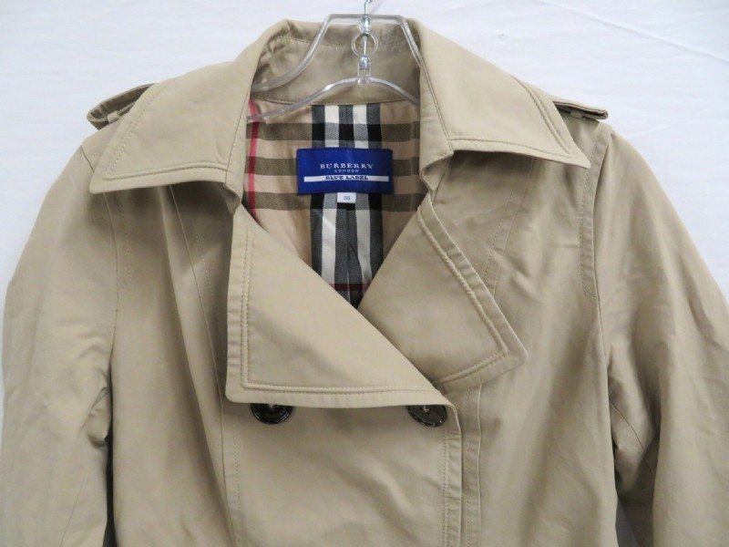

Burberry
Burberry has increased its online presence and sales.
Consumer shopping behavior changed due to online markets.
Burberry shifted their marketing strategy to capture online consumers.
It is currently pioneer in digital marketing.
Notes:
Burberry is a luxury clothing and fashion accessories brand from Britain. The efforts of the company to market its products online has enabled it to increase its online presence and sales. The digital era in the fashion industry has contributed to the shift in consumer behavior and transformed the experience of shopping for clothes. Burberry, mastered the art of digital marketing with vigor thus making it succeed. The company has been using the online platforms to market the strengths of their products and interact with all their consumers including their critics. Therefore, their approaches and strategy of selling online have enabled them to be considered as pioneers in the fashion industry when it comes to online marketing.

Slide 4
Burberry’s in the final digital matrix
It falls under digirati in the final digital matrix.
It has huge website audience.
Their website are consistent and have huge conversion rate.
The company makes sales from their digital marketing efforts.
Notes:
After all the research, Burberry’s will fall in digirati level of the digital matrix. The company’s costumers have confidence in the presence of the company online and on social media. The company have commendable digital skills which make them create impression among the online users. The company is consistent in their online presence. According to Similarweb, the luxury clothing company ranks at position 20,159 globally. In terms of shopping/clothing category, the company ranks at position 294. Besides, it has a broad Website audience that led to 10.18 million visits between January and March 2019. Moreover, the United States, the United Kingdom, Canada, China, and France are amongst the top five countries that visit the website of Burberry. Lastly, organic search marketing is the most preferred channel that the company uses to market its products alongside other channels such as direct marketing, email marketing, referrals, social media marketing, paid search marketing, paid search marketing and display ads marketing.

Slide 5

Major learnings from digital marketing strategy of Burberry’s
Wide coverage of audience.
Easy targeting of audience.
Easy and quick to execute.
Reduced advertising cost.
Notes:
The trends in SimilarWeb show that digital marketing strategy enables companies to cover more audience from all corners of the globe. The only infrastructures that are needed are for the audience to have access to the internet and a computer. Second, it can be learned that the strategy can enable the company to target their audience depending on how they interact with the internet. They can use SEO to achieve this. Also, digital marketing can be easy and quick to execute since there is no long and tedious process of producing the advertisements. From SimilarWeb, we can, therefore, conclude that it is cheap to conduct digital marketing because the company spends less on advertising.

Slide 6
Similarities between Gucci and Burberry
Both brands engage in digital marketing
Reduced advertising costs.
Increased sales from digital marketing.
Both sell cloths immediately from the runway
Notes:
Burberry and Gucci are clothing and fashion accessories manufacturers with consumers all over the globe. Both brands engage in digital marketing where they capture their target consumers through the channels that are available on the internet. Furthermore, engaging in digital marketing has enabled the two clothing companies to reduce the revenues that the companies used to tap in the process of advertising. Besides, Burberry also adopted the trend of selling their clothing immediately after they have been showcased on the runway just like Gucci. Therefore, both clothing companies have been at a position to increase their sales at a reduced cost through online advertising.

Slide 7
Gucci vs Burberry
Gucci
Burberry
It is an Italian brand.
Fast-fashion brand.
It is a British brand.
Exclusively luxury brand.
Notes:
Gucci is an Italian brand that specializes in clothing and accessories that is meant for fast fashion. They make their sales after showcasing their products on the runway. Therefore, makes it easy for their loyal customers to access them. On the other hand, Burberry is a British brand that deals in clothing as well. It is different in the sense that it only deals with exclusive luxury clothing. The company does not sell fast-fashion. Therefore, their products are hard to get.

Slide 8
Gucci’s place in the final matrix
Gucci tops digital marketing rankings.
It surpassed Burberry which dominated the spot.
It has a high customer conversion rate.
It makes 7% of its sales of luxury goods
Notes:
Rankings put Gucci on top of digital rankings above Burberry that used to dominate the position. The company upgraded its e-commerce platforms that increased its visibility on social media. The brand increase in digital prowess is attributed to the conversion rate where consumers decide to purchase their products after interacting with them. Gucci is more visible on the search as compared to other brands. Therefore, their products appear more than others. Besides, it makes 7% of its sales of luxury goods. Thus, their approach puts them in a better place to succeed more.

Slide 9
References
Boscio, C. (2019). BURBERRY VS GUCCI: GOOD THINGS COME TO THOSE WHO WAIT. Eluxe Magazine. Retrieved from https://eluxemagazine.com/fashion/burberry-vs-gucci
https://mail.google.com/mail/u/0/?tab=rm#inbox/FMfcgxwCgVNpQxTtfQHGrWwBdhGNDhhV?projector=1&messagePartId=0.1
https://mail.google.com/mail/u/0/?tab=rm#inbox/FMfcgxwCgVNpQxTtfQHGrWwBdhGNDhhV?projector=1&messagePartId=0.3

