Slide 1
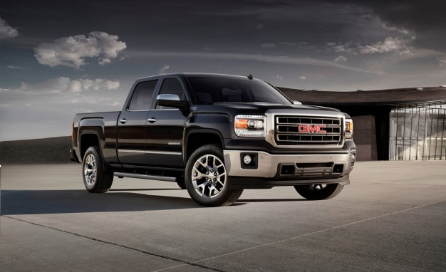
General Motors
The New General Motors (NGMCO)
vs.
The Old General Motors

Slide 2
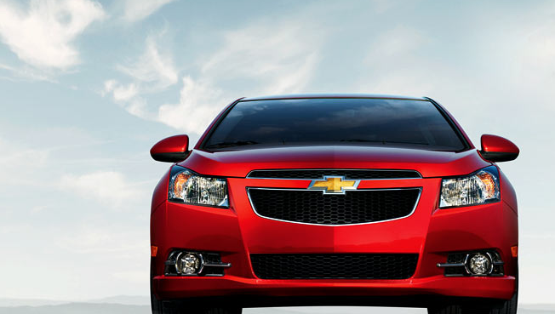
THE DIFFERENCES BETWEEN THE New GM and the Old GM
General Motors had been one of the leading car dealerships in the whole world. However, in 2009, the company filed for bankruptcy.
The company was sold and in the course of the sale, the court, through the federal bankruptcy judge, a sale order was instigated that protected the new company, New General Motors Co. (NMGCO), from the liabilities that had been incurred by the Old General Motors.
This was known as the “Chapter 11 Protection”. This created a huge difference between the old general motors and the new General Motors as the deal saw a considerable change in the organization’s assets and structure.
The New general motors has also considerably reduced the number of dealerships in the United States. This is to reduce the increasing cost of running and maintaining these dealerships. The new GM has reduced them from 5,900 to 5,000.
Notes:
Subsidiary Brands
The new GM had a reduced number of subsidiaries as compared to the old general motors. This was done to reduce the number of risks the company had exposed itself to through acquiring or launching brands that were causing the company billions of dollars.
Dealerships in the United States
The New general motors has also considerably reduced the number of dealerships in the United States. This is to reduce the increasing cost of running and maintaining these dealerships. The new GM has reduced them from 5,900 to 5,000.
Ownership
After the intervention of the government on GM’s bankruptcy, the ownership of the new GM is different from the previous ownership. The New GM has more owners than it had before.

Slide 3
US Dealerships
 | New GM | Old GM
1 | GM Daewoo | GM Daewoo
2 | Chevrolet | Chevrolet
3 | GMC | GMC
4 | Opel | Opel
5 | Buick | Buick
6 | Vauxhall Motors | Vauxhall Motors
7 | Cadillac | Cadillac
8 | Holden | Holden
9 |  | Pontiac
10 |  | Saab
11 |  | Saturn
12 |  | Hummer
Ownership
 | New GM | Old GM
1 | The US Treasury | Bond Holders
2 | Government of Ontario | Common Shareholders
3 | The Canada Development Investment Corporation | Secured Creditors
4 | CAW Union
5 | UAW Union
6 | Old GM bondholders

Slide 4
Works Cited
General Motors. General Motors. 25 April 2014. Internet Source. 1 May 2014. <http://www.gm.com/?seo=goo_|_GM+GM.com_|_AWR-GM+General-Exact_|_General+Motors+- +MSP_|_general%20motor>.

