Slide 1
HIV and Aging
Name
Class
Professor
June 21, 2014

Slide 2
History of HIV
Although the origin of HIV/AIDS is disputed, the first case occurred over 30 years ago
In the 1970s the cause of HIV was unknown but linked to homosexual behavior and drug use
In 1987, the link between HIV and AIDS started being explored with the hypothesis that HIV is the virus that causes AIDS
In the 1990s and the years following, much research was done to determine how HIV is transmitted
Researchers determined that it is passed through fluids, such as blood and semen, thus eradicating the concept that it is purely a homosexual disease
Early HIV research identified that the disease is rapidly evolving and therefore difficult to treat
Today, individuals who live with HIV and develop AIDS live longer due to the effective treatments that are now available

Slide 3
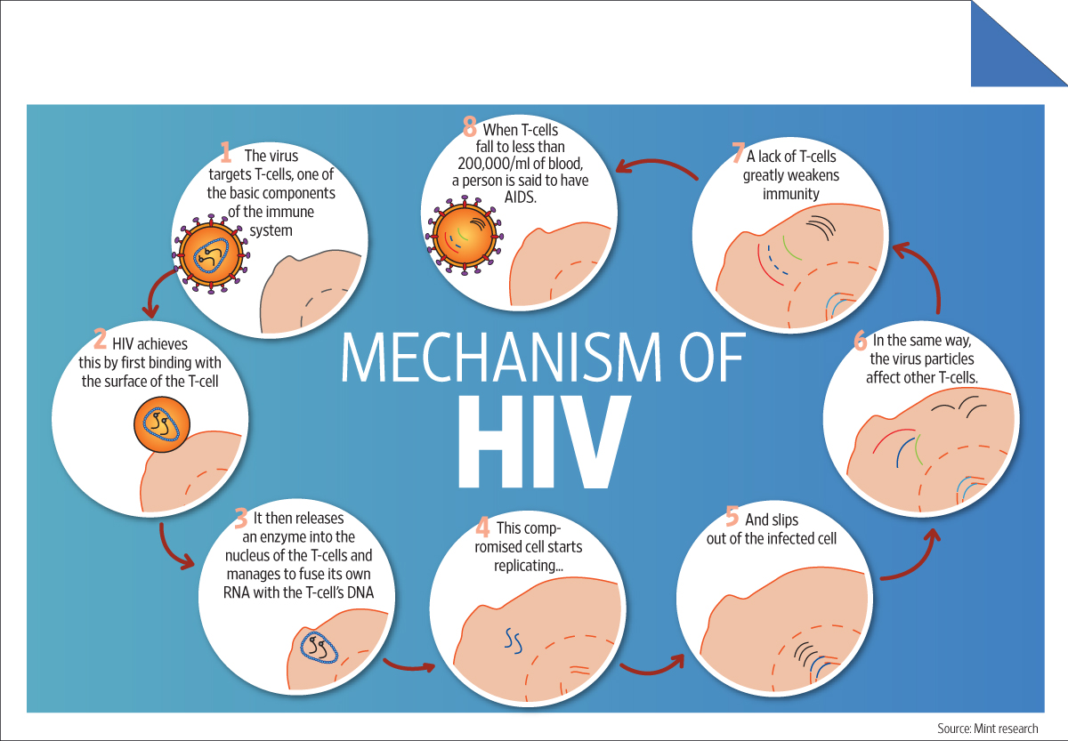
HIV Symptoms and Transmission
HIV symptoms include flu like symptoms 2-4 weeks after infection, however many do not feel symptoms until AIDS develops
Symptoms of AIDS include rapid weight loss, recurring fever, pneumonia, neurologic disorders, increase incidence of infection, and others
HIV is transmitted when an infected individual shares body fluids with an uninfected individual
When HIV enters the blood stream of an uninfected individual, it attacks and destroys T-cell of the victim, which are related to the hosts immune system
AIDS develops when the T-cells are destroyed and the immune system is no longer active

Slide 4
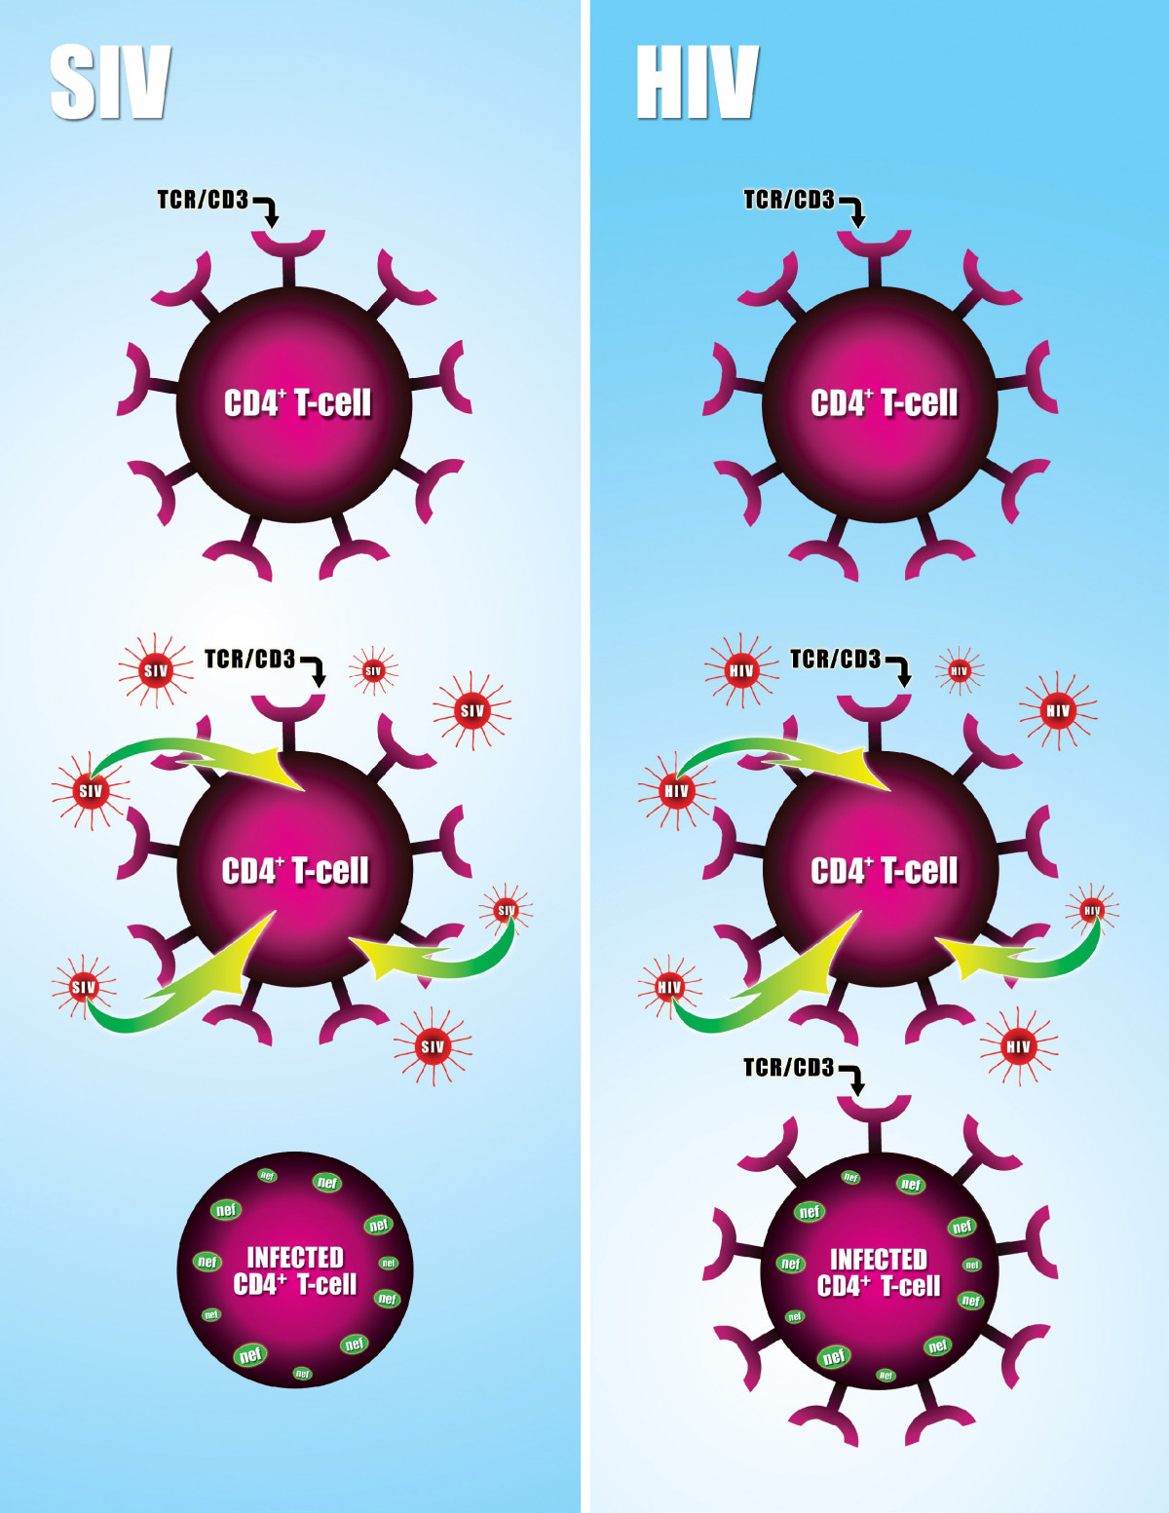
HIV Evolution
The major difficulty in treating HIV is its ability to continually evolve in response to host immune systems and treatment modalities
HIV is believed to have been derived from a chimpanzee version of the virus known as SIV or simian immunodeficiency virus
However, the virus was easily adaptable to humans and has evolved more rapidly in this new host species
The picture on the right demonstrates the main difference between HIV and SIV; SIV downregulates T-cell receptors, so its less likely to infect other cells
HIV does not achieve this downregulation and is therefore more infective

Slide 5
HIV and Response to Treatment
Although HIV treatment has improved, this has driven the evolution of the virus even more significantly
Certain antivirals cause the depletion of specific forms of the virus based on the surface receptors available
This allows the forms of the virus without the drug target to proliferate; when this new virus is transmitted to a second person, the differentiated disease will infect the new individual and continue to evolve as a result of the treatment the individual receives in addition to their genetic predisposition
The human body has many natural defense mechanisms against HIV, but disease infection is essentially a competition between the disease and the body
Since HIV is a smaller molecule with a minimized genome, it could change more readily
Therefore, it can create genes that are specifically designed to bypass host defense mechanisms

Slide 6
References
CDC. (n.d.). HIV/AIDS. Retrieved from http://www.cdc.gov/hiv/
Smith. (2006). Figure 1. Retroviology. Retrieved from http://www.retrovirology.com/content/3/1/60/figure/F1?highres=y
Unnikrishnan CH. (2013). Drug firms shift focus from HIV. Live Mint. Retrieved from http://www.livemint.com/Politics/VzhSr0e60PcIw51n2Jq1lK/Drug- firms-shift-focus-from-HIV.html

