Slide 1
PROLIA
Name
Date
Class
Professor

Slide 2
INTRODUCTION
3 year Study
Postmenopausal Women
Fracture
Notes:
Prolia is an injection medication that is used to treat postmenopausal women who have osteoporosis. Often these women are at high risk of fracture, have a history of osteoporotic fracture, or have been intolerant of other therapy. Prolia has been studied for 3 years. The results show that women were 68 Percent less likely to have a vertebral fracture and 40 percent less likely to have a hip fracture.

Slide 3
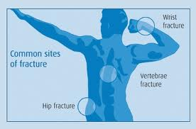
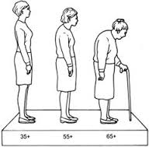
OSTEOPOROSIS
What is it?
Who does it affect?
Symptoms
Notes:
Osteoporosis causes bones to become weak and brittle — so brittle that a fall or even mild stresses like bending over or coughing can cause a fracture. Osteoporosis-related fractures most commonly occur in the hip, wrist or spine. osteoporosis affects men and women of all races. But white and Asian women — especially those who are past menopause — are at highest risk. 1 and 2 women over the age of 50 will have a fracture related to osteoporosis in their lifetime. There typically are no symptoms in the early stages of bone loss. But once bones have been weakened by osteoporosis, you may have signs and symptoms that include: Back pain, caused by a fractured or collapsed vertebra, loss of height over time, a stooped posture
A bone fracture that occurs much more easily than expected. Over time, victims of osteoporosis will take on a stooped position.

Slide 4
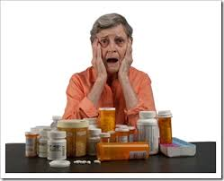
FLEXIBILITY
Injection
1 shot every six months
Limit Pill Burden
Notes:
Prolia is taken once every six months, which can be very convenient for patients. It is a 60 mg injection that is given in the upper arm, upper thigh, or abdomen by a healthcare professional. It also supplements patients with calcium and vitamin D deficiency. Patients will not have worry with taken pills everyday.

Slide 5
FACTS ABOUT PROLIA
Prescription
Affect Stomach
Increase Bone Density
Notes:
Prolia is the first and only prescription drug that treats postmenopausal osteoporosis. It is taken only twice a year. It is not in pill form, so it doesn’t travel through the stomach like other oral medications, which can cause stomach upset and or ulcers over time. Research has proven that Prolia protects the bones from fractures, increases bone density, and make the bones stronger.

Slide 6
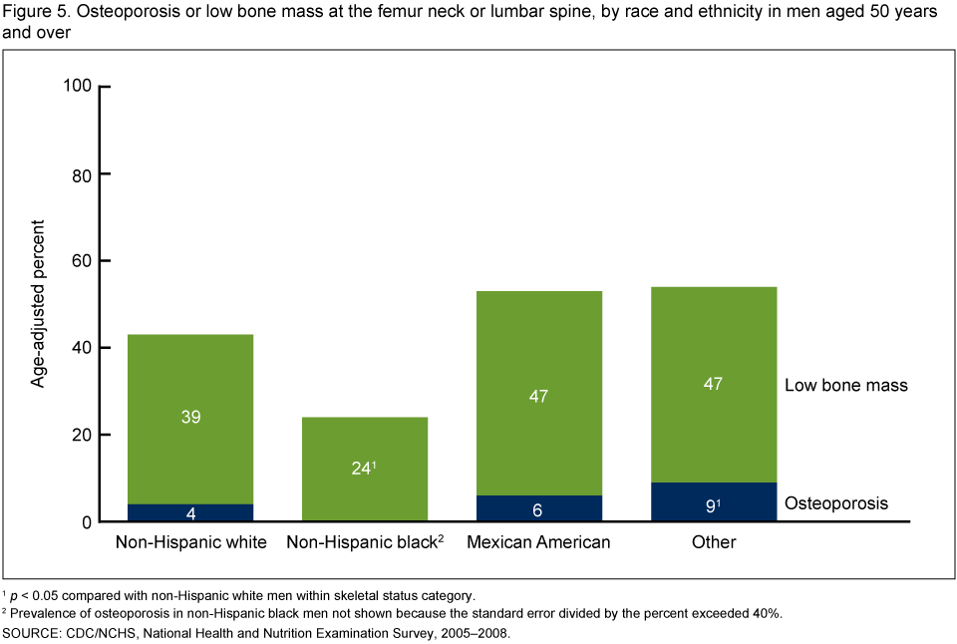
PRAVALENCE
Notes:
Osteoporosis or low bone mass at the femur neck or lumbar spine, by race and ethnicity in men aged 50 years and over.

Slide 7
HOW DOES IT WORK?
Body Cells
Bone Removing Cells
Development of Bone Removing Cells
http://www.prolia.com/postmenopausal-osteoporosis/how-prolia-works.html
Notes:
There are cells in your body that remove old bone, and other cells that rebuild bone. This ongoing process is part of what keeps your bones strong. After menopause, bone removing cells cause you to lose bone at a rate that is too fast. This can leave you with thinner, weaker bones and put you at risk for breaking a bone. Prolia helps stop the development of bone-removing cells before they can reach the bones and cause damage. The link is to the short presentation of how Prolia works. You may have to copy and paste it in a search box to view, if it does not allow you to click on it.

Slide 8
COMPARED TO OTHER FORMS OF TREATMENT
Side Effects
Long Term Effects
Osteonecrosis
Notes:
Side effects include nausea, abdominal pain, difficulty swallowing, and the risk of an inflamed esophagus or esophageal ulcers. These are less likely to occur if the medicine is taken properly. Long-term bisphosphonate therapy has been linked to a rare problem in which the middle of the thighbone cracks and might even break completely. Bisphosphonates also have the potential to affect the jawbone. Osteonecrosis of the jaw is a rare condition mostly occurring after a tooth extraction in which a section of jawbone dies and deteriorates. Estrogen therapy can increase a woman's risk of blood clots, endometrial cancer, breast cancer and possibly heart disease.

Slide 9
COMPARED TO OTHER FORMS OF TREATMENT
Equal Outcomes
Limited Side Effects
Intolerable to Other Therapies
Notes:
Compared with bisphosphonates, Prolia produces similar or better bone density results while targeting a different step in the bone remodeling process. Prolia is delivered via a shot under the skin every six months. The most common side effects are back and muscle pain. If you can't tolerate the more common treatments for osteoporosis — or if they don't work well enough — Prolia may be right for you.

Slide 10
ACCESS TO PROLIA
Medicare
Financial Assistance
Major Insurance
Notes:
100 percent Medicare Part B coverage. 90 percent of Medicare Part D recipients have coverage. Financial assistance is available for patients as well. Patient assistance programs are aimed primarily to households that fall within a certain income bracket, but some programs extend services to people who have higher incomes if they have no health insurance or drug coverage, and are not eligible for either private or public insurance.

Slide 11
STATISTICS
3 year Study
7, 808 participants
Significant Reduction of Fraction Incidence
FDA APPROVAL
Notes:
The FDA approval of Prolia for the treatment of postmenopausal osteoporosis was based on a 3-year, randomized, double-blind, placebo-controlled trial. The trial enrolled 7,808 women aged 60 to 91 years with a baseline BMD T-score between -2.5 and -4.0 at either the lumbar spine or total hip. Women with other diseases or on therapy that affect bone were excluded. The Women were randomized to receive SC injections of either placebo or Prolia 60 mg once every 6 months. All women received at least 1000 mg calcium and 400 IU vitamin D supplementation daily. The primary efficacy endpoint as the incidence of new morphometric (radiologically-diagnosed) vertebral fractures at 3 years. Prolia significantly reduced the incidence of new morphometric vertebral fractures at 1, 2, and 3 years (p < 0.0001). The incidence of new vertebral fractures at year 3 was 7.2% in the placebo-treated women compared to 2.3% for the Prolia-treated women. The incidence of hip fracture was 1.2% for placebo-treated women compared to 0.7% for Prolia-treated women at year 3.

Slide 12
STATISTICS
Notes:
Prolia was studied for 3 years in a pivotal phase 3 fracture trial of 7808 women with postmenopausal osteoporosis, aged 60-91 years, with an average age of 72. Prolia reduced the incidence of new vertebral fracture in patients with or without a baseline vertebral fracture.

Slide 13
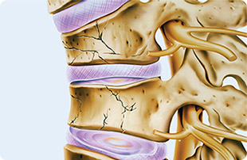
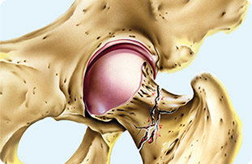
STATISTICS
Notes:
In women, prior osteoporotic fracture increases the relative risk of a subsequent hip fracture by 77%. Only 24% of women using Prolia suffered an osteoporotic fracture that required treatment during the following year.

Slide 14
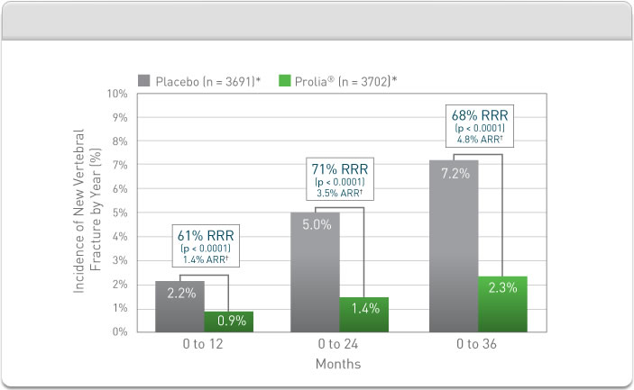
STATISTICS
Notes:
Prolia significantly increased BMD vs placebo at lumbar spine (8.8%), total hip (6.4%), and femoral neck (5.2%), at 3 years. Prolia increased bone mass and strength in both cortical and trabecular bone. Prolia patient bone biopsies showed normal bone architecture and quality.^{1,‡}

Slide 15
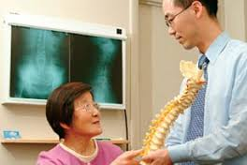
WHY SHOULD I RECOMMEND PROLIA TO MY PATIENTS?
FDA Approval
Clinical Study
Statistics
Accessibility
Other Therapies Have Failed
Notes:
Prolia is the only FDA approved drug to treat postmenopausal osteoporosis. An extensive clinical study was conducted over a three year period of time on more than seven thousand women. The results of the study showed that the women who were taking Prolia significantly reduced their chances of osteoporosis related fractures. Prolia is convenient because it is only administered twice a year through injection. Prolia is effective for some people who have tried other forms of therapy to no avail. Prolia is also covered by 90 percent of all major insurances, and for those who do not have insurance, prescription assistance may be available.

