Slide 1
Qualitative Research Proposal: Workplace Bullying Experiences
Student’s Name
Institution

Slide 2

BACKGROUND
Workplace bullying experiences have become common in the job sector (Vie, 2012).
Mental Health Counselors have been seen to experience workplace bullying.
However, this is not a well studied or explored area.
Notes:
Workplace bullying is a pervasive issue that has been gaining momentum over the years. According to studies, almost half of the United States workers are affected by this problem. For mental health counselors, their nature of work exposes them to bullying from different parties. In this case, bullying can target the mental and emotional aspect of the individual. People tend to focus on the patients being attended to by the health counsellors and forget about the mental health counselors themselves. This is the main reason why the sector remains neglected.

Slide 3
DEFINITION OF TERMS
Lived experiences: Understanding and defining experiences of a research participant.
Phenomenological studies: Research approach that focuses on commonality of lived experiences.
Mental health counseling: Medical approach to help individuals achieve emotional wellness.
Notes:
For life experiences, some of the considerations of the research participant include the experiences, choices, as well as options. The impact of these factors on the individual’s perception of knowledge are also considered. The commonality of these life experiences can be studied qualitatively using phenomenological research.

Slide 4
RESEARCH PURPOSE AND SIGNIFICANCE
Purpose statement: The purpose of this phenomenological study is to understand the life experiences of mental health counselors who have experienced bullying within a community mental health work environment (who live in Northern Kentucky with 5 years or more experience).
Studies Significance: The importance of this study is to reduce and to prevent the case of workplace bullies for mental health counselors.
Notes:
By understanding the life experiences of mental health counselors who are victims of bullying, it will be possible to identify their perception of the issue as well as their awareness of the problem. This will help in the prevention of the incidents and hence improved quality of work as well as delivery (Watkins, 2012).

Slide 5
RESEARCH QUESTION(S) AND SUB-QUESTION(S)
Research question: What are the life experiences of mental health counselors who experience bullying with the community mental health work environment (who live in Northern Kentucky with 5 years of more experience)?
Sub-questions:−Has bullying led to low job satisfaction and mental health disorders?−Is bullying among mental health workers a neglected area?
Notes:
Low job satisfaction is perceived to be one of the impacts of bullying, not only among mental health counselors but also in other professions. In addition to this, bullying may also affect the psychological aspect of the victim hence leading to mental health disorders.

Slide 6
AFFECTIVE EVENTS THEORY
Affective Events Theory (AET) assumes that job satisfaction and emotions about job events are not equal (Glaso et al., 2011).
Features of the work environment, i.e. job roles, directly influence attitudes about the job.
These influences can occur through a cognitive or affective route (Glaso et al., 2011).
Overall job satisfaction comes from a person’s affective state or mood.
While effects include employee moods and varied emotions, workplace attitude is a cognitive judgment that is based on the employee’s overall effect (Carlson et al., 2011).
AET explains the connection between positive & negative work environments and how they affect formed from the experiences is connected to overall workplace satisfaction.
AET posits that work specific evaluations such as job satisfaction & commitment to organizations have affective antecedents (Tillman et al., 2018).

Slide 7
Affective
Events
Theory
Workplace Bullying
Effect on Employees’ Moods and Emotions
Feelings of Job Dissatisfaction
Counselors who are subjected to workplace bullying have emotional responses to that bullying. Those emotional responses can influence behavior while performing that job. Counselors emotional responses to workplace bullying can increase counselor burnout, low job satisfaction, low job productivity, and to an increase in the likelihood that the counselor will leave the job placement, but not necessarily the field of counseling.

Slide 8
Affect
Events
Theory
Counselors understand how workplace bullying impacts the mental health of other workers.
Counselors use self evaluation to become more aware of their own moods and emotions in their own workplace settings.
Counselors become able to describe their own attitudes about their lived experiences in workplace bullying atmospheres.

Slide 9
RESEARCHER’S ROLE
The site chosen for this study is a community mental health setting in the Northern Kentucky area due to the availability of both rural and urban influences and the diverse nature of the counselors working in the area.
The researchers conducting this study are graduate students working on either a Master’s Degree in Clinical Mental Health Counselor and/or a Master’s Degree in Addiction Counseling.

Slide 10
RESEARCHER’S ROLE / BIAS
What is the researcher’s connection to the study?
  One of the researchers (Sara) connects to this study from her own personal experiences and witnessing of bullying, including workplace gossiping among co-workers in the past.
  Researcher bias (for Patti) includes previous victimization of workplace bullying. Researcher has been a victim of workplace bullying in two separate work environments in the past 15 years.
  Researcher (Megan) has minimal experience with being a target of workplace bullying but has experienced being a bystander to bullying, both supervisory and by coworkers.

Slide 11
RESEARCHER’S ROLE / BIAS CONT…
Researcher (Gayle) has never been a target of bullying. However, researcher includes experience working in a toxic environment where there was much disagreement among employees and an undercurrent of toxicity due to negative dialogue, exclusion of employees with regard to sharing pertinent workplace procedures, and rapid turnover of employees.

Slide 12
RESEARCHER’S ROLE / BIAS
What biases or preconceptions does the researcher maintain about the proposed study?
  Sara’s biases may include having more compassion and empathy towards victims of bullying in the work environment and associating negative feelings towards perpetrators of this phenomenon.
  Patti has the potential to hold bias in favor of the victims in the qualitative study. In addition, Patti’s workplace bullying experience is based in abusive supervision, so Patti has a bias that is not in favor of the perpetrators of workplace bullying if those perpetrators are in supervisory positions.
  Megan’s bias involves personal experience of feeling unsafe in a toxic work environment. Megan may feel more compassion towards victims of toxic work environments.
  Gayle’s bias involves having witnessed personnel exclusion in the workplace due to workplace bullying and may hold bias in favor of victims of bullying.

Slide 13
METHOD - POPULATION AND SAMPLE
Results can be generalized for mental health counselors in community mental health settings in Northern Kentucky
Selection and delimiting criteria
  Mental Health Counselors who have experienced workplace bullying
  Licensed 5 or more years
  Working in community mental health agencies
  Northern Kentucky

Slide 14

METHOD - POPULATION AND SAMPLE
Sample size- 6 to 10 participants or until saturation (Creswell & Creswell, 2018)
Purposeful sampling was used to select those that have experience with the phenomena (Groenewald, 2004)
  Snowball sampling was used to enlist additional participants
Information gathered on sample participants:
  General demographics
  License credential information
  Work setting, location, role

Slide 15
METHOD - DATA COLLECTION
Data was collected by two semi-structured one on one interviews and memos of researcher insight and experience (Creswell & Creswell, 2018; Groenewald, 2014).
Two broad open-ended interview questions were developed to elicit participants experience with bullying. Probing questions were used to gain a deeper understanding of the participant’s experience (“Phenomenology Research,” n.d.)
Questions were based on the Affective Events Theory and validated using a delphi study (Habibi, Sarafrazi & Izadyar, 2014).

Slide 16

METHOD - DATA COLLECTION
Process-
  Internet search to identify community mental health agencies in North Kentucky
  Email & letter sent to gatekeepers. Letters of approval obtained
  Obtained contact information for possible participants
  An invitation sent via email
  Interviews scheduled,

Slide 17
PROCESS OF DATA COLLECTION CONT.
  Interview process- introduction, purpose, confidentiality, risks/benefits, consent.
  In-depth semi-structured approach focused on understanding participant’s experience
  Follow-up interview- shorter, gain more information on presenting themes, check understanding
  List of local mental health professionals was provided for referral to participants that would like assistance in coping with their experience.
  Thank you email and amazon gift card amounting $40 included
  Completed findings of study shared with participants

Slide 18
METHOD - DATA RECORDING
Researchers will record answers to the questions asked during the semi-structured interview and follow-up interview using handwritten notes and audiotaping for accuracy.
The researchers will then transcribe by hand the information from the interviews in addition to any field notes that accompanied the interviews.

Slide 19
METHOD - DATA PROTECTION AND CONFIDENTIALITY
The data will be protected using encryption software and only researchers who have IRB approval will have access to data.
Access to data information will be regularly reviewed and all emails will be encrypted.
Passwords to access data will be changed frequently
Physically secure devices and paper documents
Securely dispose of data, devices, and paper records
Manage devices (Kirilova & Karcher, 2017)

Slide 20
METHODS- DATA ANALYSIS
Data analysis will be performed by the researchers and will occur simultaneously while other parts of the study are being conducted such as data collection and the write-up of findings. In the attempt to aggregate data into a small number of themes (between 5 and 7) information will be winnowed. In addition, using qualitative analysis software programs, such as NVivo or Atlas.ti, the data collection will be analyzed.
Transcribe interviews – Obtaining a general sense of what has been said in the interviews, checking for credibility and tone of the responses, and reading field notes.

Slide 21
METHODS- DATA ANALYSIS
Coding – Organize the data by bracketing text into categories and labeling with terms used. Coding falls into three categories which are expected codes (topics researchers would expect to find), surprising codes (which are findings that could not be anticipated before the study began), and codes of unusual or of conceptual interest (which are unusual ideas).
The codes/themes will be arranged in a flow of ideas in the findings section. Finally, in the phenomenological study a narrative will be written for each theme in the findings section or for a general summary. It may also go into the discussion section of the study.

Slide 22
INTERPRETATION AND OUTCOME
Interpretation involves summarizing the overall findings.
Comparing the findings to the literature and whether it confirms past research or diverges from it.
The findings may also raise new questions that emerged during the study.
Stating limitations may indicate weaknesses or problems with the study that the author acknowledges so that future studies will not suffer the same problems.
Directions for future research to advance findings.

Slide 23
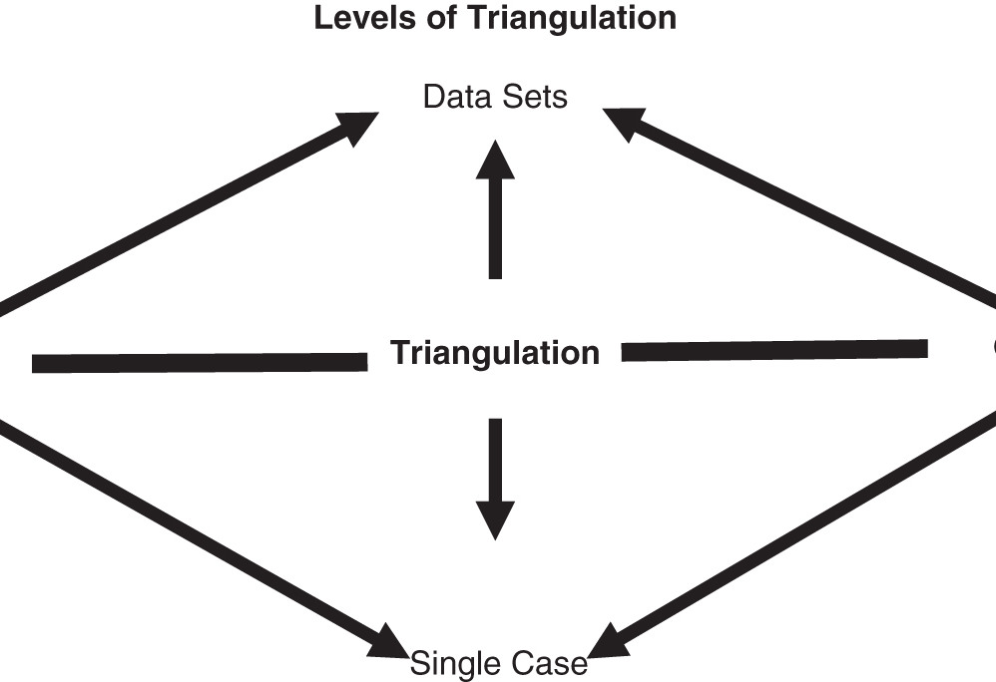
STRATEGIES FOR VALIDATING FINDINGS
  Triangulation Strategy: Use various perspectives (i.e, multiple moderators, varied locations, several different individuals analyze the same data).
  Ex. We will conduct semi-structured interviews and gather informal observations from the site studied to find common themes from the data in both.

Slide 24

VALIDATING FINDINGS (CONT.)
Respondent Validation: Test initial results with participants to see if still true.
  Despite research having been interpreted and narrowed in focus, they should still recognize findings (i.e., our observations, their personal experience) as authentic. May also refine the researcher’s understanding.
Thick description: Describe situation with rich detail so readers develop their own conclusions of findings.
  Ex. Observations of the site described in more detail and experiences from participants have more descriptive examples.

Slide 25

VALIDATING FINDINGS (CONT.)
Analysis of contradictory findings: Actively look for inconsistencies, or discrepant voices in data. Continually revise assertions throughout all findings.
  Ex. Researcher looks for discrepancy among observations collected and interview responses to refine explanations.
Follow-up studies: To eliminate alternate explanations for findings and reduce other interpretations from the results.
  Ex. Researcher conducts at least one follow-up interview to discredit possibility of other explanations (i.e., ask questions in inverse format).

Slide 26
ANTICIPATED ETHICAL CONSIDERATIONS
Specific standards that may be jeopardized for this study include:
Obtaining local permission from the site being studied and its participants;
Preventing from pressuring participants into signing consent forms;
This ethical issue can be minimized by:
Identifying and obtaining local approval, finding gatekeepers/significant personnel to gain permission for the study.
Letting participants know that they are not obligated to sign the forms.

Slide 27
ETHICAL CONSIDERATIONS (CONT.)
Respecting anonymity and privacy rights of the participants;
Avoiding taking sides/ supporting participant’s side of the story;
Not revealing actual names; use initials or fictitious names and composite profiles of participants
Including in data multiple and different perspectives of participants.

Slide 28
ETHICAL CONSIDERATIONS (CONT.)
Avoiding the reporting of any false information of findings and conclusions;
Refraining from disclosing any information that could potentially harm the participant;
Reporting findings and conclusions honestly with accurate information
Using composite stories to maintain anonymity

Slide 29
ETHICAL CONSIDERATIONS (CONT.)
Communicating with clear and appropriate language;
Refraining from plagiarism;
Avoiding duplication of material or piecemealing publications
Using unbiased, straightforward language when presenting the study
Referring to APA (2014) guidelines on permissions required to adapt/reproduce another’s work
Avoiding using the same material for more than one publication

Slide 30
REFERENCES
American Counseling Association (ACA). (2014). ACA code of ethics. American Counseling Association. Retrieved from https://www.counseling.org/docs/default-source/default-document-library/2014-code-of-ethics-finaladdress.pdf?sfvrsn=96b532c_2
Anjum, A., Ming, X., Siddiqi, A., & Rasool, S. (2018). An Empirical Study Analyzing Job
Productivity in Toxic Workplace Environments. International Journal of Environmental Research and Public Health, 15(5), 1035.
https://doi.org/10.3390/ijerph15051035
Creswell, J. W., & Creswell, J. D. (2018). Research design: qualitative, quantitative, and mixed
methods approaches. Los Angeles, CA: SAGE Publications.
Dellasega, C., Volpe, R. L., Edmonson, C., & Hopkins, M. (2014). An exploration of relational aggression in the nursing workplace. Journal of Nursing Administration, 44(4), 212–218.
https://doi.org/10.1097/NNA.0000000000000052
Fahie, D., & Devine, D. (2014). The Impact of Workplace Bullying on Primary School Teachers and Principals. Scandinavian Journal of Educational Research, 58(2), 235–252. Retrieved from https://search.ebscohost.com/login.aspx?direct=true&AuthType=shib&db=eric&AN=EJ1027607&site=ehost-live
Gardner, D., O'Driscoll, M., Cooper-Thomas, H. D., Roche, M., Bentley, T., Catley, B., … Trenberth, L. (2016). Predictors of workplace bullying and cyber-bullying in New Zealand. International Journal of Environmental Research and Public Health, 13(5), 448. https://doi.org/10.3390/ijerph13050448
Giorgi, G., Perminienė, M., Montani, F., Fiz-Perez, J., Mucci, N., & Arcangeli, G. (2016).
Detrimental effects of workplace bullying: Impediment of self-management
competence via psychological distress. Frontiers in Psychology, 7.
https://doi.org/10.3389/fpsyg.2016.00060

Slide 31
REFERENCES
Glambek, M., Skogstad, A., & Einarsen, S. (2018). Workplace bullying, the development of job insecurity and the role of laissez-faire leadership: A two- wave moderated mediation study. Work & Stress: An International Journal of Work, Health & Organisations, 32(3), 297-312. doi: 10.1080/02678373.2018.1427815
Grand Canyon University, Center for Innovation in Research and Teaching. (n.d.) Retrieved from https://cirt.gcu.edu/research/developmentresources/research_ready/phenomenology/phen_overview
Groenewald, T. (2004). A Phenomenological Research Design Illustrated. International Journal of Qualitative Methods, 42–55. https://doi.org/10.1177/160940690400300104
Habibi, A., Sarafrazi, A., & Izadyar, S. (2014). Delphi technique theoretical framework in qualitative research. The International Journal of Engineering and Science, 3(4), 8-13.
Kirilova, D. & Karcher, S., (2017). Rethinking data sharing and human participant protection in
social science research: Applications from the qualitative realm. Data Science Journal, 16,
p.43. https://doi.org/10.5334/dsj-2017-043
Leedy, P. D., & Ormrod, J. E. (2016). Practical research: planning and design. Boston: Pearson.
Pickering, C. E. Z. ., Nurenberg, K., & Schiamberg, L. (2017). Recognizing and responding
to the “toxic” work environment: Worker safety, patient safety, and abuse/neglect in
nursing homes. Qualitative Health Research, 27(12), 1870–1881.
https://doi.org/10.1177/1049732317723889
Thompson, I., Amatea, E., & Thompson, E. (2014). Personal and contextual predictors of mental health counselors compassion fatigue and burnout. Journal of Mental Health Counseling, 36(1), 58–77. https://doi.org/10.17744/mehc.36.1.p61m73373m4617r3
Vie, T. L., Glasø, L., & EINARSEN, S. (2012). How does it feel? Workplace bullying, emotions and musculoskeletal complaints. Scandinavian Journal of Psychology, 53(2), 165-173.
Watkins, D. C., Hunt, J. B., & Eisenberg, D. (2012). Increased demand for mental health services on college campuses: Perspectives from administrators. Qualitative Social Work, 11(3), 319-337.

