Slide 1
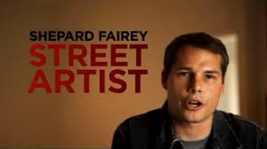
SHEPARD FAIREY
Name
Date
Class
Professor

Slide 2
INTRODUCTION
Humble Beginning
Defiant
Skateboarder
South Carolina
Rhode Island School of Design
Notes:
Shepard Fairley had a very humble beginning, growing up in Charleston, South Carolina, many deemed him a trouble maker and deviant. Shepard Fairey has been creating art on the street for 20 years. As a youngster, he was an avid skateboarder and was inspired by the various graffiti he saw in the city. Shepard Fairey has developed into one of the most influential street artists of our time. Despite breaking many of the spoken and unspoken rules of contemporary art and culture, his work is now seen in museums and galleries, as well as the worlds of graphic design and signature apparel. He received a BA from the Rhode Island School of Design in 1991. He has had recent solo exhibitions at Merry Karnowsky Gallery, Los Angeles (2007); Jonathan Levine Gallery, New York (2007); Stolen Space, London (2007); and Galerie Magda Danysz, Paris (2006). His work is in the collection of the Victoria and Albert Museum, London; the Los Angeles County Museum of Art; the Museum of Contemporary Art, San Diego; and the National Portrait Gallery, Washington, DC. Fairey is also the founder of Studio Number One, a graphic design company. He currently lives and works in Los Angeles, California

Slide 3
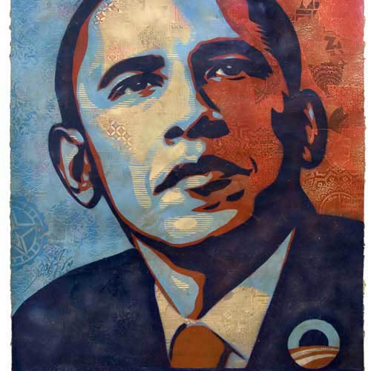
MOST INFAMOUS
2008 Presidential Election
Who does it affect?
Support
Notes:
Shepard Fairey is famous for designing the 2008 iconic poster of Barrack Obama which was a portrait labelled hope. This painting of mixed-media stenciled collage, was created by Los Angeles-based street artist Shepard Fairey. It was the central portrait image used in Obama's 2008 presidential election campaign. It is now in the National Portrait Gallery in Washington DC. Fairey is a member of a group called Artists for Positive Social Change. This picture became the most popular picture of Obama during his plight for presidency. This picture has a great effect on everyone who saw it. Many scholars said it had more of an effect on people as the infamous Uncle Sam Wants You poster during war time. In February 2008, Fairey received a letter of thanks from Obama for his contribution to the campaign. The letter stated:
I would like to thank you for using your talent in support of my campaign. The political messages involved in your work have encouraged Americans to believe they can change the status-quo. Your images have a profound effect on people, whether seen in a gallery or on a stop sign. I am privileged to be a part of your artwork and proud to have your support. I wish you continued success and creativity.– Barack Obama, February 22, 2008^{[37]}

Slide 4
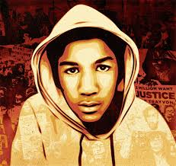
WHY STREET ART?
Notes:
“To me the idea of street art, screen printing, and stencil-making—the methods I use—is all about showing you can connect with people through very basic methods,” Fairey says. “You don’t have to paint like Michelangelo to connect with people. It’s more about your spirit and your tenacity than your technical ability.” Fairey deeply believes that art challenges people to think about a “different perspective and about what’s possible, giving them hope and optimism promoting action—which he hopes his art does.” Fairey picture of Travon Martin also had a great effect on society due to the controversial issues surrounding his death. “I became active as a street artist because I felt public space was the only option for free speech and expression without bureaucracy… I also found the whole idea that you could be arrested for stickering or postering as something I wanted to rebel against”.

Slide 5
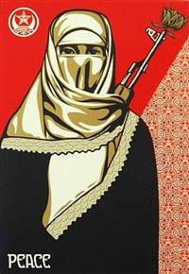
CONTROVERSIAL ISSUES
Notes:
More than half of women aged 15-49 believe that a husband has the right to hit his wife in certain instances, so violence against women occurs at markets, on the streets, and while using transportation. This is another controversial issue that caught the attention of the American public. Obviously, from this picture, one can conclude that Fairey supports equal rights for women.

Slide 6
SHEPARD FAIREY TODAY
Clothing line
Criticism
Money
Life Long Job
Notes:
One of the reasons Fairey says he started his clothing line was because he went into an Urban Outfitters and they were bootlegging his star logo on T-shirts. “To see it in there, just ripped off, was definitely upsetting to me, because I was still totally broke at the time”. Fairey has been criticized for using images from social movements of people of color, but he remains adamant that he uses his art to support people who are struggling with issues, regardless to race or color. Fairey says he's spend the money and take the risks he does because he wants to and he doesn’t feel that anyone owes him anything; however, he does feel sorry for himself when he’s sitting in jail, but overall he feels it is all very worth it. Fairey says he will continue to do street art although he does dabble in traditional art.

