Slide 1
Surcharge Load on the walls
Student’s Name
Instructor’s Name
Course
Date Presented

Slide 2
Explainations
Walls that have retained soil that have been drained can be designed in a way it can retain the force it gets exerted by fluids
Vertical components and horizontal forces need to be known and measured for accurate design analysis and construction
There are mandatory specification of the necessary fluid pressures that is needed to retain a wall which supports soil, fluid pressure and other forces being exerted on.

Slide 3
Assumptions & Specifications
Assumptions on the earth pressure should be measured and compared with that of standard fluid pressure.
Earth pressure should not be exceeded by the standard fluid pressure that would be given as a basis for measuring
Earth’s remaining structure is dependent on the lateral deformations that occur on soil.
The Pressure exerted on earth is the basic foundation of structure to be maintained.

Slide 4
The vertical component specifications are not permitted when filter fabric are used behind retaining walls
The depth of the retained earth shall be the vertical distance below the ground surface measure at the wall face for stem design or measured at the heel of the footing for overturning and sliding.
A surcharge shall be considered when loading is superimposed except for the retained earth. A provision in designing such loadings are to be considered in the wall design.

Slide 5
Example Design of retaining wall (6 ft< H_{retaining} ≤ 8 ft)
Where backfill is less or equal to 8 feet in height but greater than 6 feet, an active pressure that is vertically distributed is proposed and designed
The design should be based on an additional seismic lateral pressure and triangular loading
A retaining wall design shall be compared with a wall having seismic and active pressures and all must have equal height.

Slide 6
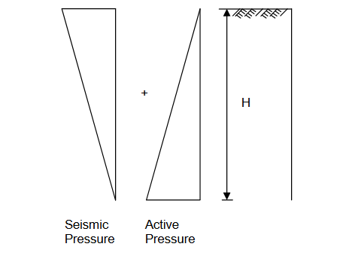
A Table of Equivalent Fluid Weights for Active and At-Rest Pressure may be used to find the relevant comparisons.

Slide 7
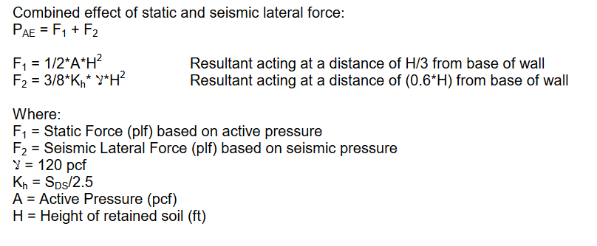
.

Slide 8
Practical Example
Given the following calculate the combined effect of seismic and static lateral forces:
H= 8 ft Sds= 7.5 A= 40 pcf
γ= 120 pcf θ= 30̊

Slide 9
Practical Example Conti…
Thus,
Kh= 7.5/2.5= 3
F1= ½*40*8² F2= 3/8*3*120*8²
= 1280 N/ft = 8640 N/ft
Pae= 9920N/ft or 9.92 kN/ft which is the combined effect of seismic and static lateral force

